Slide 1
A Whistlestop Tour of PSC, IBD and Microbiome Research
Dr Sarah Al-Shakhshir MBChB MRCP
Hepatology Clinical Research Fellow
PSC Support Information Day
19th Oct 2024

Slide 2
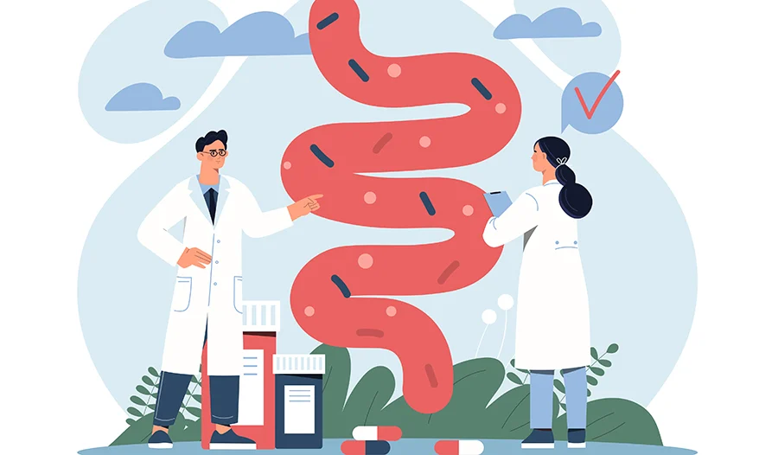
Contents
What is the gut microbiome?
How does the gut microbiome affect PSC?
How the gut microbiome is being used as a treatment target in PSC?
  Current research in this area

Slide 3
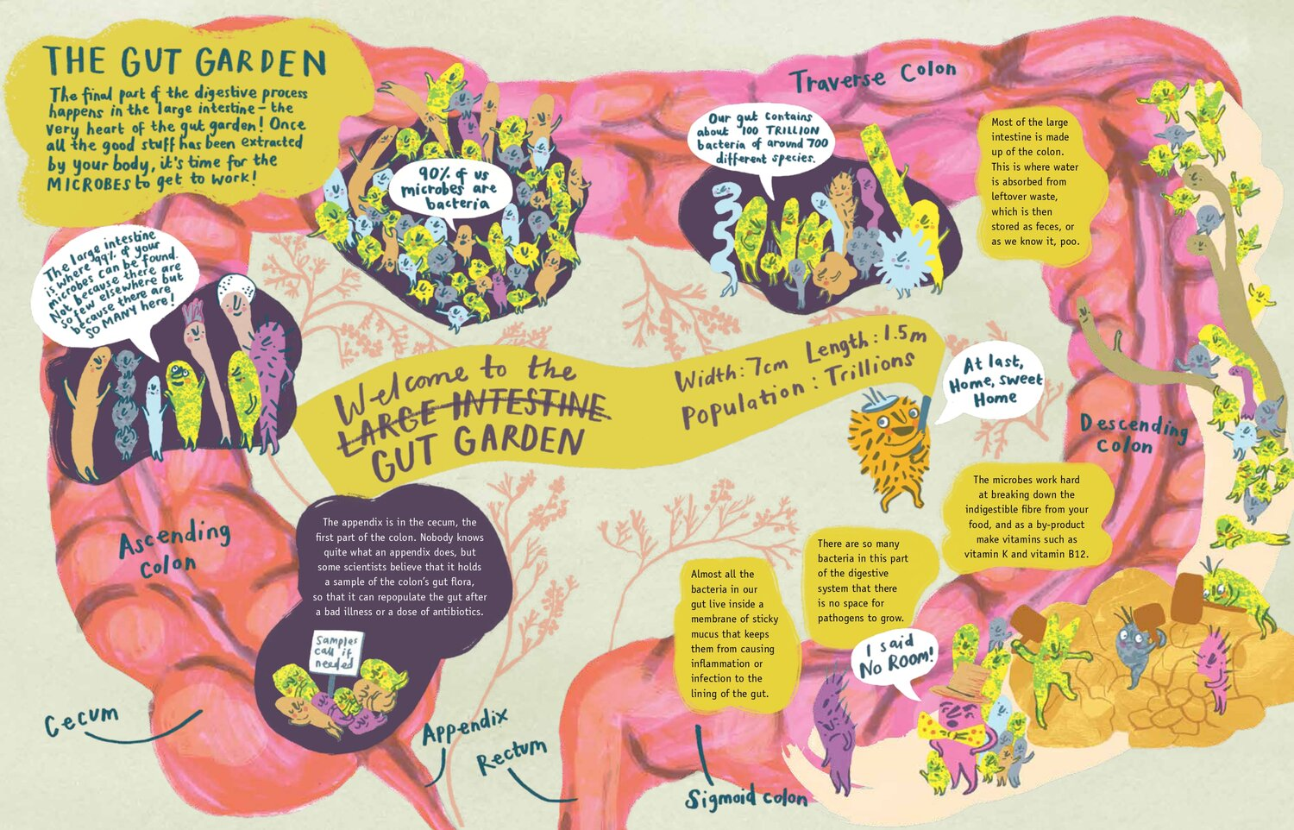
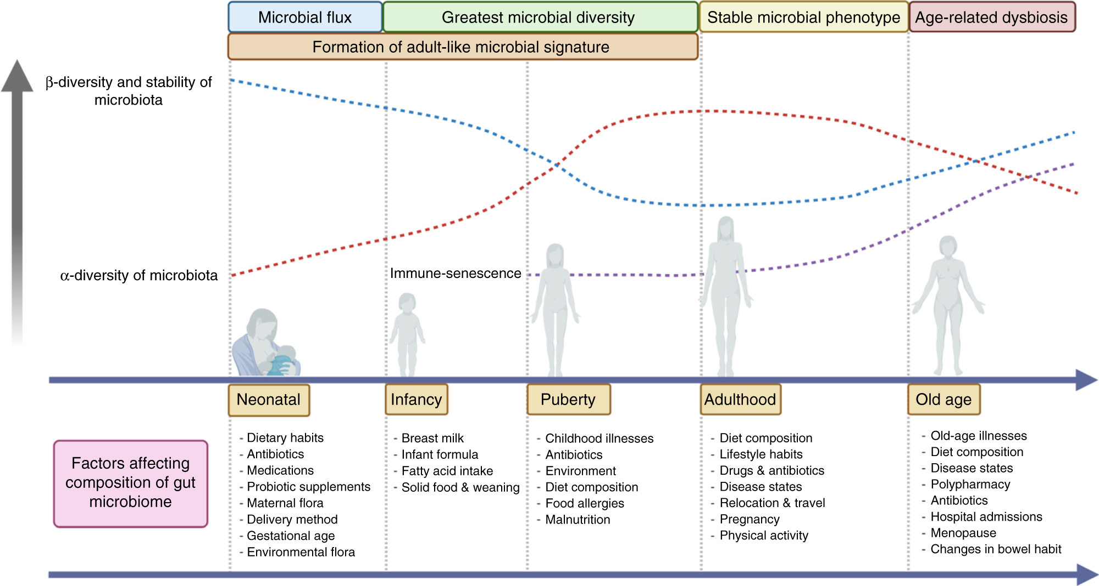
The Gut Microbiome
Community of organisms (bacteria, fungi, and viruses) that live in the digestive system.
Balanced microbiome is essential in health, imbalance implicated in disease.
Problems:
  Constantly evolving = difficult to study
  ‘Ideal’ microbiome?
(How unique or similar the microbiome is in different individuals)
(Richness)
De Vos et al. Gut. 2022
Lee et al. Br J Cancer. 2021
Katie Brosnan. Gut Garden – A journey into the wonderful world of your microbiome. 2019
Notes:
Here’s a simple way to think about it: Imagine your gut is like a garden, and the microbes are all the different plants, bugs, and creatures living in that garden. Some of these organisms help break down food, produce vitamins, and keep the bad bugs (the harmful bacteria) under control, like how plants and insects in a garden help it thrive. Others, if not kept in check, can cause problems, like weeds in the garden.
A balanced gut microbiome helps with digestion, strengthens the immune system, and even affects your mood and brain function. But if the balance is off—like if there are too many "bad" bacteria or not enough "good" ones—it can lead to issues

Slide 4
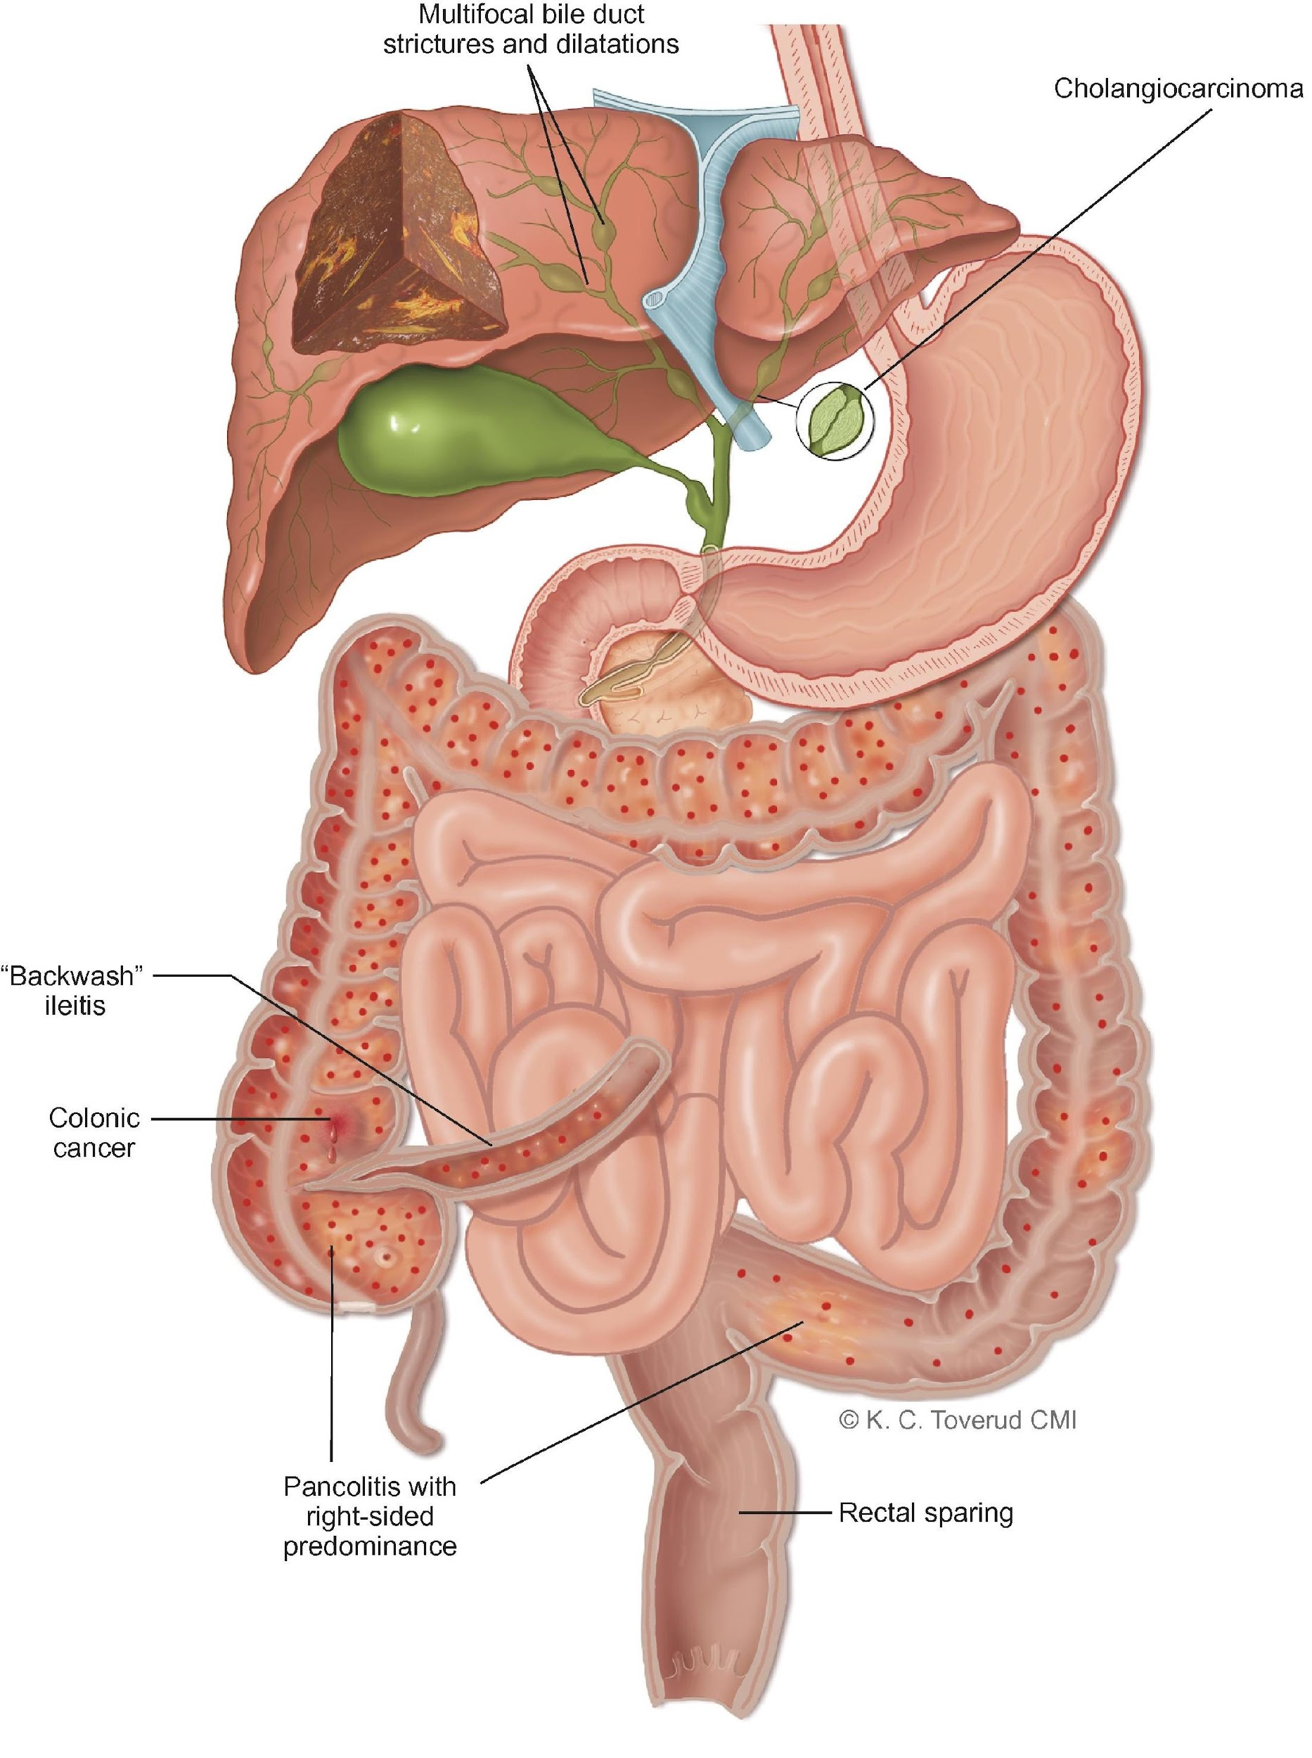
PSC and IBD
Narrowing bile ducts
Progressive
Unclear cause
Complications:
Cholangitis
Liver cirrhosis
Cancer
Liver transplant
60-80% IBD diagnosis
‘Chicken and egg’
Higher risk bowel cancer
Treatment: medical or surgical

Slide 5
PSC and The Gut Microbiome
Reduced variety of microbes in PSC gut
Reduced ‘good’ bacteria
Increased ‘bad’ bacteria
PSC Microbiome
Li et al. World J Gastroenterol. 2022
Quraishi et al. J Crohns Colitis. 2020
Trivedi et al. Gut. 2018
Kummen et al. Gastroenterology. 2021

Slide 6
PSC and The Gut Microbiome
Leaky Gut
Reduced ‘good’ bacteria
Reduced production of SCFAs
Compromised gut lining
Endotoxins cross through the gut lining and transported to the liver
Inflammation!
PSC Microbiome
Immune response
Bile acid metabolism
*Endotoxins: toxic substances (bad stuff) in the membrane of certain bacteria.
*SCFAs (short chain fatty acids) – produced when good bacteria break down fibre in food. Help maintain gut lining among other jobs.
Li et al. World J Gastroenterol. 2022
Quraishi et al. J Crohns Colitis. 2020
Trivedi et al. Gut. 2018
Kummen et al. Gastroenterology. 2021

Slide 7
PSC and The Gut Microbiome
Leaky Gut
PSC Microbiome
Immune response
Bile acid metabolism
Li et al. World J Gastroenterol. 2022
Quraishi et al. J Crohns Colitis. 2020
Trivedi et al. Gut. 2018
Kummen et al. Gastroenterology. 2021

Slide 8
PSC and The Gut Microbiome
Leaky Gut
Increased ‘bad’ bacteria
Generates fuel for specific proteins which are more abundant in PSC
Draws pro-inflammatory immune cells from the gut into the liver
Inflammation!
PSC Microbiome
Immune response
Bile acid metabolism
Li et al. World J Gastroenterol. 2022
Quraishi et al. J Crohns Colitis. 2020
Trivedi et al. Gut. 2018
Kummen et al. Gastroenterology. 2021

Slide 9
PSC and The Gut Microbiome
Leaky Gut
Increased ‘bad’ bacteria
Increased bile acid processing
Build-up of secondary bile acids
Inflammation!
PSC Microbiome
Immune response
Bile acid metabolism
Li et al. World J Gastroenterol. 2022
Quraishi et al. J Crohns Colitis. 2020
Trivedi et al. Gut. 2018
Kummen et al. Gastroenterology. 2021

Slide 10

PSC and The Gut Microbiome
Leaky Gut
Reduce inflammation
Improve PSC outcomes
PSC Microbiome
Immune response
Bile acid metabolism
Microbiome Manipulation

Slide 11

How?
Giving FMT ‘healthy poo’
Removing endotoxins
CATCh Trial
An open-label trial of CARBALIVE for the Treatment of Cholestatic Liver Disease
A randomised, phase IIa, multi-centre, placebo-controlled trial of FAecal microbiota transplantation in primaRy sclerosinG cholangitis
Actively recruiting!
Coming soon!

Slide 12
The FARGO Trial
Question: how does changing the PSC microbiome using Faecal Microbiota Transplants (FMT = processed poo from healthy donors) affect PSC?
  Single FMT treatment:
    ↓ ALP levels by ≥50% in 3/9 patients
    Microbiome diversity ↑ in all patients
  In mild-moderate IBD → 40% improved symptoms after 8 weeks
Allegretti et al. American Journal of Gastroenterology. 2019
Anderson et al. Aliment Pharmacol Ther. 2012
Notes:
Can we replicate these results?
How long does this effect last for?
How does this affect the inflammatory pathways we discussed earlier?

Slide 13
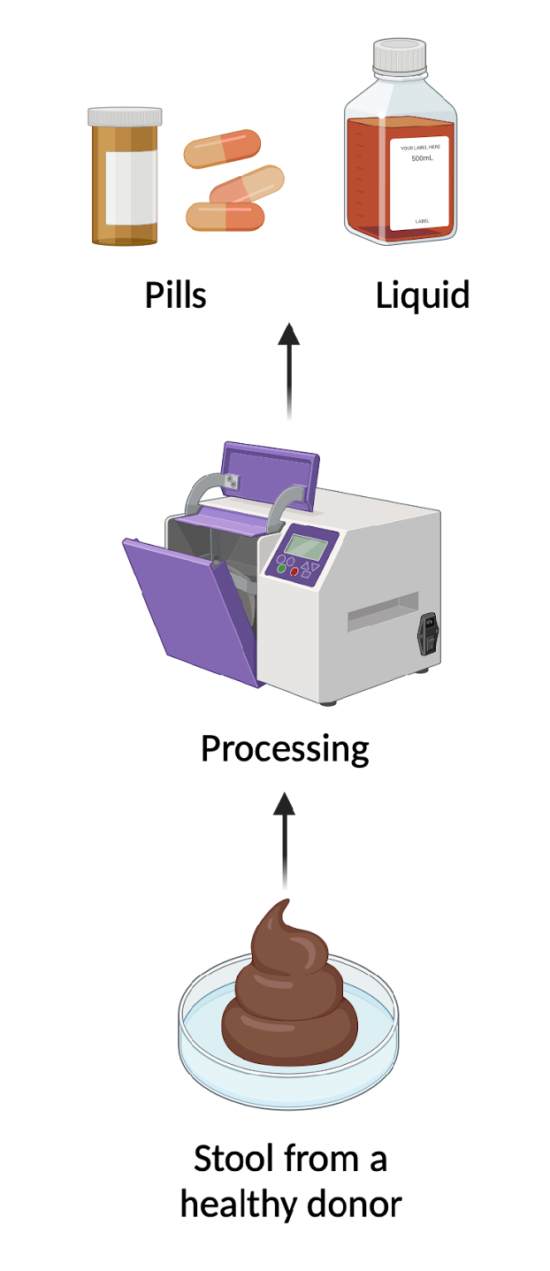
The FARGO Trial
UoB Microbiome Treatment Centre
Target: 58 patients
  Early PSC and
  Well controlled IBD
6 recruitment centres
FMT
PSC + IBD
Eligible
Placebo
Notes:
Recruitment centres:
QEHB
KCL
Royal Free, London
St Marks’ London
Joh Radcliffe Hospital
Norfolk and Norwich University Hospital
PIC sites:
QMC, Nottingham
St James’ Hospital, Leeds

Slide 14
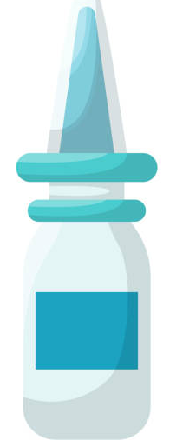
The FARGO Trial
Treatment 1 Colonoscopy
Weekly FMT/Placebo Enema
Week 12 Flexible sigmoidoscopy
Week 48 Colonoscopy
Treatment 2
Treatment 3
Treatment 4
Treatment 5
Treatment 6
Treatment 7
Treatment 8
Week 24 – Follow-up
Week 36 – Follow-up

Slide 15
What are we looking at?
Safety Data
Adverse events as per CTCAE v5.0
Adverse events of special interest e.g. cholangitis, colitis flare, decompensated liver disease.
Standard blood tests (FBC, LFTs, U&Es, INR)
Child-Turcotte-Pugh Score
MELD Score
Vibration controlled transient elastography (VCTE)
Enhanced Liver Fibrosis Score (ELF)
UK-PSC Score
Amsterdam-Oxford PSC score
Prognostic Scoring and Surrogate Biomarkers of Liver Fibrosis
Faecal calprotectin
Partial Mayo score
Endoscopic scores (Mayo Score/SES-CD Score)
IBD Activity Stratification
Patient Reported Outcomes
PSC-PRO questionnaire
SF-36 questionnaire
5D-itch
SIBDQ questionnaire
Translational (Research) Samples
Gut biopsies
Peripheral blood
Urine samples
Stool samples

Slide 16
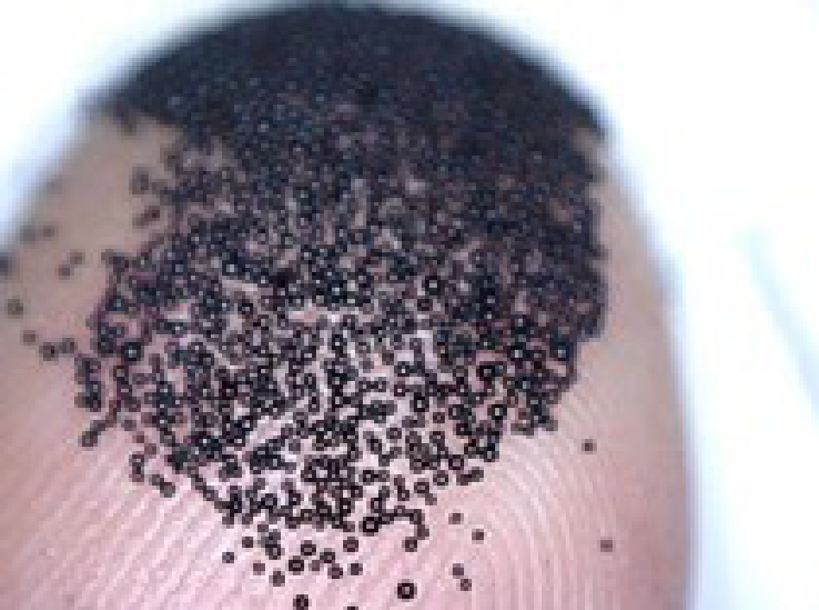

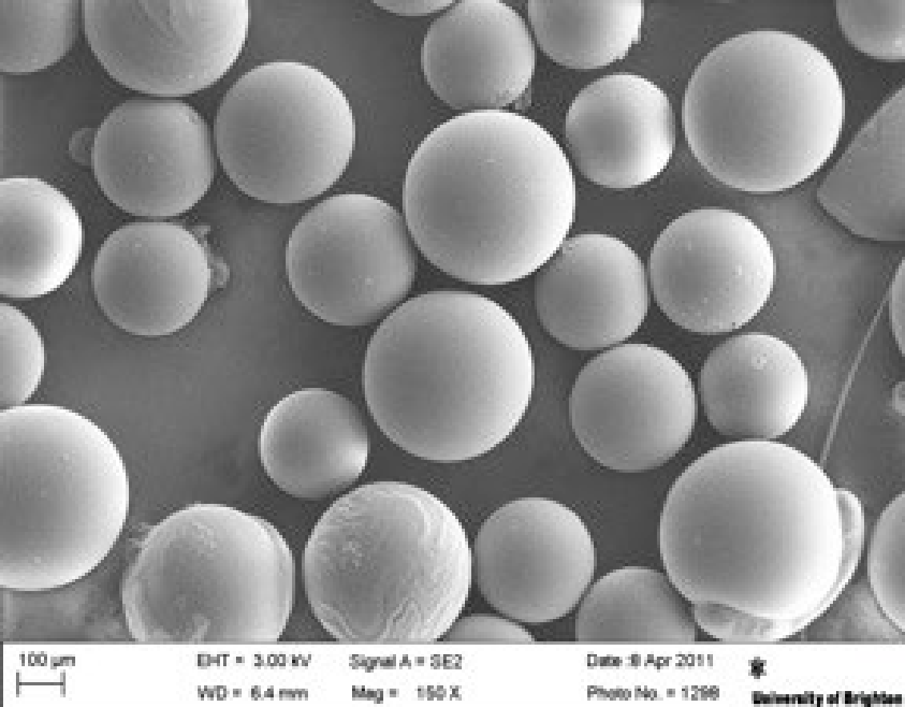
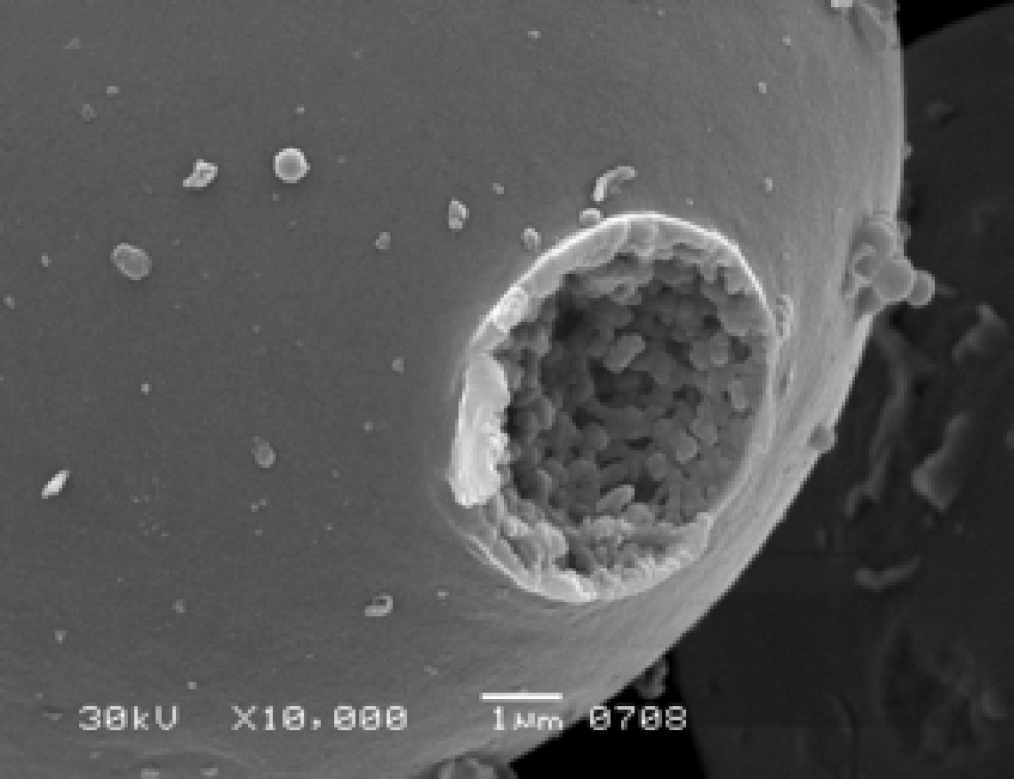
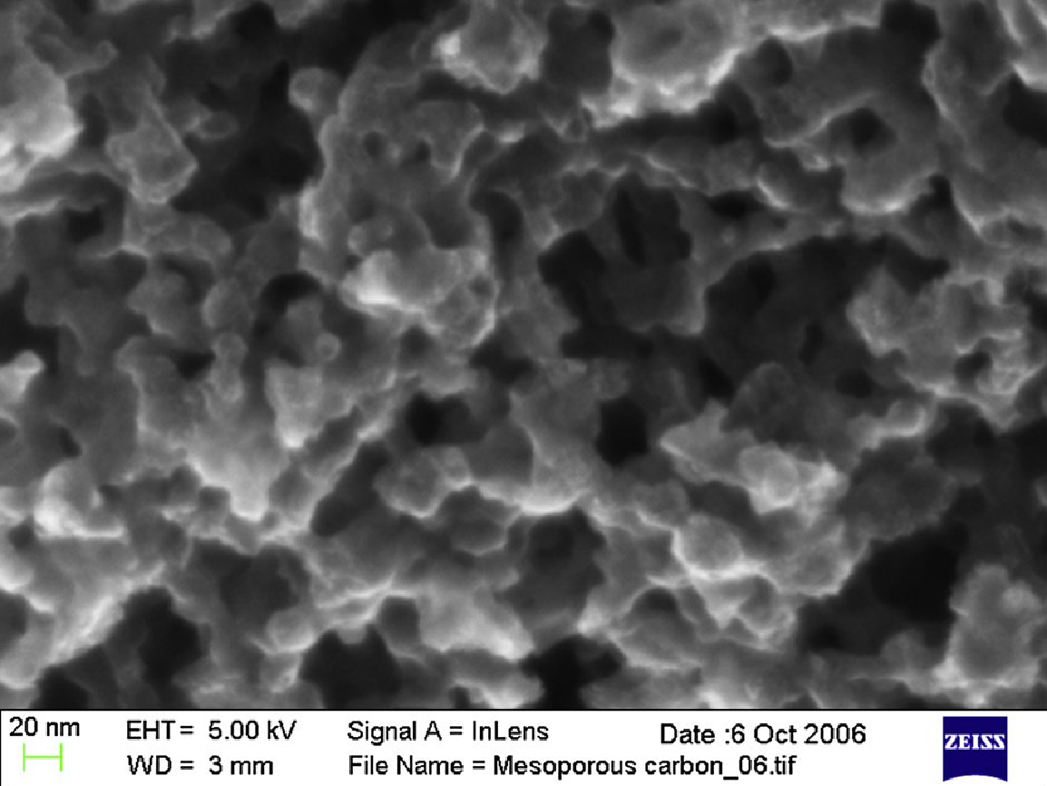
The CATCh Trial
Question: what is the safety and tolerability of CARBALIVE (in 2 different doses) in patients with PSC and IBD?
What is CARBALIVE?
  Tiny carbon beads engineered to selectively remove endotoxins from the gut
  Not absorbed the body, removed with bowel motion
Safety assessed in patients with cirrhosis (4g and 8g/day):
  No death or serious injury
  Side effects: diarrhoea/constipation
Increasing Magnification
Liu et al. Gut. 2024
Notes:
Data in mouse models: significant impact on severity of endotoxaemia, hyperammonaemia, liver cell death, systemic inflammation. Reduced gut permeability in the organoids and impacted positively on the microbiome composition and metabolism.

Slide 17
The CATCh Trial
Screening
Target: 12 patients
  PSC with moderate to advanced fibrosis and
  Well controlled IBD
Single centre – QEHB
Dosing:
  Patients 1-6: 8g once a day
  Patients 7-12: 12g once a day
Week 1 Visit
Week 6 Visit
Treatment Period
Week 12 Visit

Slide 18
What are we looking at?
Safety Data
Adverse events as per CTCAE v5.0
Adverse events of special interest e.g. cholangitis, colitis flare, decompensated liver disease.
Standard blood tests (FBC, LFTs, U&Es, INR)
Child-Turcotte-Pugh Score
MELD Score/UKELD score
Vibration controlled transient elastography (VCTE)
UK-PSC Score
Amsterdam-Oxford PSC score
Prognostic Scoring and Surrogate Biomarkers of Liver Fibrosis
Faecal calprotectin
Partial Mayo score
IBD diary
IBD Activity Stratification
Patient Reported Outcomes
PSC-PRO questionnaire
SF-36 questionnaire
5D-itch
SIBDQ questionnaire
Translational (Research) Samples
Peripheral blood
Urine samples
Stool samples

Slide 19
Take Away Message
The role of an imbalanced PSC microbiome in the disease process
The role of the gut microbiome as a treatment target in PSC (results pending)

Slide 20





Acknowledgements
Supervisors
Dr Palak Trivedi (CI)
Dr Chris Weston
Trivedi/Weston Group
Arzoo Patel
CRUK CTU
Anna Rowe
Alexandra Vince
Derick Gyimah
Victoria Homer
Nicola Jackson
UoB MTC
Susan Manzoor
Sahida Shabir
Liver Research Nurses
Michelle Panton
Penelope Rogers
Khush Bhandal
Gifty Essel
Diana Hull
BRC
Janine Fear
Thin Nguyet Luu
Migena Tushe
Beggs Group
Elena Efstathiou
Kaitlin Marley
Luke Ames
Nicholas Tovey
Asif Iqbal Group
Jenefa Begum
Areeba Fatima
Clinical Research Facility
Claire Brown
Sibil Fernandez
Alla Kistanova
Catherine
April An Berbo
Cherie Nicholls
Fiona Stead
Theresa Brady
Zoe Haygarth
Co-investigators
Dr Nabil Quraishi
Prof Tariq Iqbal
Prof Andrew Beggs
Dr Rachel Cooney
Prof Simon Gates
Prof Christopher Quince
Dr Benjamin Mullish
Prof Ailsa Hart
Dr Laith Rubaiy
Prof Douglas Thorburn
Martine Walmseley
Endoscopists
Dr Naveen Sharma
Dr Karl Hazel
Dr Peter Rimmer
Dr Ayman Bannaga
Dr Veiorelia Stoica
Yaqrit Ltd
Carrie Morgan
Prof Rajiv Jalan
Michal Kowalski

Slide 21
PSC and IBD
*Endotoxins: toxic substances (bad stuff) in the membrane of certain bacteria.
Bile drains from liver into small bowel
Endotoxins translocate to the liver through the portal vein
Portal Vein
Gut Microbiome!
Hov et al. Nat Rev Gastroenterol Hepatol. 2023
Notes:
When bacteria dies or is damaged, endotoxins are released into their surroundings which can trigger a strong immune responses in humans.

