Slide 1

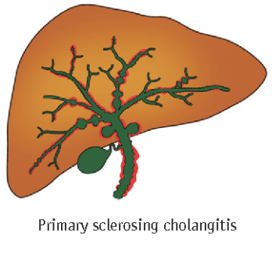
Promoting good personal health
Jenny Towey
Specialist Hepatology and Transplant Dietitian
University Hospitals Birmingham NHS Foundation Trust

Slide 2
Aims
To understand what it means to eat for health.
To understand the role of diet in PSC.
To consider your individual needs and the importance of early intervention.

Slide 3
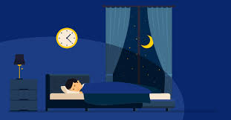



Diet can impact many things….

Slide 4
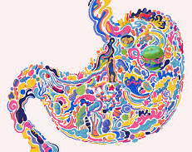
Microbiome

Slide 5
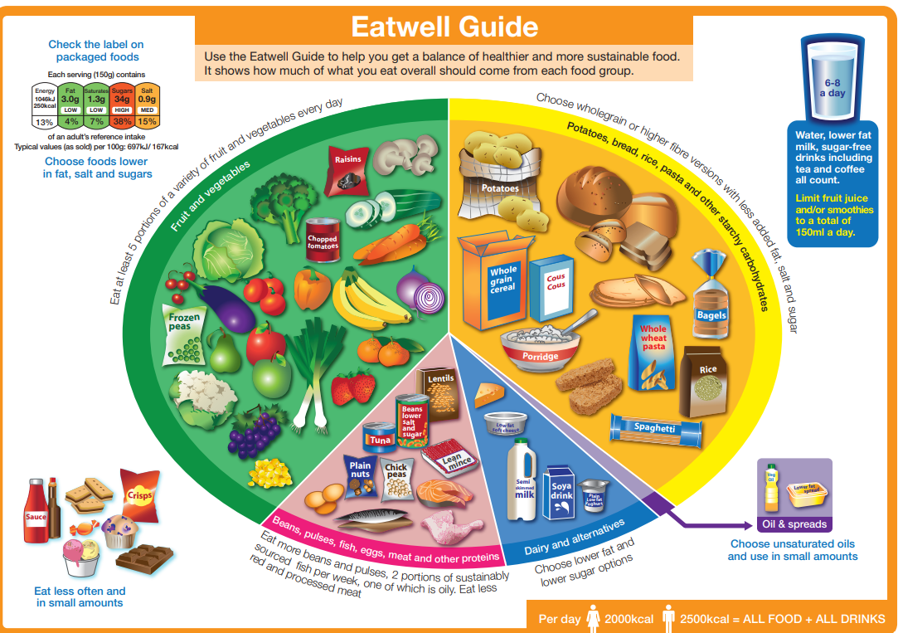
Eating for health
Provides the correct balance of nutrients to help the body work properly.
Can help to manage weight.
Can help with mood, sleep, brain function.
Notes:
Growth and repair
Natural anti-inflammatory foods
Link microbiome with health eating – natural probiotics

Slide 6
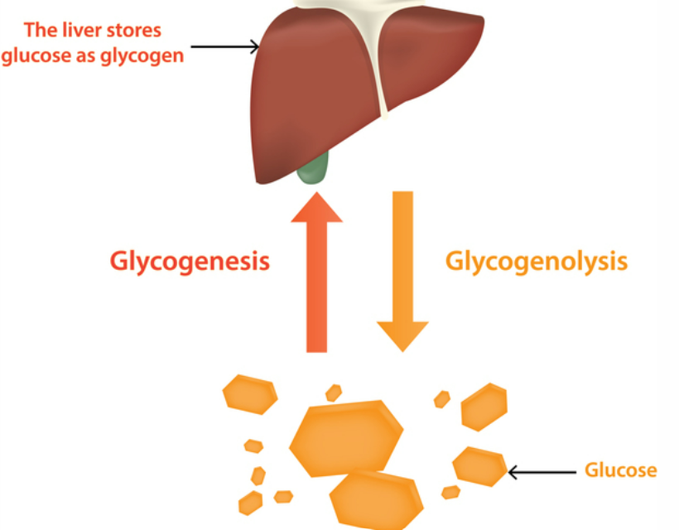
Does anything change with PSC?
Spare energy should be stored in the liver and muscle as ‘glycogen’.
Increase reliance on muscle and fat stores for energy provision.
May be subtle changes to absorption.
Notes:
Usually store spare energy in the liver and muscle as ‘glycogen’ – not replenished in liver disease so muscle and fat are burnt for fuel instead

Slide 7
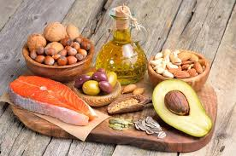
Dietary fat
Bile acids are important for the digestion of fats in the gut and for carrying toxins/other substances away from the liver.
Insufficient bile to digest fats.
Can be helpful to reduce dietary fat intake.
Notes:
The liver produces diverse biologic mediators, including bile acids (BAs), which are secreted into the intestine through the biliary tract. BAs are especially important for the digestion of fats in the gut as well as for carrying toxins/other substances away from the liver, where they can be eliminated from the body in feces.
In the gut, the microbiota metabolizes BAs and other dietary nutrients, which flow back to the liver via the portal vein.
In cases of dysbiosis resulting from diverse intestinal disorders, chronic inflammation and oxidative stress can build up and lead to augmented production of endotoxin, dysregulation of BAs and disruption of the intestinal barrier, all of which can impact the liver5 . For example, compromising the gut integrity can cause translocation of bacteria as well as harmful bacterial products such as lipopolysaccharide (LPS) into the circulation, which can easily reach the liver to produce hepatic inflammation5.
An example of this bidirectional gut–liver axis is epitomized by the case of primary sclerosing cholangitis (PSC) and inflammatory bowel disease (IBD). PSC and IBD are immune-mediated diseases that are strongly intertwined.
Impaired bile acid homeostasis. Cholestatic liver disease, including PSC, is a chronic condition that is characterized by reduced biologically toxic bile flow and consequent impaired systemic BA homeostasis69. BAs are important regulators of metabolism and the immune system. The synthesis, secretion and/or metabolism of BAs are strictly regulated to maintain BA homeostasis
Clinical characteristics of PSC-IBD PSC is usually asymptomatic in the early stage; however, as the disease progresses, patients complain of nonspecific symptoms such as fatigue, pruritus, fever, and weight loss. In advanced cases, abdominal pain and jaundice often develop. In IBD patients, PSC can be diagnosed when biochemical screening reveals abnormal liver chemistry findings, especially serum alkaline phosphatase (ALP) levels. In patients with PSC-IBD, IBD may manifest prior to or be concurrently diagnosed with PSC, while in some cases, IBD becomes apparent at a late stage of PSC, even after liver TPL. In a retrospective cohort study, of 84 PSC patients with no evidence of IBD at the time of liver TPL, 22 (26.2%) patients developed IBD after liver TPL1

Slide 8
Which types of fat need to be reduced?
All types of dietary fat require bile acids for digestion.
Steatorrhoea
  Fatty / oily
  Pale / orange / yellow / tan
  Foul smelling
  Not flush well
  Loose consistency (not always)
  Associated wind / bloating
Notes:
The liver produces diverse biologic mediators, including bile acids (BAs), which are secreted into the intestine through the biliary tract. BAs are especially important for the digestion of fats in the gut as well as for carrying toxins/other substances away from the liver, where they can be eliminated from the body in feces.
In the gut, the microbiota metabolizes BAs and other dietary nutrients, which flow back to the liver via the portal vein.
In cases of dysbiosis resulting from diverse intestinal disorders, chronic inflammation and oxidative stress can build up and lead to augmented production of endotoxin, dysregulation of BAs and disruption of the intestinal barrier, all of which can impact the liver5 . For example, compromising the gut integrity can cause translocation of bacteria as well as harmful bacterial products such as lipopolysaccharide (LPS) into the circulation, which can easily reach the liver to produce hepatic inflammation5.
An example of this bidirectional gut–liver axis is epitomized by the case of primary sclerosing cholangitis (PSC) and inflammatory bowel disease (IBD). PSC and IBD are immune-mediated diseases that are strongly intertwined.
Impaired bile acid homeostasis. Cholestatic liver disease, including PSC, is a chronic condition that is characterized by reduced biologically toxic bile flow and consequent impaired systemic BA homeostasis69. BAs are important regulators of metabolism and the immune system. The synthesis, secretion and/or metabolism of BAs are strictly regulated to maintain BA homeostasis
Clinical characteristics of PSC-IBD PSC is usually asymptomatic in the early stage; however, as the disease progresses, patients complain of nonspecific symptoms such as fatigue, pruritus, fever, and weight loss. In advanced cases, abdominal pain and jaundice often develop. In IBD patients, PSC can be diagnosed when biochemical screening reveals abnormal liver chemistry findings, especially serum alkaline phosphatase (ALP) levels. In patients with PSC-IBD, IBD may manifest prior to or be concurrently diagnosed with PSC, while in some cases, IBD becomes apparent at a late stage of PSC, even after liver TPL. In a retrospective cohort study, of 84 PSC patients with no evidence of IBD at the time of liver TPL, 22 (26.2%) patients developed IBD after liver TPL1

Slide 9
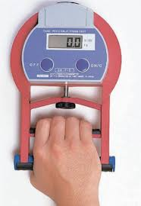
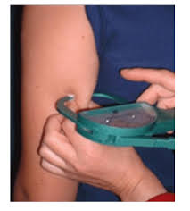
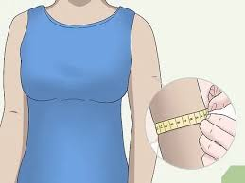

Assessment of body composition
Mid upper arm circumference
Tricep skinfold
Handgrip strength
Notes:
Discuss non measurable signs of change in weight etc e.g. clothes / reduced function etc

Slide 10
Summary

Slide 11
Promoting good personal health
Alice Freer
Specialist Hepatology and Transplant Physiotherapist
University Hospitals Birmingham NHS Foundation Trust

Slide 12
Aims
To understand what it means to move for health.
To understand the role of movement in PSC.
To consider your individual needs and the importance of early intervention.

Slide 13
What is Physical Activity?
“Any bodily movement produced by skeletal muscles that results in energy expenditure”
What is Exercise?
“Exercise is a subset of physical activity that is planned, structured, and repetitive with an aim to maintain or improve physical fitness”

Slide 14
Adults Aged 19-64 | Adults Aged over 65
Strengthening activities twice weekly | Aim to be physically active every day and reduce sedentary living
150 minutes of moderate intensity activity a week or 75 minutes vigorous | 150 minutes of moderate intensity activity a week or 75 minutes vigorous if already active
Minimise time spent sedentary | Complete strength, balance, and flexibility activities twice a week
Spread exercise throughout the week | Spread exercise throughout the week

Slide 15
Physical Frailty in Chronic Liver Disease
“A state of decreased physiological reserve and increased vulnerability to health stressors”
Loss of muscle mass
Waiting list mortality
Reduced physical function
Post-LTx recovery
Psychological
Physical
Physical disability
Hospital admissions
Reduced QoL
Reduced aerobic capacity
Infections
Social
Fried et al, 2001; Lai et al, 2014; Lai et al 2017, Williams et al, 2019; Lai et al., 2019; Renau et al., 2021;
Notes:
So it would make sense from the ERAS perspective that we target frailty to reduce the stress response of a transplant and improve the short term outcomes post surgery

Slide 16
Motivators | Barriers
Improve fitness | Symptom burden
Supportive family network | Lacking in support
Confidence | Reduced confidence/fearful
Access to resources and equipment | No access to resources or equipment

Slide 17

Not One Size Fits All…
Notes:
Liver disease originates from different sources
Even with the same diagnosis, two people can have different symptoms
May have different severity of symptoms, PH, ascites, fatigue, HE, itching, loss of balance, falls.

Slide 18
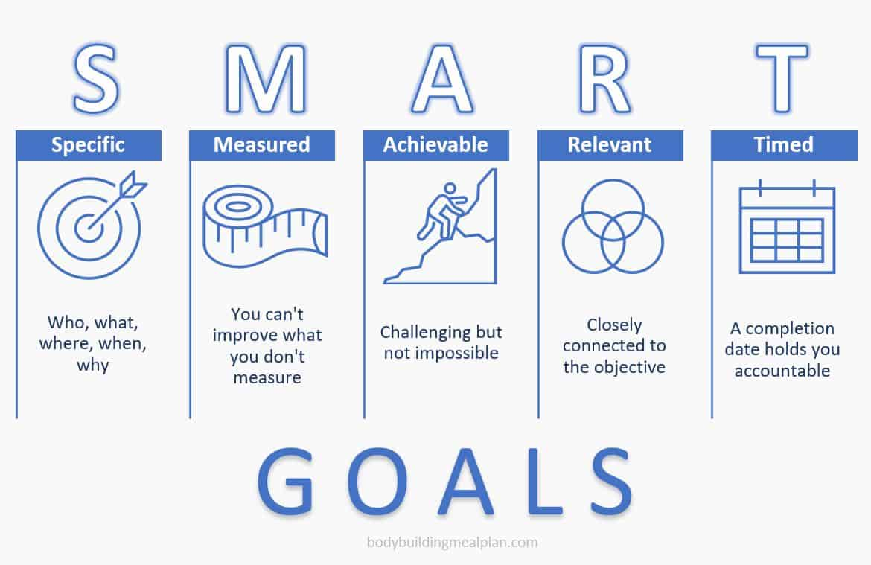

Slide 19
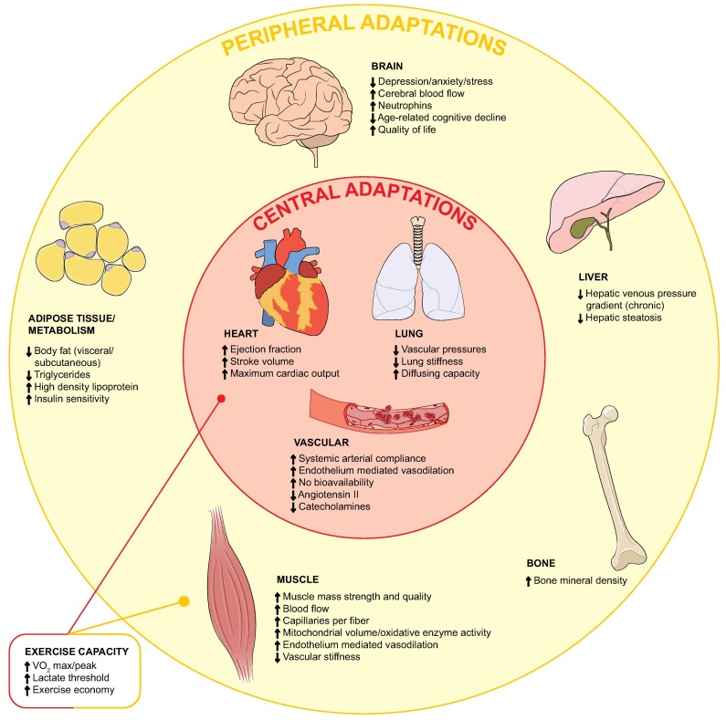
Puneeta Tandon ¹, Kathleen Patricia Ismond ¹, Kenneth Riess ² ¹⁰, Andres Duarte-Rojo ³, Bandar Al-Judaibi ⁴, Michael Andrew Dunn ⁵, Jennifer Holman ⁶, Nancy Howes ⁷, Mark Joseph Franklin Haykowsky ⁸, Deborah Ann Josbeno ⁹, Margaret McNeely ¹⁰
Notes:
Puneeta Tandon ¹, Kathleen Patricia Ismond ¹, Kenneth Riess ² ¹⁰, Andres Duarte-Rojo ³, Bandar Al-Judaibi ⁴, Michael Andrew Dunn ⁵, Jennifer Holman ⁶, Nancy Howes ⁷, Mark Joseph Franklin Haykowsky ⁸, Deborah Ann Josbeno ⁹, Margaret McNeely ¹⁰

Slide 20
Breathlessness: The Borg Scale of RPE
6 | No Exertion at all
7 | Extremely Light
8
9 | Very Light
10
11 | Light
12
13 | Somewhat Hard
14
15 | Hard (Heavy)
16
17 | Very Hard
18
19 | Extremely Hard
20 | Maximal Exertion
The Borg Scale of RPE
Phrases linked to numbers on a scale
Work rates of 12-14
  Correlates to anaerobic threshold
Moderate Intensity
  Contributes to NHS recommended activity guidelines
Perception
Individualised exercise programs
Work in safe & effective training zones

Slide 21
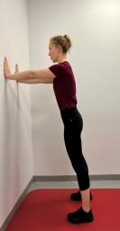
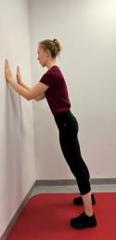
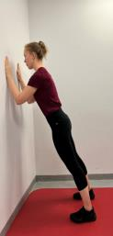
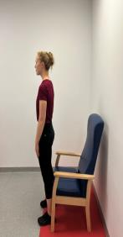
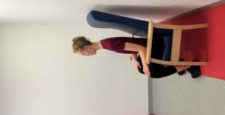
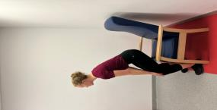

Wall Press
Chair Stands
Notes:
‘The building blocks’

Slide 22
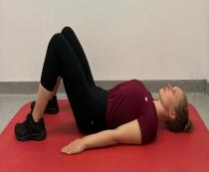
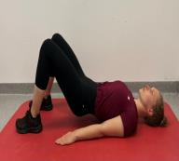
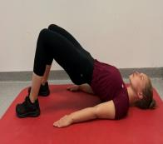


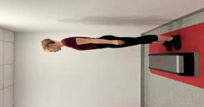
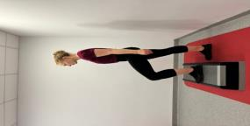
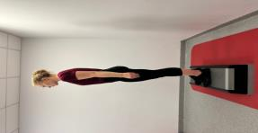


Bridge holds x5 seconds
Step Ups

Slide 23
Example Week | Monday | Tuesday | Wednesday | Thursday | Friday | Saturday | Sunday
Type of session/Rest | Aerobic | Resistance | Rest | Aerobic | Rest | Resistance | Rest
Type of aerobic activity | Walking |  |  | Walking
Duration (mins) | 10 | 20 |  | 10 |  | 20
Session RoPE | 12 | 13 |  | 13 |  | 14
Symptoms | None | None |  | None |  | Pain in left shoulder

Slide 24
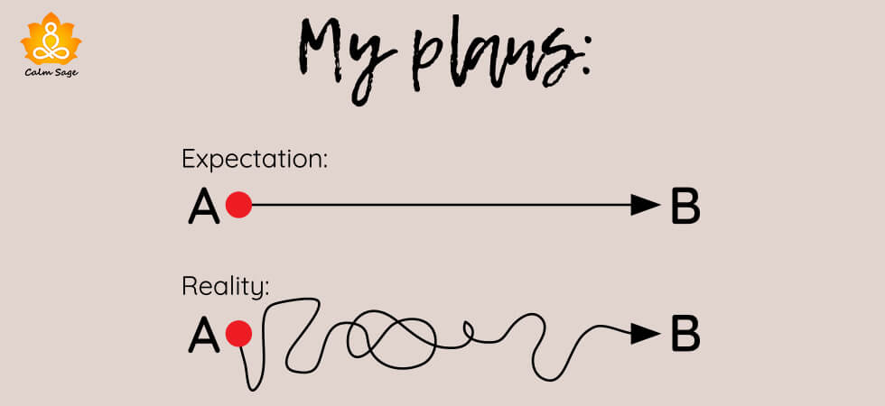

Slide 25


Thank you

