Slide 1
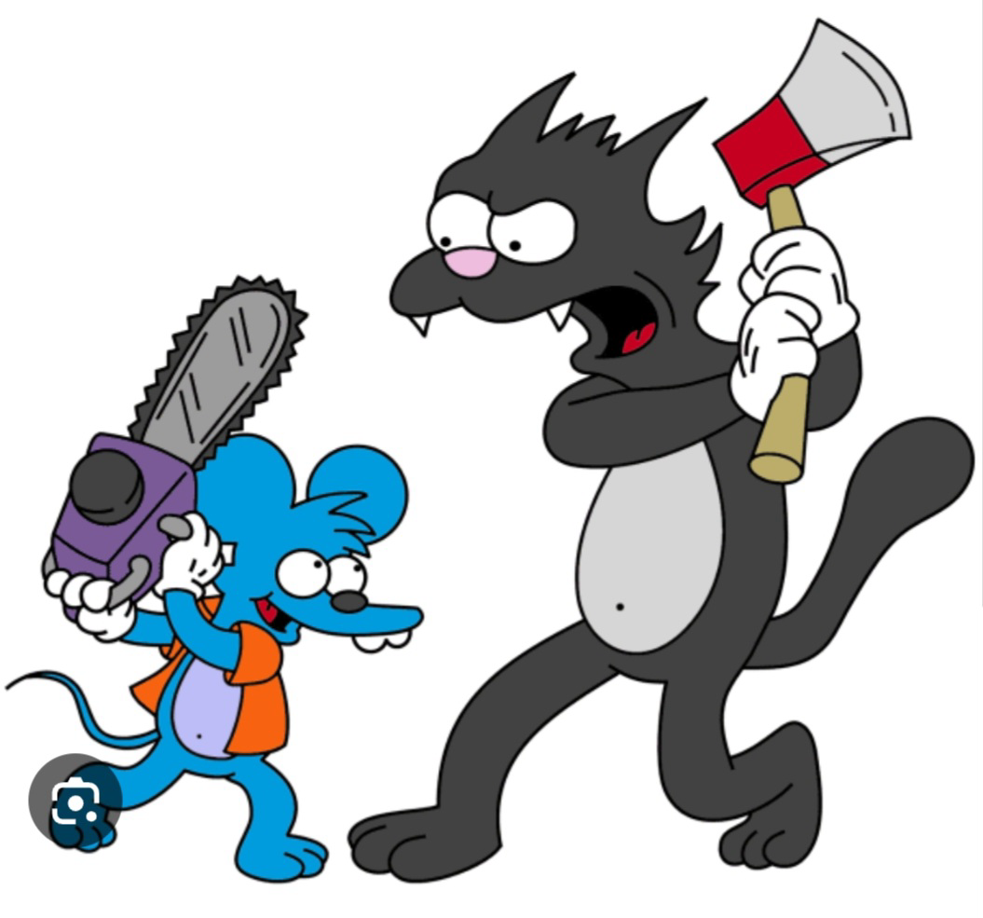

ITCH in PSC
Dr Nasir Hussain
Clinical Research Fellow

Slide 2
Pruritus in PSC
Itch in PSC
We know patients experience itch
But we don’t know:
  Proportion of those that experience itch
  Severity of the itch experienced
  Factors associated with itch
  Impact on quality of life

Slide 3
Questionnaires used
NRS scale
5D itch score
CLDQ questionnaire
EQ 5D 5L

Slide 4
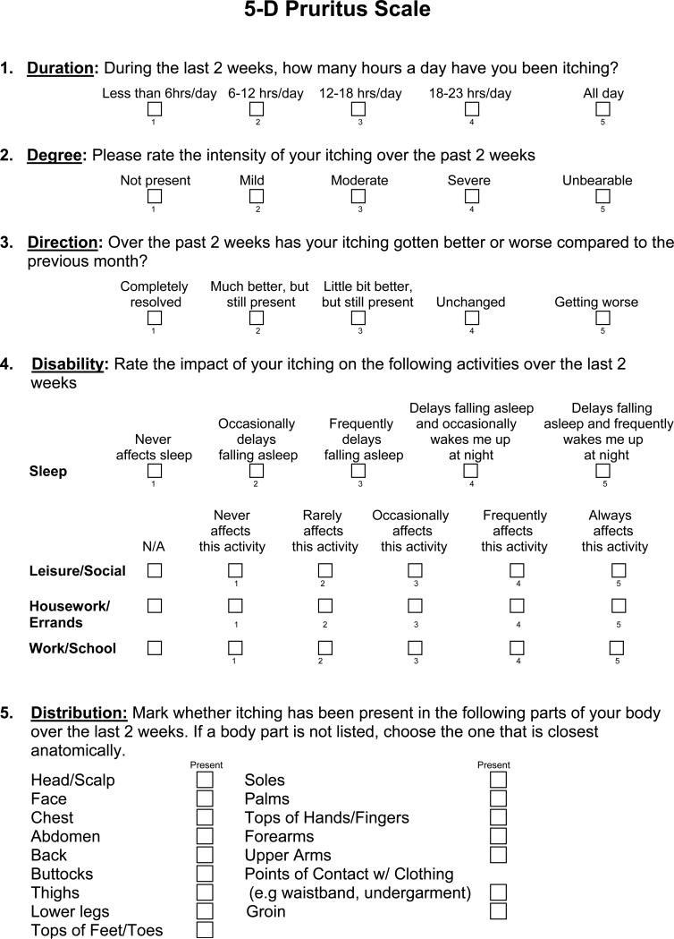
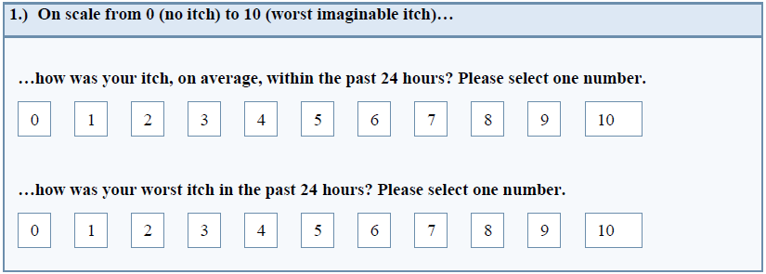
NRS itch scale
  0 = no itch
  1-3 = mild itch
  4-6 = moderate itch
  7-10 = severe itch
5D itch scale

Slide 5
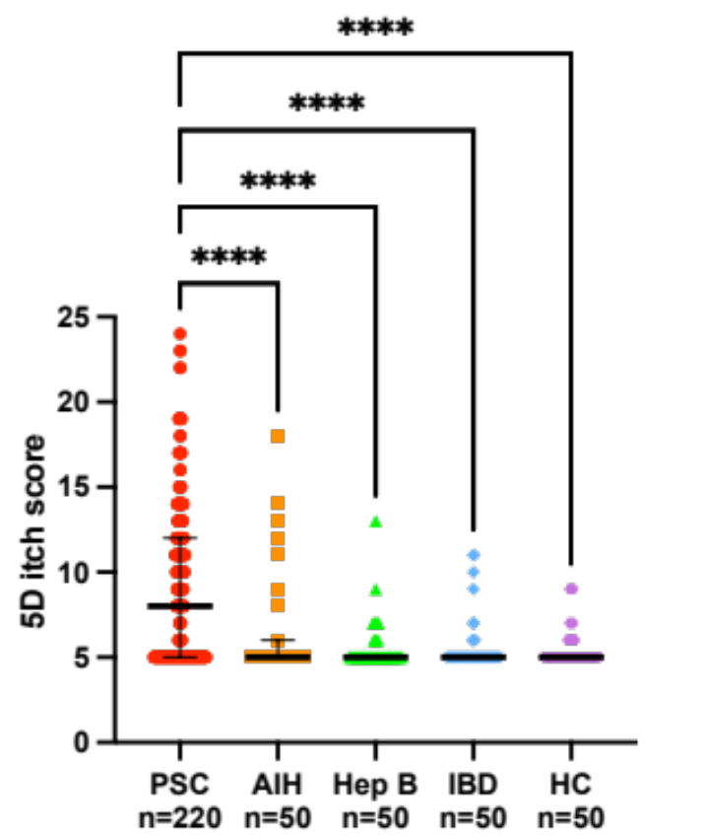
PSC (n=200) | n/median | %/IQR
Age | 39 | 28-57
Male | 115 | 57.5%
NRS Average No itch (NRS =0) Mild itch (NRS 1-3) Moderate-severe itch (NRS 4-10) | 100 59 41 | 50.0% 29.5% 20.5%
Inflammatory Bowel Disease | 170 | 85.0%
Antipruritic therapy | 33 | 16.5%

Slide 6
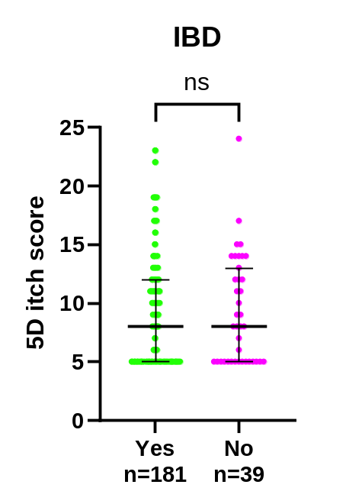
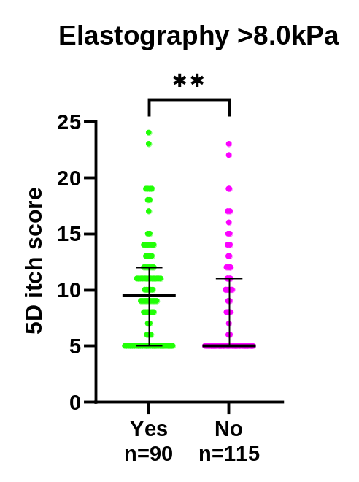
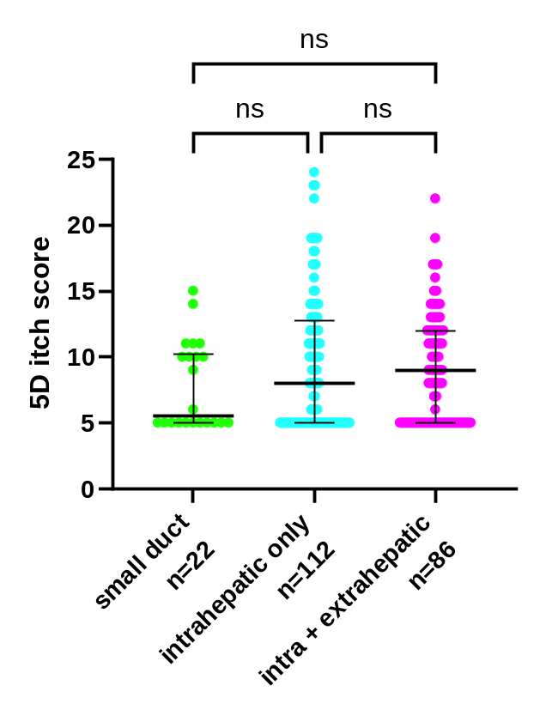
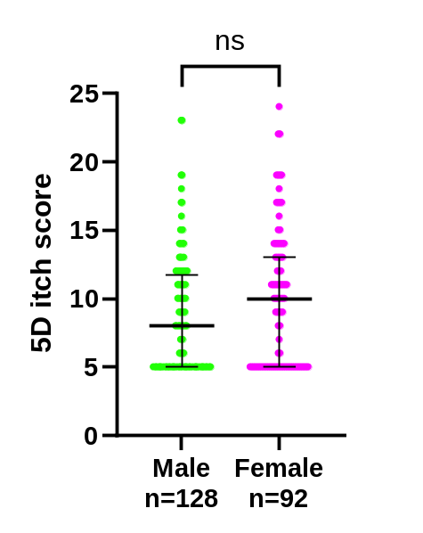
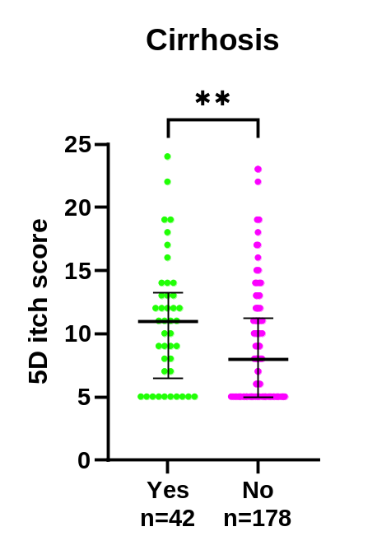
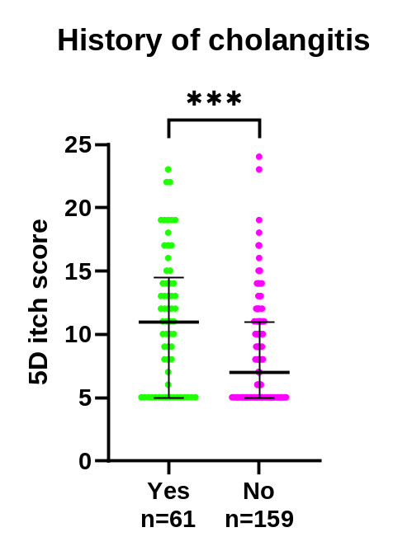
Who gets itchy?

Slide 7
What is causing the itch?
ALP?
  Moderate correlation
Bile acids?
  Moderate correlation
Autotaxin?
  Moderate correlation

Slide 8
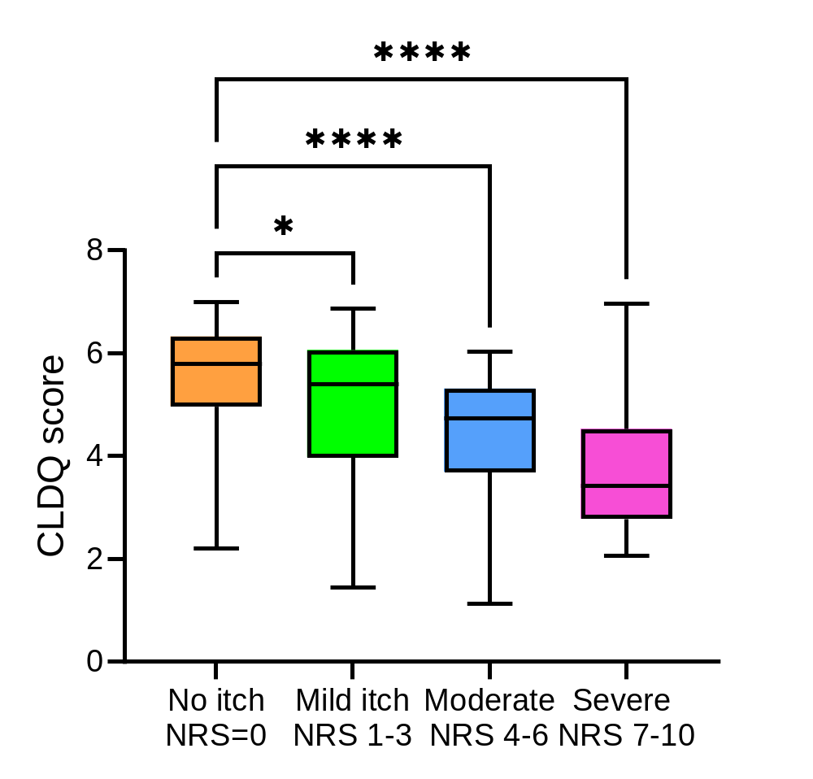
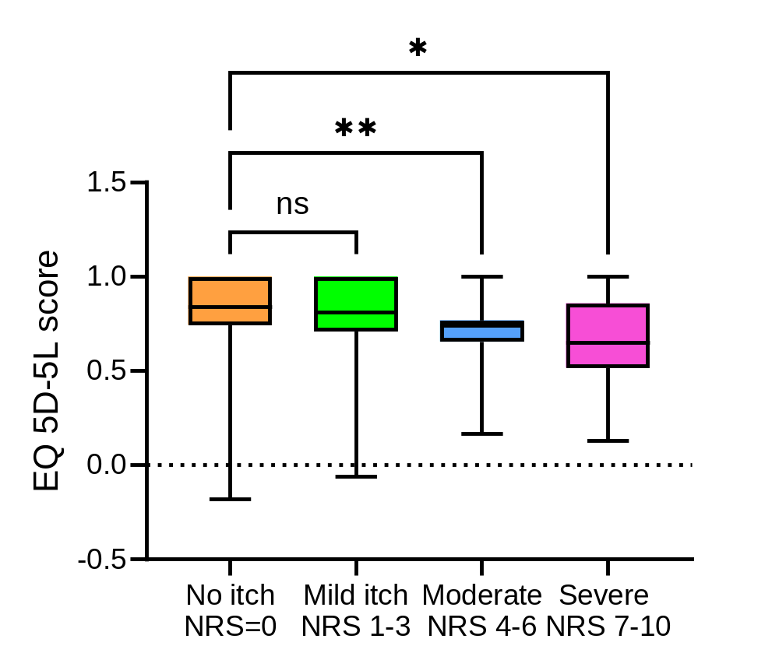
Impact on quality of life
In particular correlated with fatigue

Slide 9
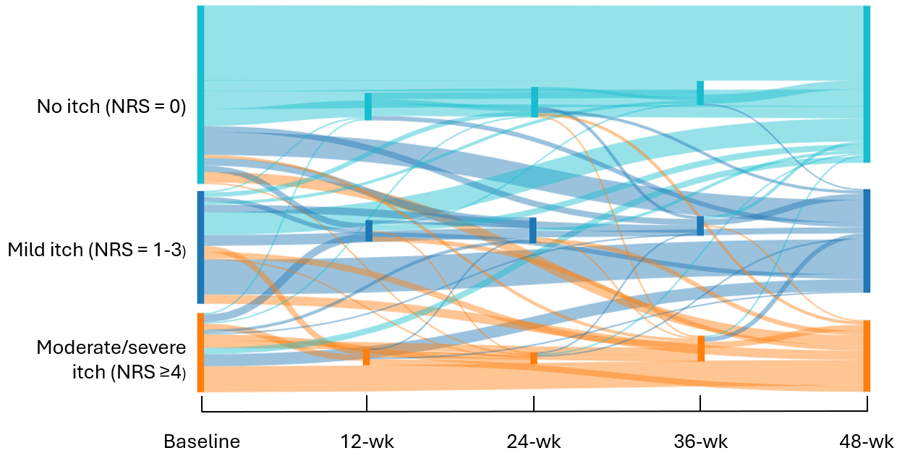
Is itch short lived?

Slide 10
Conclusions
Around 1 in 5 will have moderate-severe itch
Itch most severe in those with more advanced liver disease
Itch persists over time
Itch impacts quality of life

Slide 11
Take aways
Ask for treatment
Ask about clinical trials
  PSC Support webpage
  Ask an Expert session

Slide 12

Thank you

