Slide 1

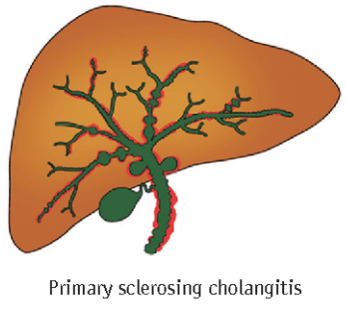
Maintaining fitness
Jenny Towey
Specialist Hepatology and Transplant Dietitian
University Hospitals Birmingham NHS Foundation Trust

Slide 2
Aims
To understand the role of diet in PSC.
To consider your individual needs and the importance of early intervention.

Slide 3
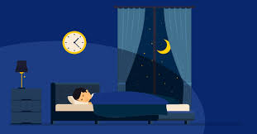



Diet can impact many things….
Notes:
Can link with symptoms of PSC

Slide 4
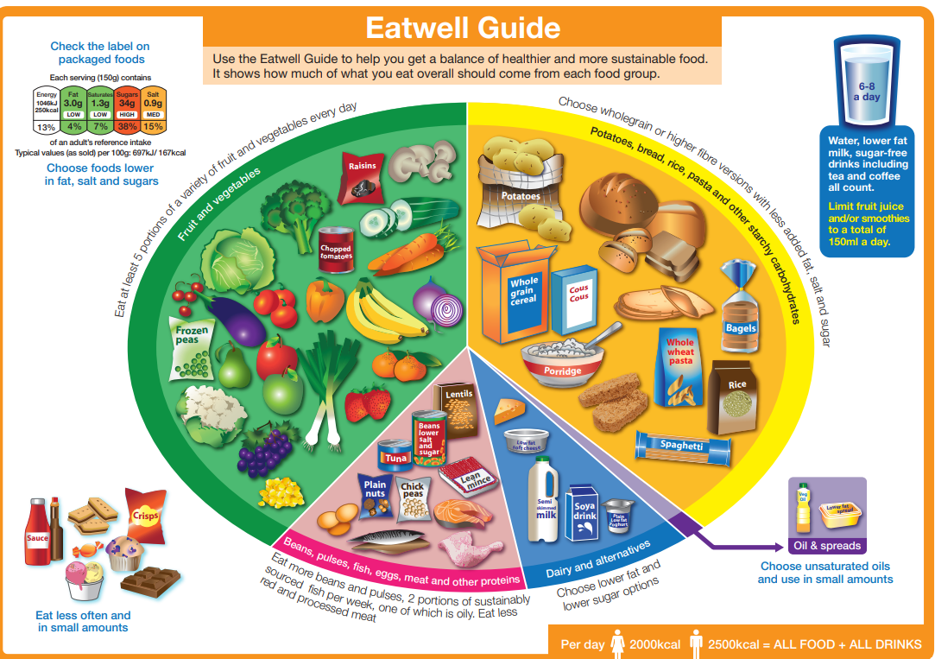
Eating for health
Provides the correct balance of nutrients to help the body work properly.
Can help to manage weight.
Can help with mood, sleep, brain function.
Notes:
Growth and repair

Slide 5
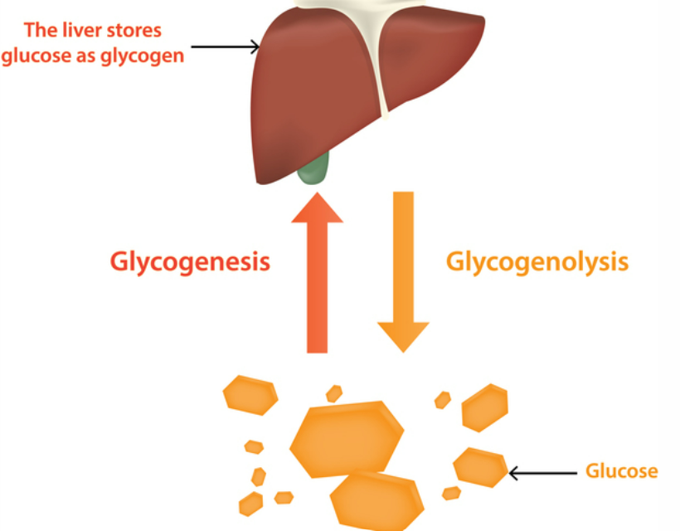
Does anything change with PSC?
Spare energy should be stored in the liver and muscle as ‘glycogen’.
Increase reliance on muscle and fat stores for energy provision.
May be subtle changes to absorption.
Notes:
Usually store spare energy in the liver and muscle as ‘glycogen’ – not replenished in liver disease so muscle and fat are burnt for fuel instead

Slide 6
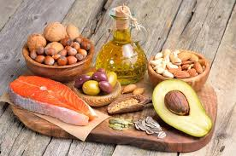
Dietary fat
Bile acids are important for the digestion of fats in the gut and for carrying toxins/other substances away from the liver.
Insufficient bile to digest fats.
Can be helpful to reduce dietary fat intake.
Notes:
The liver produces diverse biologic mediators, including bile acids (BAs), which are secreted into the intestine through the biliary tract. BAs are especially important for the digestion of fats in the gut as well as for carrying toxins/other substances away from the liver, where they can be eliminated from the body in feces.
In the gut, the microbiota metabolizes BAs and other dietary nutrients, which flow back to the liver via the portal vein.
In cases of dysbiosis resulting from diverse intestinal disorders, chronic inflammation and oxidative stress can build up and lead to augmented production of endotoxin, dysregulation of BAs and disruption of the intestinal barrier, all of which can impact the liver5 . For example, compromising the gut integrity can cause translocation of bacteria as well as harmful bacterial products such as lipopolysaccharide (LPS) into the circulation, which can easily reach the liver to produce hepatic inflammation5.
An example of this bidirectional gut–liver axis is epitomized by the case of primary sclerosing cholangitis (PSC) and inflammatory bowel disease (IBD). PSC and IBD are immune-mediated diseases that are strongly intertwined.
Impaired bile acid homeostasis. Cholestatic liver disease, including PSC, is a chronic condition that is characterized by reduced biologically toxic bile flow and consequent impaired systemic BA homeostasis69. BAs are important regulators of metabolism and the immune system. The synthesis, secretion and/or metabolism of BAs are strictly regulated to maintain BA homeostasis
Clinical characteristics of PSC-IBD PSC is usually asymptomatic in the early stage; however, as the disease progresses, patients complain of nonspecific symptoms such as fatigue, pruritus, fever, and weight loss. In advanced cases, abdominal pain and jaundice often develop. In IBD patients, PSC can be diagnosed when biochemical screening reveals abnormal liver chemistry findings, especially serum alkaline phosphatase (ALP) levels. In patients with PSC-IBD, IBD may manifest prior to or be concurrently diagnosed with PSC, while in some cases, IBD becomes apparent at a late stage of PSC, even after liver TPL. In a retrospective cohort study, of 84 PSC patients with no evidence of IBD at the time of liver TPL, 22 (26.2%) patients developed IBD after liver TPL1

Slide 7
Which types of fat need to be reduced?
All types of dietary fat require bile acids for digestion.
Steatorrhoea
  Fatty / oily
  Pale / orange / yellow / tan
  Foul smelling
  Not flush well
  Loose consistency (not always)
  Associated wind / bloating
Notes:
The liver produces diverse biologic mediators, including bile acids (BAs), which are secreted into the intestine through the biliary tract. BAs are especially important for the digestion of fats in the gut as well as for carrying toxins/other substances away from the liver, where they can be eliminated from the body in feces.
In the gut, the microbiota metabolizes BAs and other dietary nutrients, which flow back to the liver via the portal vein.
In cases of dysbiosis resulting from diverse intestinal disorders, chronic inflammation and oxidative stress can build up and lead to augmented production of endotoxin, dysregulation of BAs and disruption of the intestinal barrier, all of which can impact the liver5 . For example, compromising the gut integrity can cause translocation of bacteria as well as harmful bacterial products such as lipopolysaccharide (LPS) into the circulation, which can easily reach the liver to produce hepatic inflammation5.
An example of this bidirectional gut–liver axis is epitomized by the case of primary sclerosing cholangitis (PSC) and inflammatory bowel disease (IBD). PSC and IBD are immune-mediated diseases that are strongly intertwined.
Impaired bile acid homeostasis. Cholestatic liver disease, including PSC, is a chronic condition that is characterized by reduced biologically toxic bile flow and consequent impaired systemic BA homeostasis69. BAs are important regulators of metabolism and the immune system. The synthesis, secretion and/or metabolism of BAs are strictly regulated to maintain BA homeostasis
Clinical characteristics of PSC-IBD PSC is usually asymptomatic in the early stage; however, as the disease progresses, patients complain of nonspecific symptoms such as fatigue, pruritus, fever, and weight loss. In advanced cases, abdominal pain and jaundice often develop. In IBD patients, PSC can be diagnosed when biochemical screening reveals abnormal liver chemistry findings, especially serum alkaline phosphatase (ALP) levels. In patients with PSC-IBD, IBD may manifest prior to or be concurrently diagnosed with PSC, while in some cases, IBD becomes apparent at a late stage of PSC, even after liver TPL. In a retrospective cohort study, of 84 PSC patients with no evidence of IBD at the time of liver TPL, 22 (26.2%) patients developed IBD after liver TPL1

Slide 8

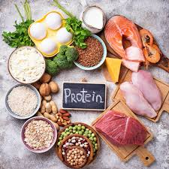
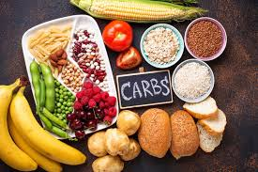
How to maintain muscle mass
Notes:
Mention exercise

Slide 9
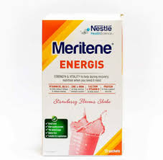
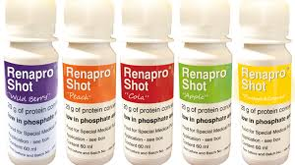
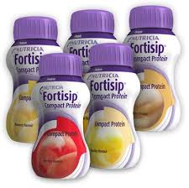
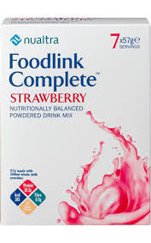

Additional nutrition support

Slide 10
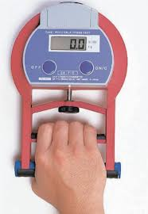
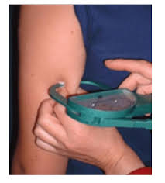
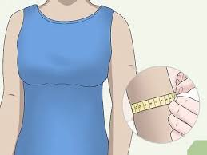

Assessment of body composition
Mid upper arm circumference
Tricep skinfold
Handgrip strength

Slide 11
Summary

Slide 12
Maintaining fitness
Alice Freer
Specialist Hepatology and Transplant Physiotherapist
University Hospitals Birmingham NHS Foundation Trust

Slide 13
What is Physical Activity?
“Any bodily movement produced by skeletal muscles that results in energy expenditure”
What is Exercise?
“Exercise is a subset of physical activity that is planned, structured, and repetitive with an aim to maintain or improve physical fitness”

Slide 14
Exercise
How confident are you to exercise?
Not Confident
Neutral
Very Confident
1 2 3 4 5 6 7 8 9 10
Notes:
With this in mind how confident are you to exercise?

Slide 15
Adults Aged 19-64 | Adults Aged over 65
Strengthening activities twice weekly | Aim to be physically active every day and reduce sedentary living
150 minutes of moderate intensity activity a week or 75 minutes vigorous | 150 minutes of moderate intensity activity a week or 75 minutes vigorous if already active
Minimise time spent sedentary | Complete strength, balance, and flexibility activities twice a week
Spread exercise throughout the week | Spread exercise throughout the week

Slide 16

Moderate | Vigorous
Brisk Walking | Running at a fast past
Water Aerobics | Aerobics class
Cycling (easy terrain) | Cycling up a hill
Gentle Gardening (potting, clearing leaves, pushing a lawn mower) | Rowing machine
Racket sports- doubles (tennis/badminton) | Swimming- Front Crawl
Breaststroke

Slide 17
Reduces
Stroke
Non-insulin dependent diabetes
Some Cancers
Depression
Osteoarthritis
Falls
Dementia
Coronary heart disease

Slide 18
Motivators | Barriers
Improve fitness | Symptom burden
Supportive family network | Lacking in support
Confidence | Reduced confidence/fearful
Access to resources and equipment | No access to resources or equipment

Slide 19
What does this mean for my liver disease?
May help to maintain or improve overall muscle mass and strength
May improve health-related quality of life
Improved cardiovascular fitness improves outcomes
Improve symptom burden- FATIGUE?

Slide 20
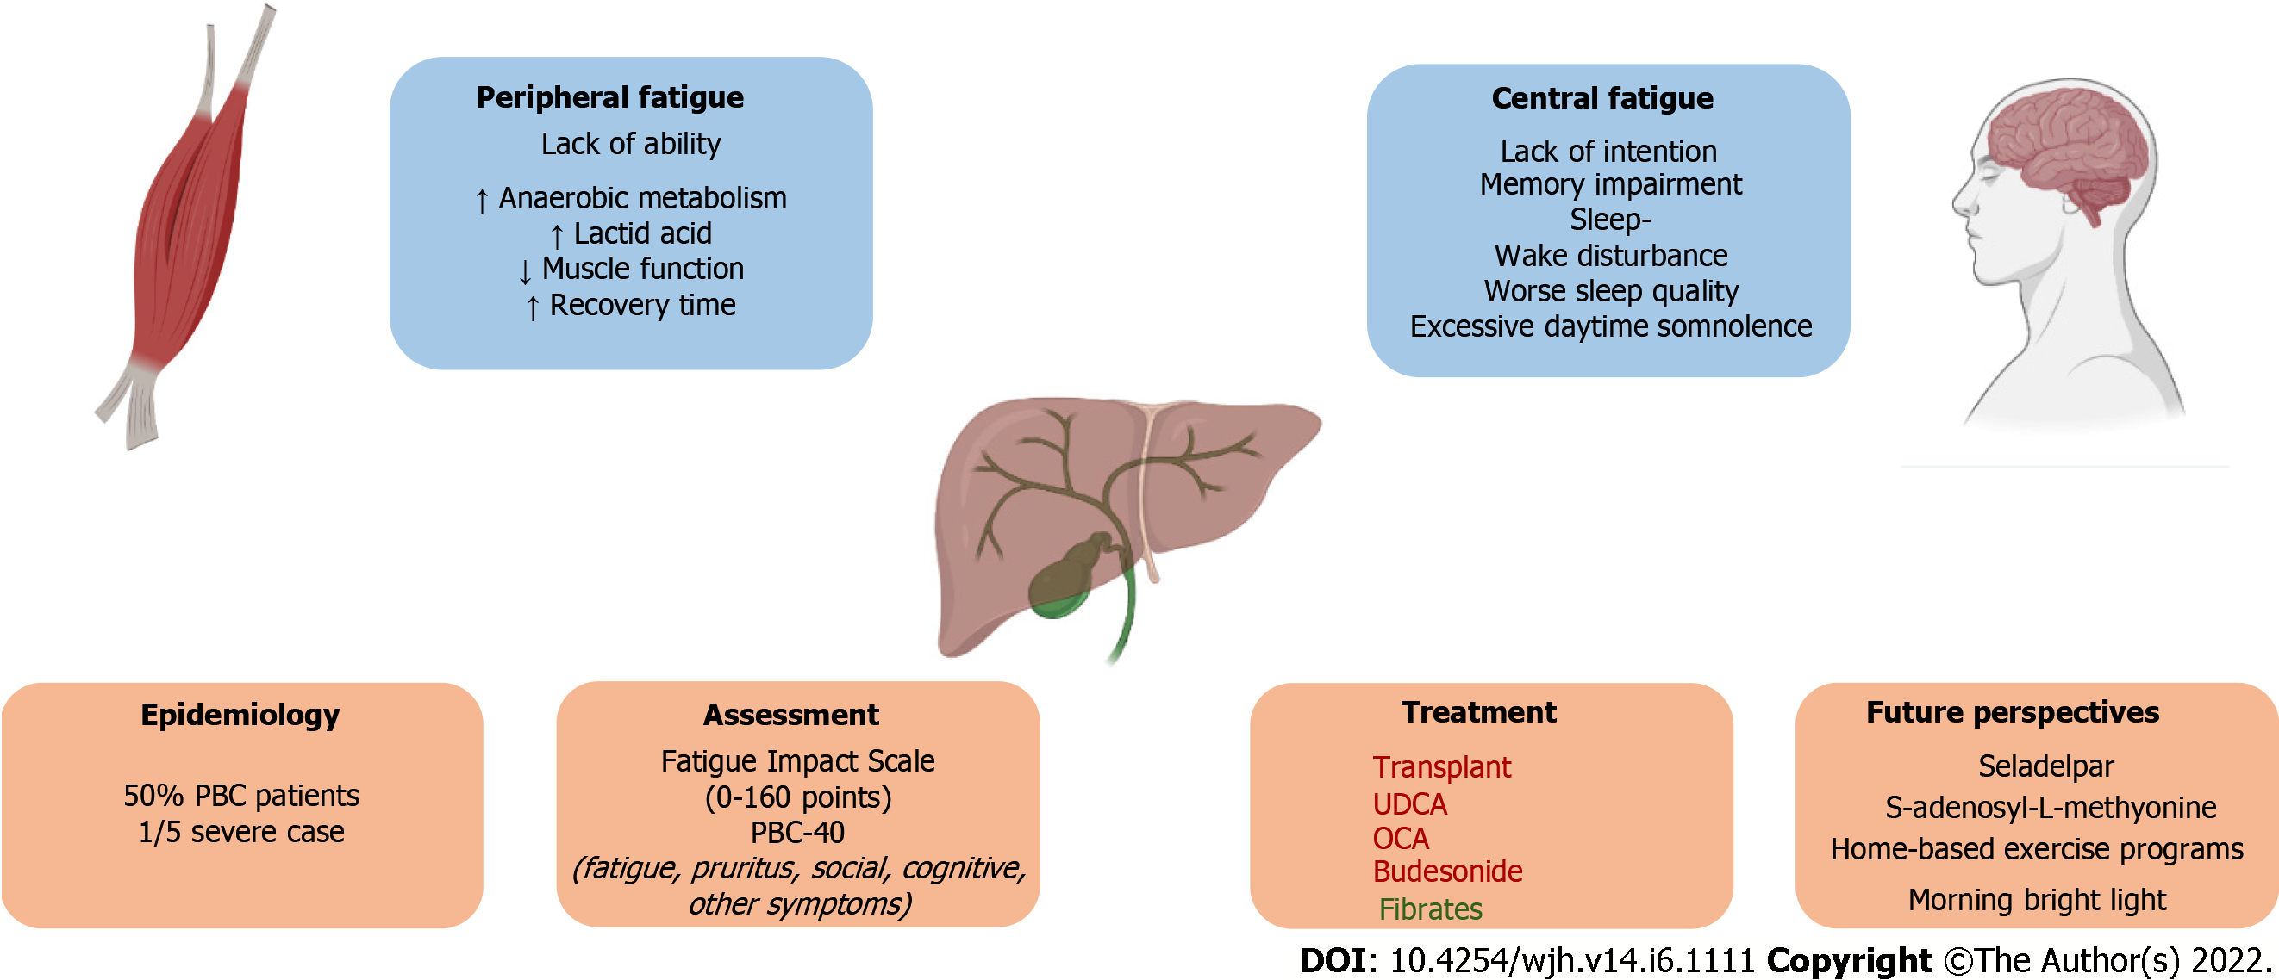

Fatigue
CENTRAL
PERIPHERAL
Memory Disturbances
Sleep Disturbance
Reduced Sleep Quality
Increased Daytime Somnolence
Reduced Functional Capacity
Increased Anaerobic Metabolism
Increased Lactic Acid
Increased Recovery Times

Slide 21
Question: Do you get asked about fatigue in the clinical setting? Yes
No
Question: What do we do with the answers?
Something
Nothing

Slide 22

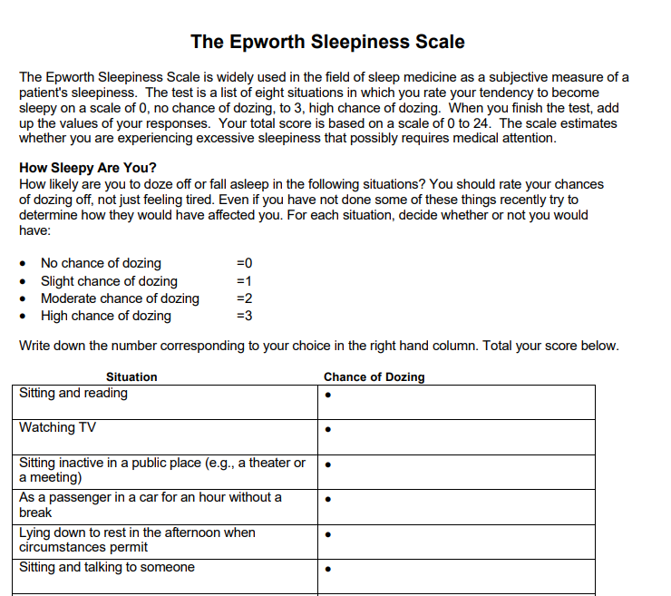

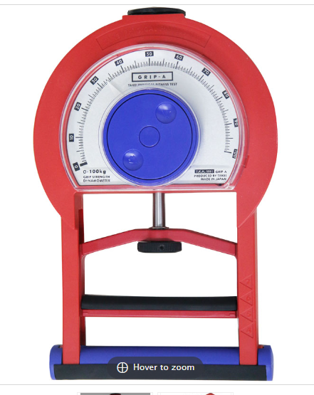
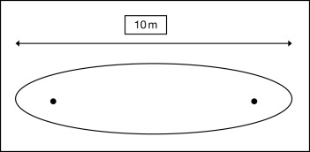
Sleep
Muscle Fatigability
Activity Profiling
Time to fatigue with physical outcomes
Intensity gradients
Accelerometery/Sleep diaries
Self-reported questionnaires:
-Epworth Sleepiness Scale
-Pittsburgh Sleep Quality Index
Health Psychology

Slide 23
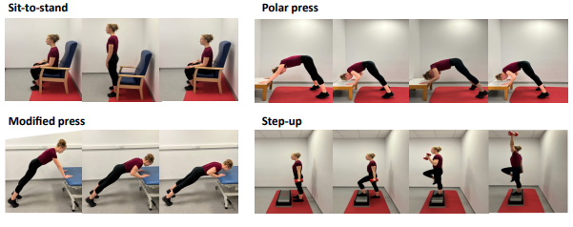

Slide 24






Question: What can I do now?
Sleep & Meaningful Rest
Physical Activity
Mental Wellbeing
Sustainable change that is well paced

Slide 25
Take Home Messages
Exercise improves outcomes
Improved cardiovascular fitness improves survival
Combination of aerobic and resistance exercise
Pacing will allow for sustainability
Adequate nutrition will help optimise results

Slide 26


Thank you

