Slide 1




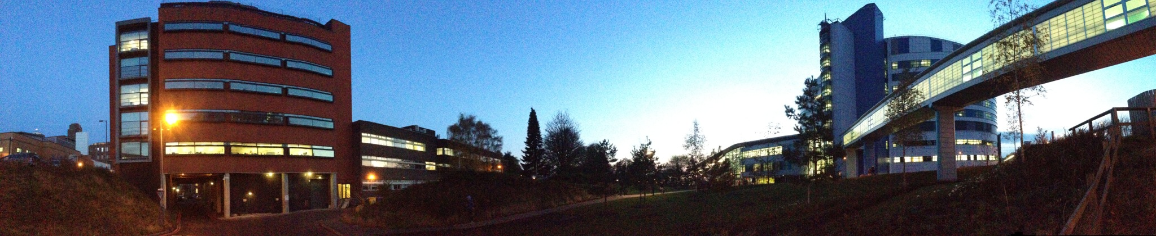
Primary sclerosing cholangitis: what does good care look like?
Palak J. Trivedi; @CholestasisDoc

Slide 2
Mr. J.
36-year-old anaesthetist
(non-smoker)
Asymptomatic pan-colitis (UC) for 3 years
  Mesalazine (Salofalk) 3g daily
Increasingly fatigued (4/12)
Pruritus (nocturnal; 6/12)
Bloods:
  ALP 174
  ALT 70
  Bili 25
  Albumin 39
  Plts. 211
  INR 0.9
USS:
  Coarse, enlarged liver, normal spleen size
MRCP:
Multifocal intrahepatic stricturing
No dominant strictures
In keeping with PSC

Slide 3
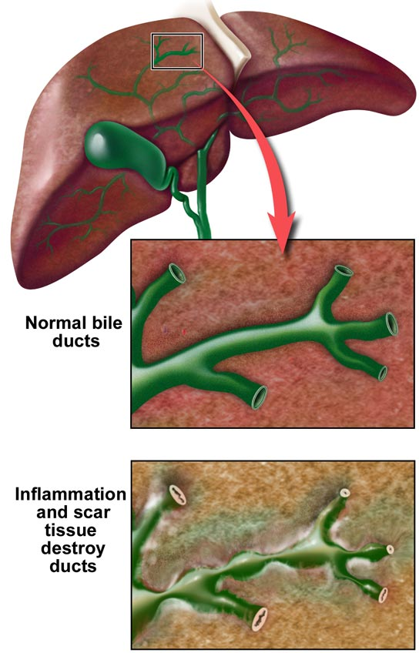
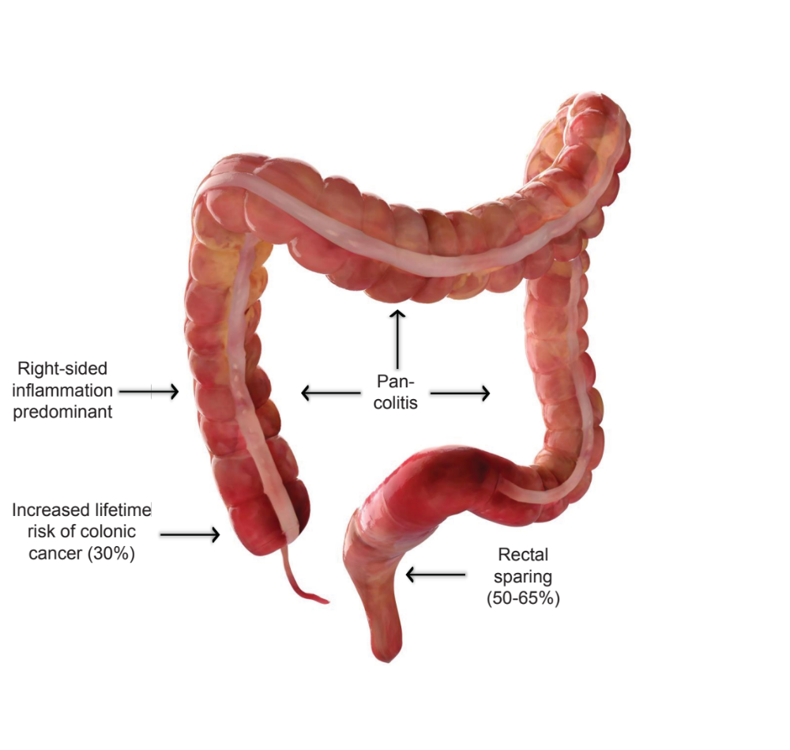
For many, PSC is not just a condition of the liver
70-80% have inflammatory bowel disease
Boonstra et al. Inflamm. Bowel. Dis. 2013
Trivedi et al. Clin. Res. Gastroenterol. Hepatol. 2012

Slide 4
The patient asks:
“How common is PSC?”
“How will IBD and PSC affect each other?”
“Am I going to develop cancer, and if so, what is my risk?”
“Will I need a new liver (and if so when)?”
“What treatment options are available?”
“How do I need to be monitored moving forward?”
“Will a liver transplant cure me?”

Slide 5
The PSC Consultation in 2011
New diagnosis
Follow-up appointment
”PSC is chronic condition”
“It’s rare”
“It can be unpredictable”
“No real treatments available”
”Ursodeoxycholic might help”
“Mainstay of care is monitoring”
“There is a higher risk of cancer”
“Some go on to need a transplant”
“How are your symptoms?”
”How are your bowels?”
“If your bowels are active I can give you some mesalazine or steroids”
”Any symptoms of infection?”
“There is still no real treatment.”
“You may need a transplant at some point”
“You need / don’t need a transplant now”

Slide 6
Drug-induced
Vaccine-induced
Trivedi et al. Gut 2021

Slide 7
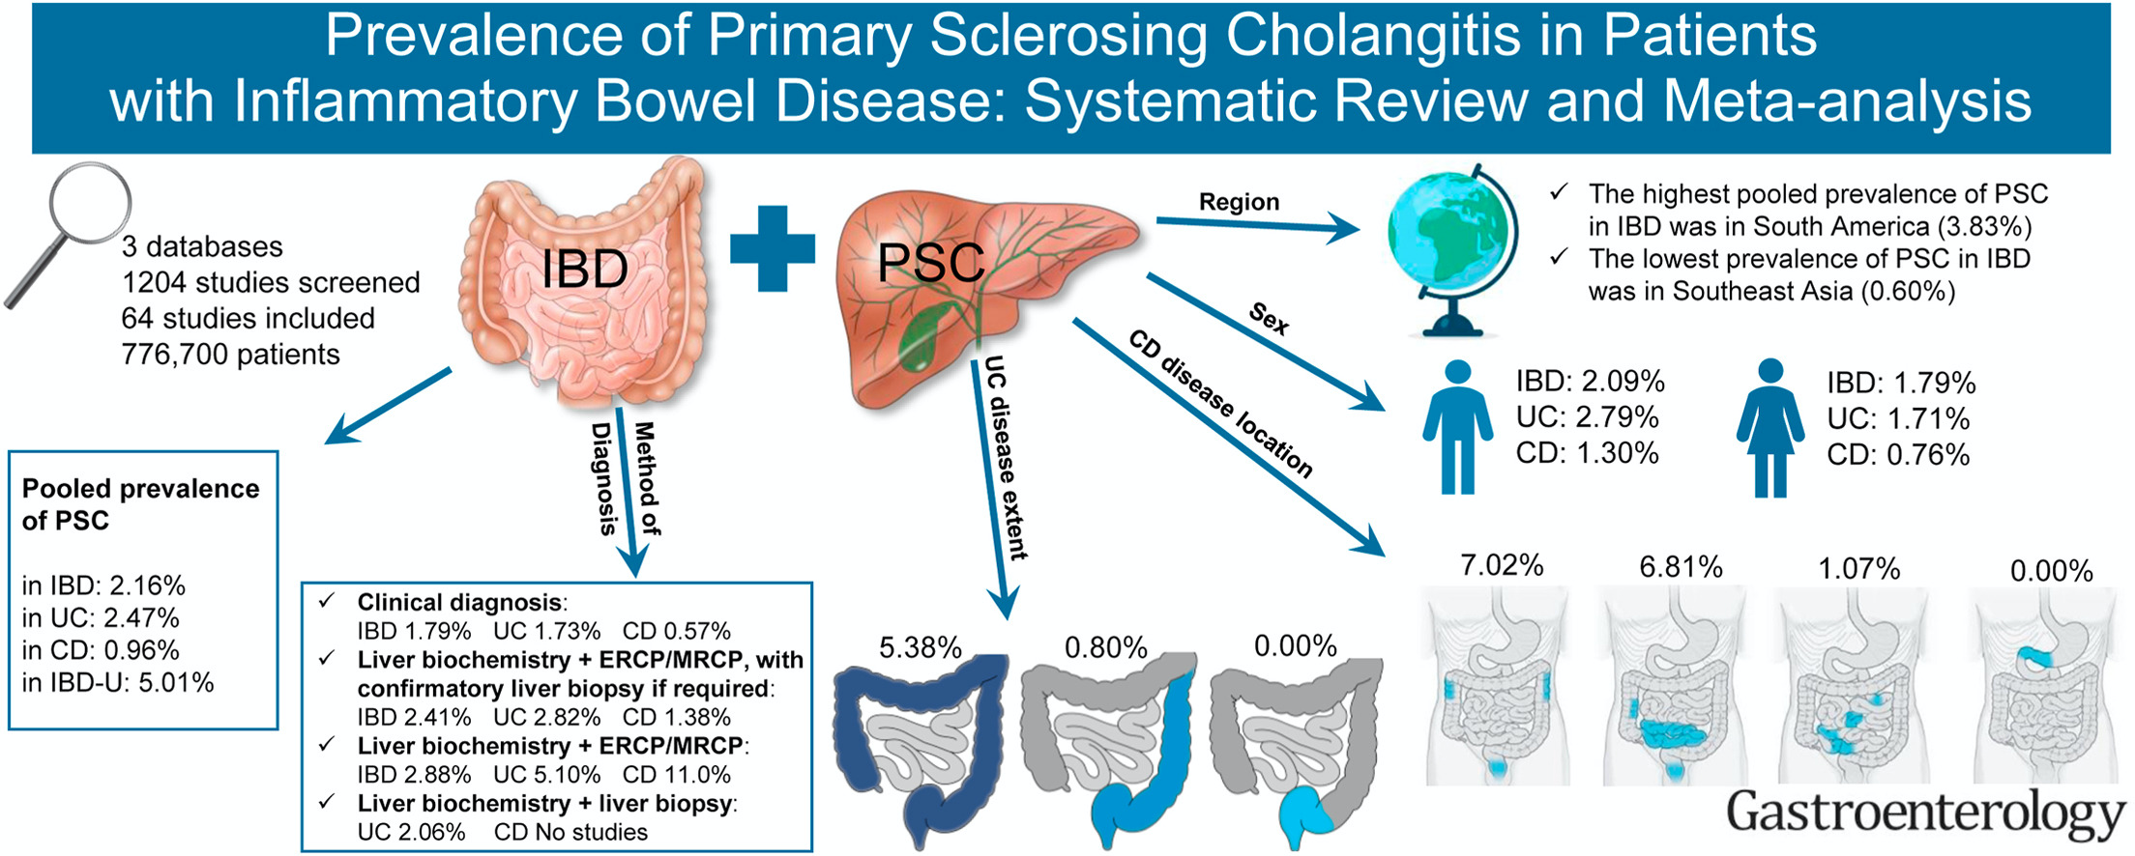
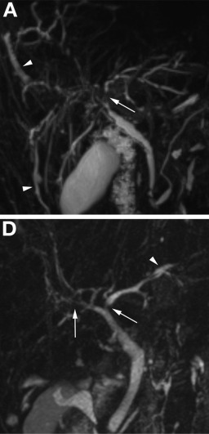
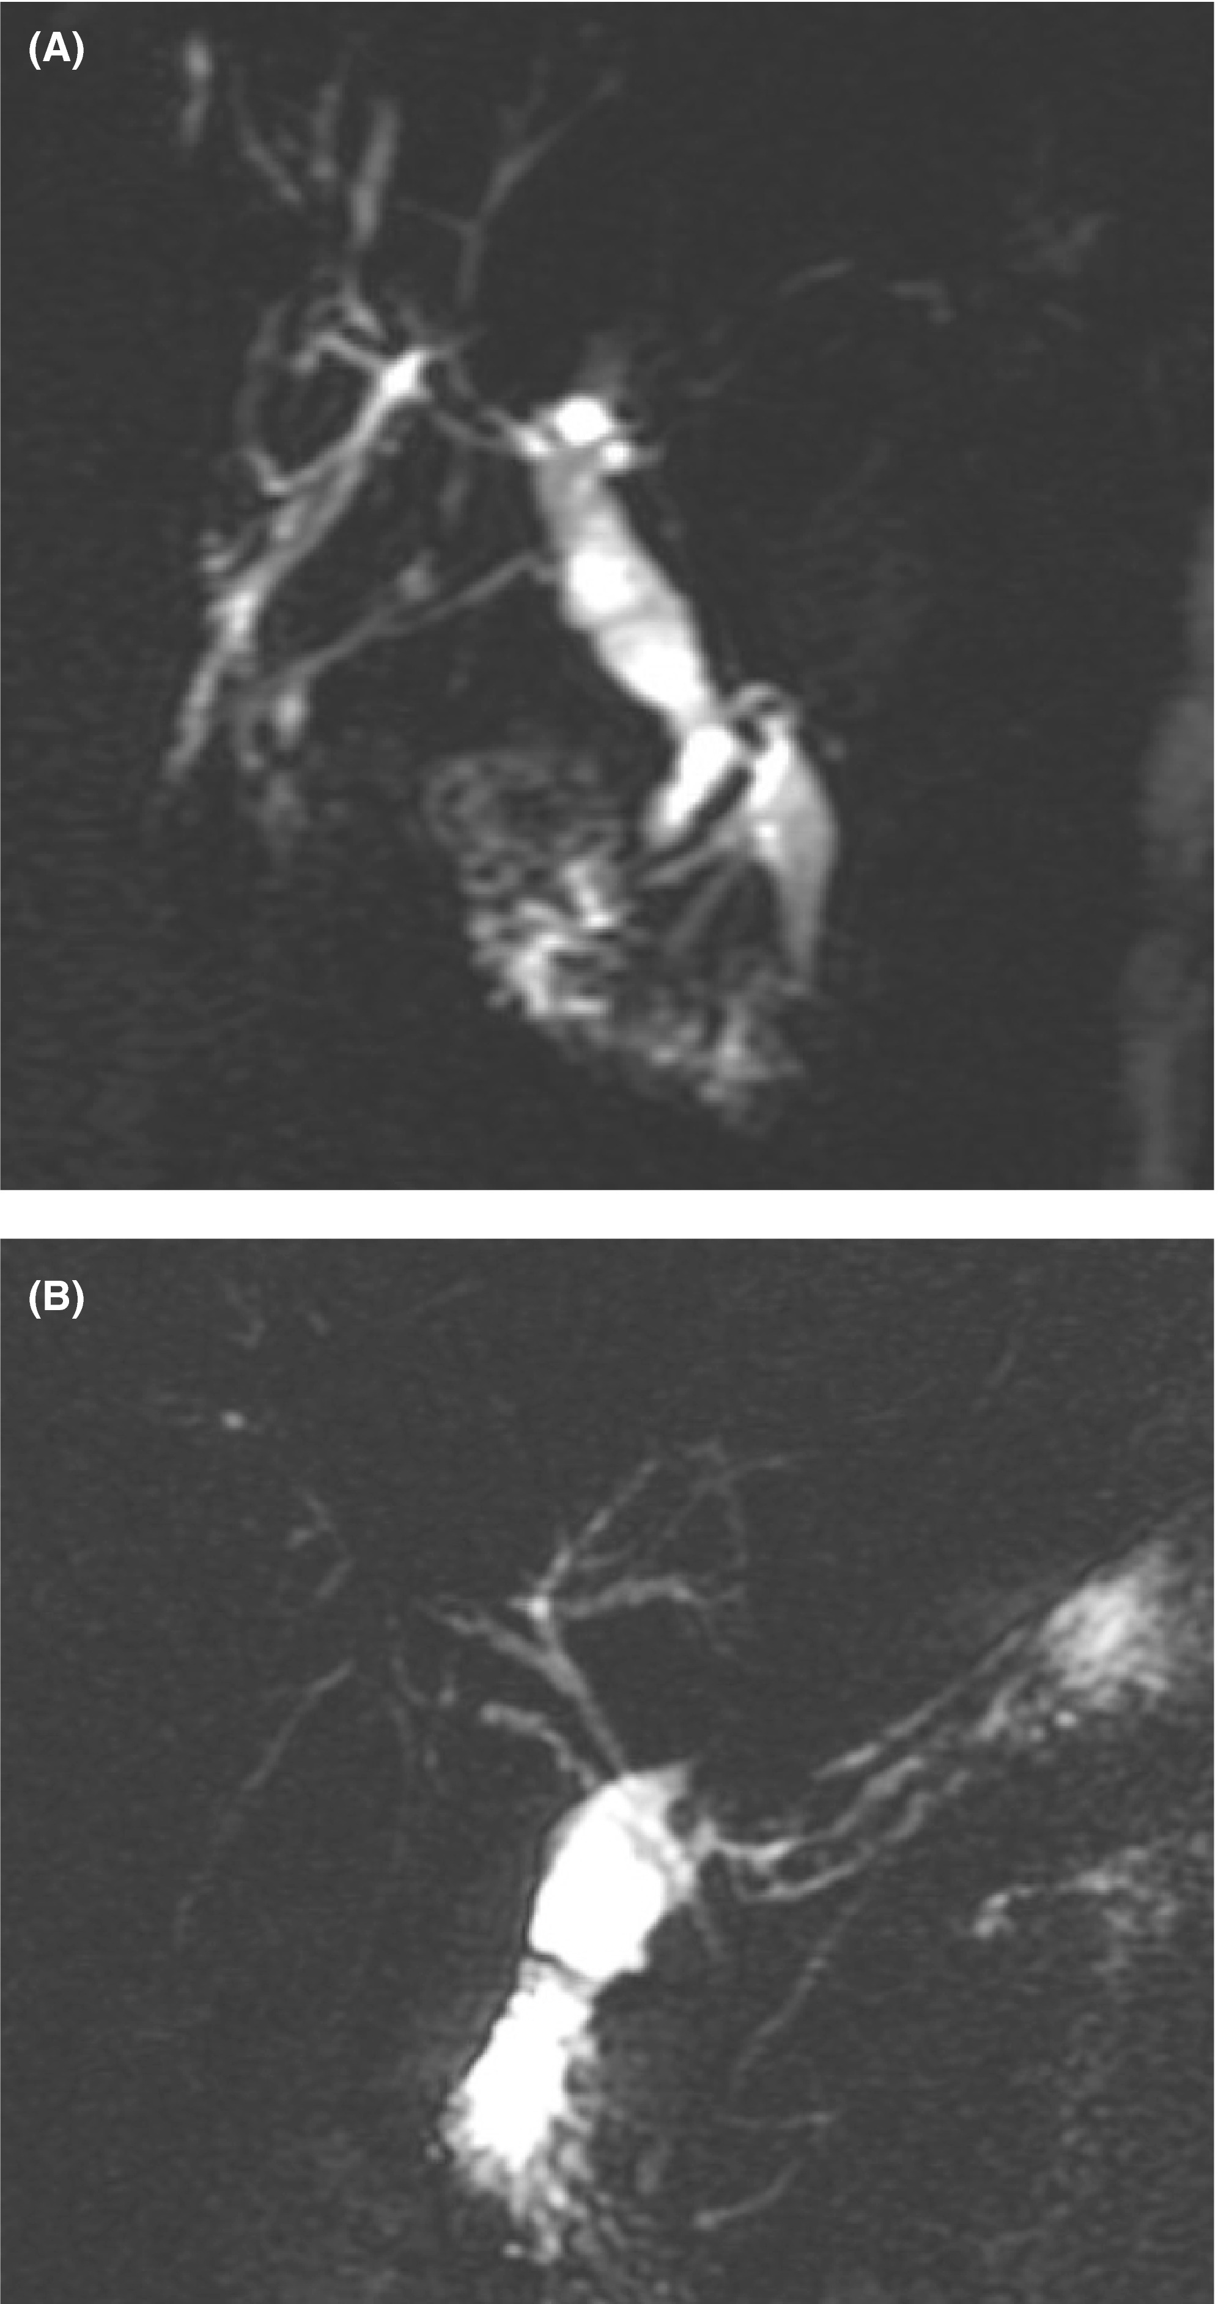
Prevalence of PSC in IBD
Oslo, Norway
Oxford, UK
PSC-like lesions
8.1% of IBD pts.
*Sub-clinical biliary changes:
14% with extensive UC
21% with colorectal dysplasia
Lünder et al. Gastroenterology 2016
*Culver et al. Liver Int. 2020
Barberio et al. Gastroenterology 2021

Slide 8
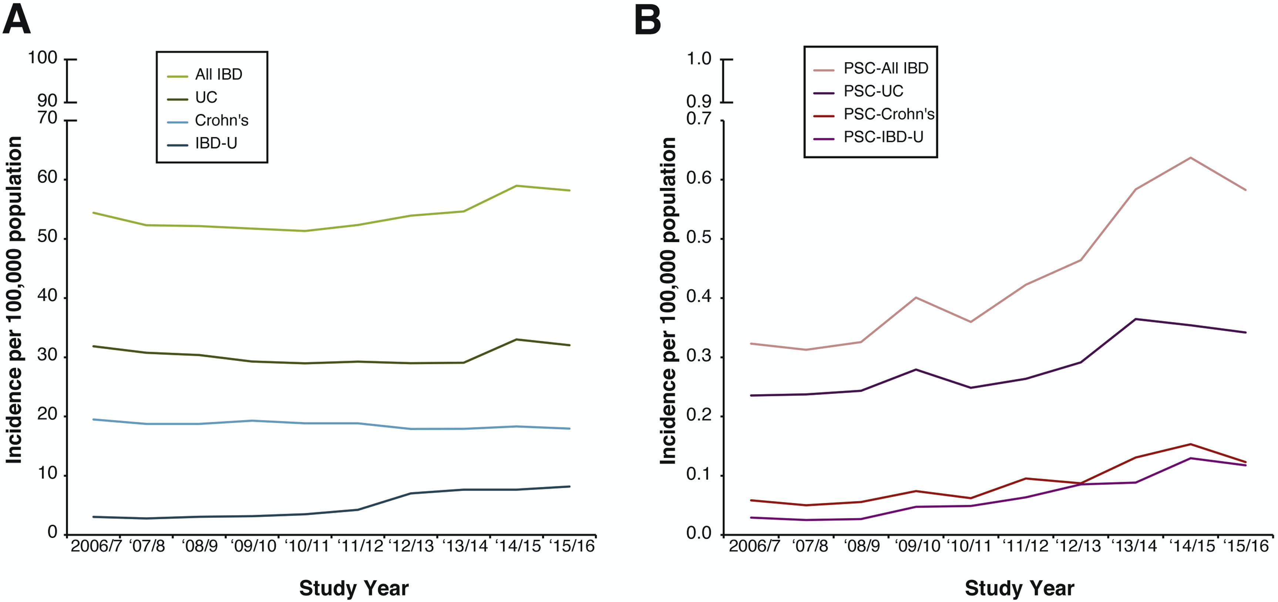
IBD incidence is plateauing but PSC-IBD is rising
Trivedi et al. Gastroenterology 2020

Slide 9
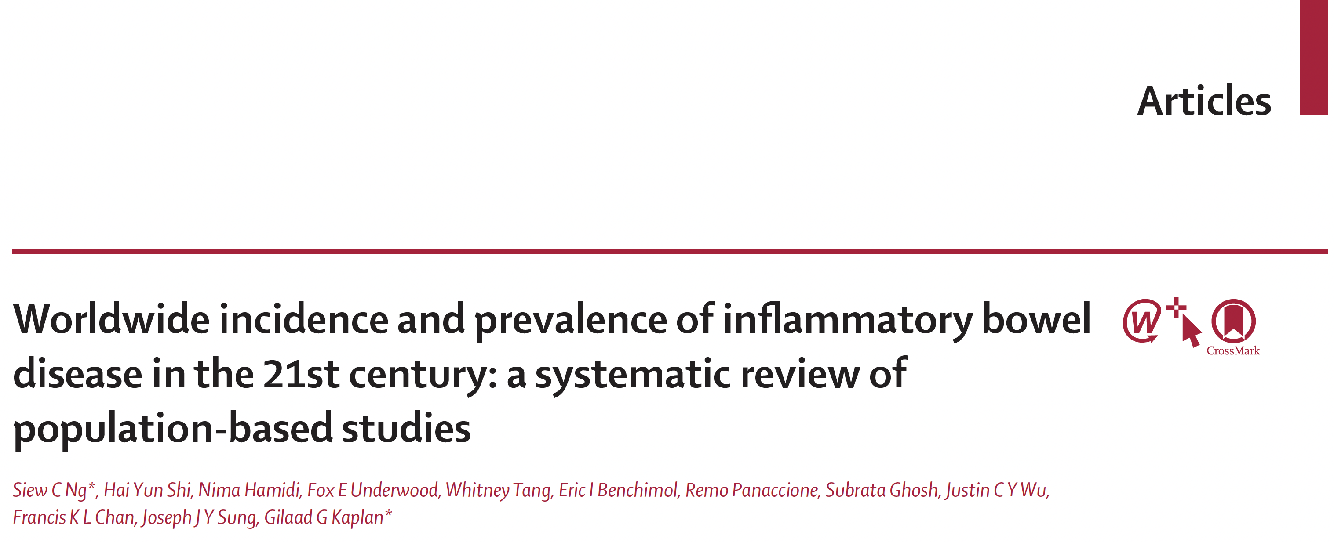
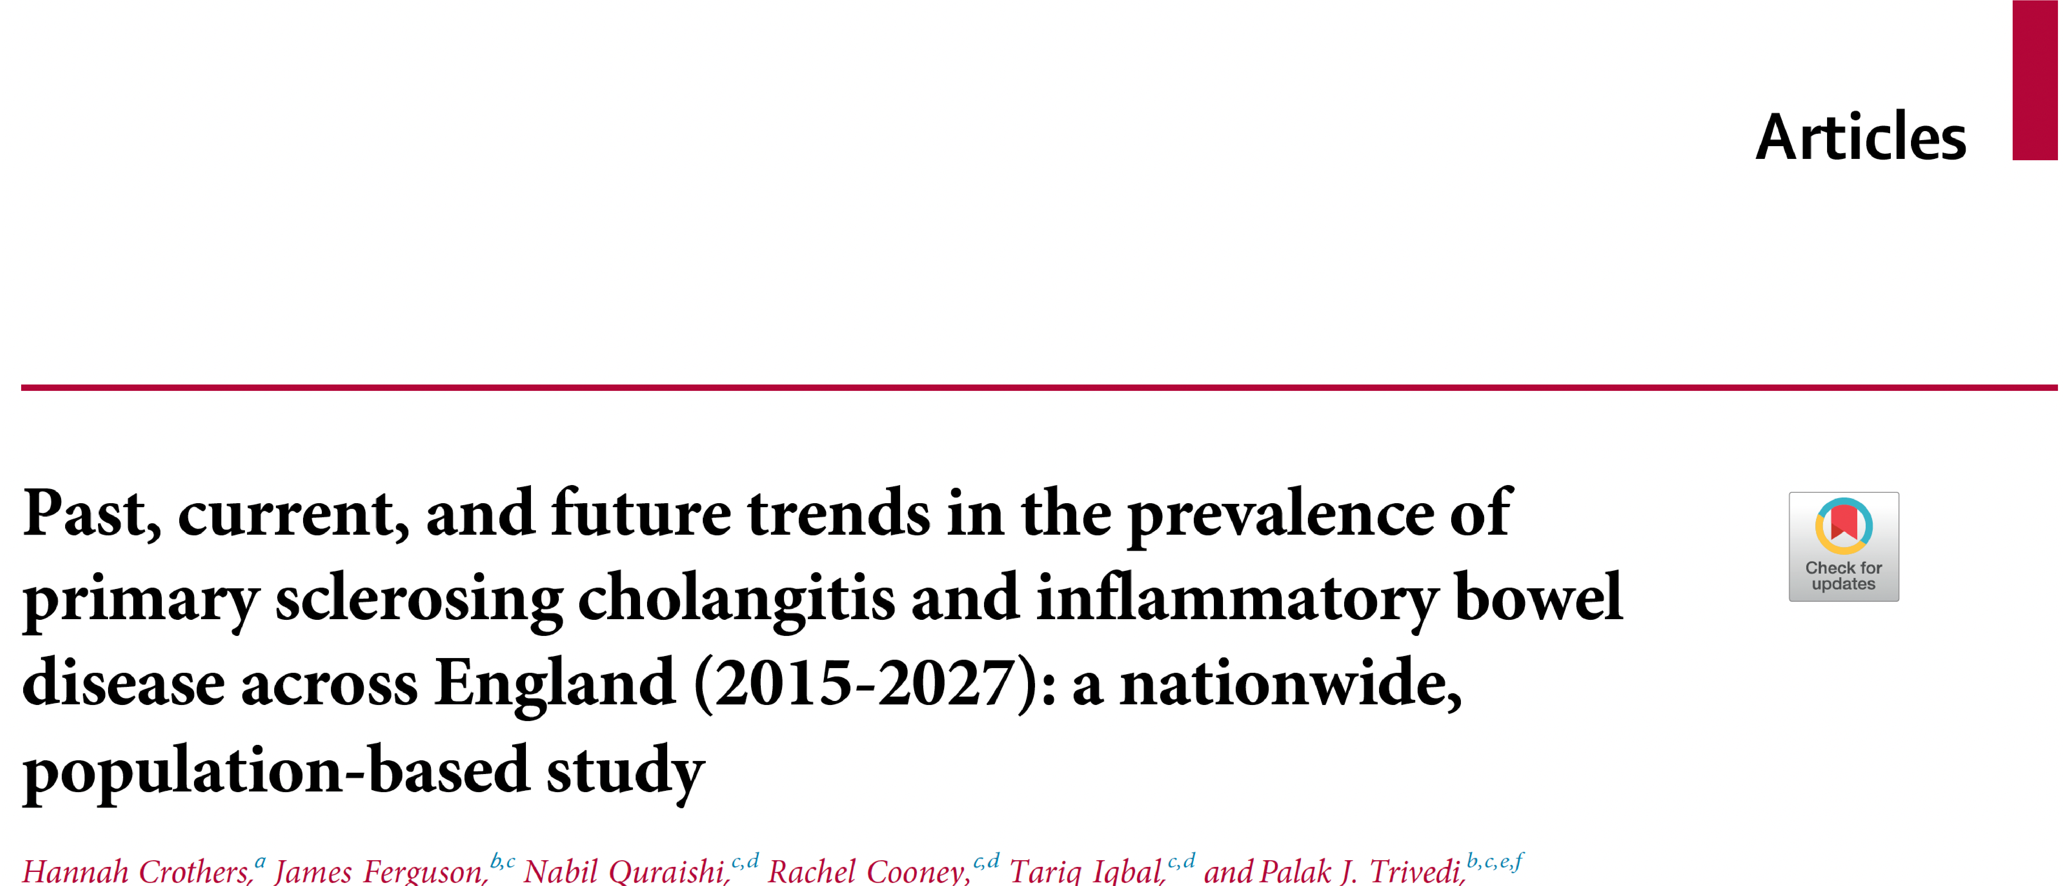
IBD incidence rising in newly industrialised countries.
IBD incidence stabilising / plateauing in the west
Prevalence rising globally
Current annual % change in IBD prevalence: 7.0%
Forecasted annual % change in IBD prevalence: 4.7%
Current annual % change in PSC-IBD prevalence: 8.8%
Forecasted annual % change in PSC-IBD prevalence: 6.4%
Relative risk of an IBD patient developing PSC iis increasing by 9% every five years.
Ng et al. Lancet 2017
Crothers et al. Lancet Europe 2024

Slide 10
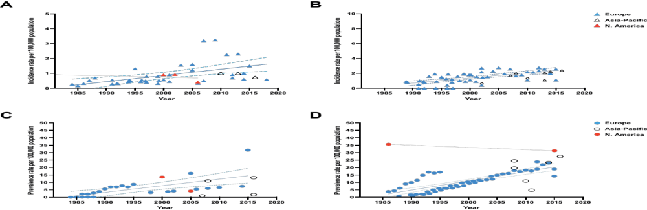
The incidence and prevalence of PSC are rising across Europe
Incidence
Prevalence
Trivedi et al. Gut 2021
Trivedi et al. Clin. Gastroenterol. Hepatol. 2022

Slide 11
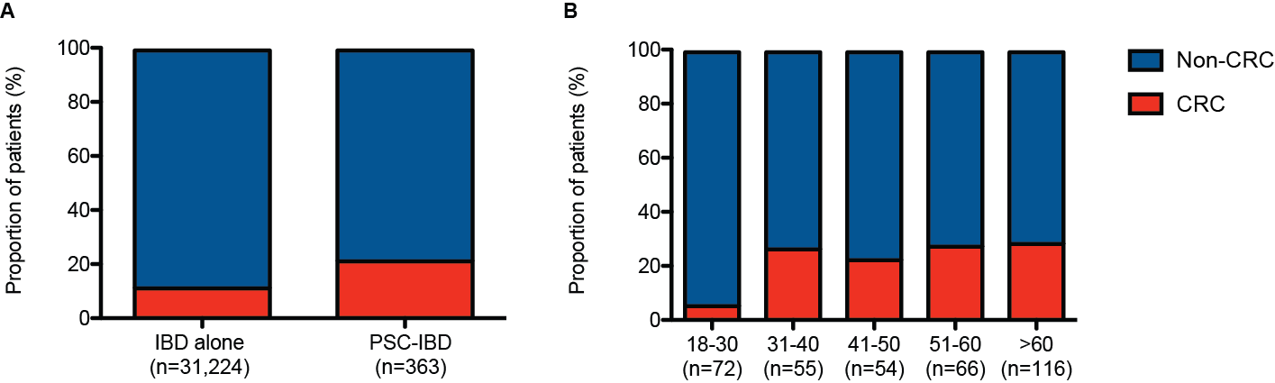
Indications for colonic surgery
UK data: 284,560 people with IBD; 2,588 with PSC
P<0.001
No high quality evidence for the treatment of colitis-associated with PSC
Trivedi et al. Gastroenterology 2020

Slide 12
Experience of biologics in PSC-IBD
Anti-TNFα (Infliximab, Adalimumab)
  Multi-centre study (IPSCSG); N=95: 3-month response 48%, 3-month remission 23% ¹
  2-centre study; N=228: Increased odds of acute cholangitis: 7.29 (95% CI 2.63-12.43) ²
Anti-α4β7 (Vedolizumab)
  Multi-centre study (IPSCSG); N=36: median Tx duration 412d (IQR 180–651d)
  Mean Mayo Colitis Subscore (2.2 ± 0.8 to 1.4 ± 0.9; P<0.001) ³
JAK inhibitors (Tofacitinib mainly)
  Multi-centre study (IPSCSG); N=43: median Tx duration 13.1 mo. (IQR 16.7mo.)
  21 discontinued therapy (2 due to adverse events); colitis activity improved in the majority
1. Hedin et al. Clin. Gastroenterol. Hepatol. 2020
2. Kulkarni et al. Inflamm. Bowel. Dis. 2021
3. Lynch et al. Clin. Gastroenterol. Hepatol. 2019
4. Schregel et al. Clin. Gastroenterol. Hepatol. 2023

Slide 13
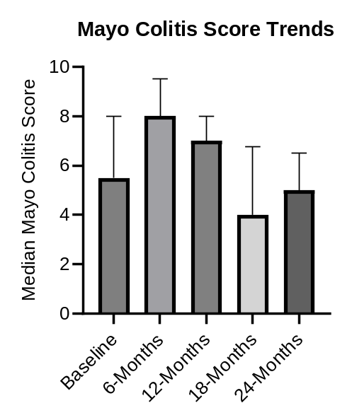
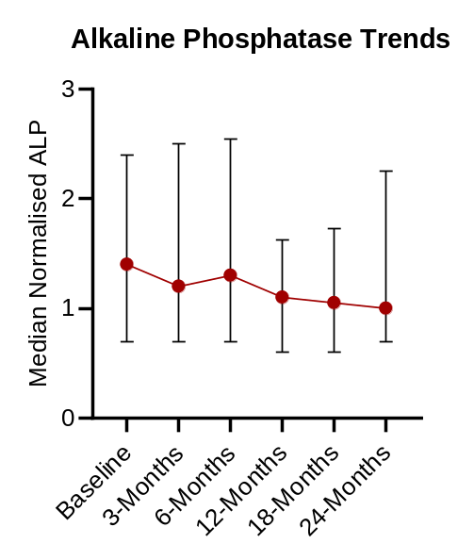
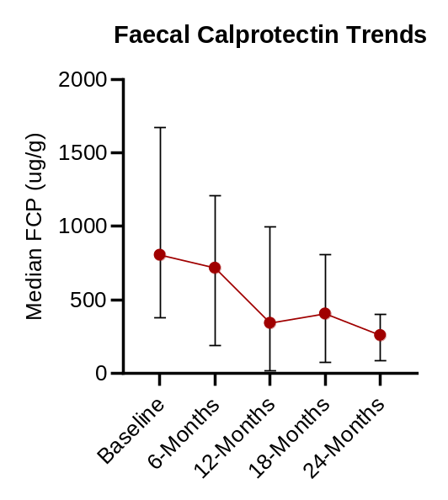
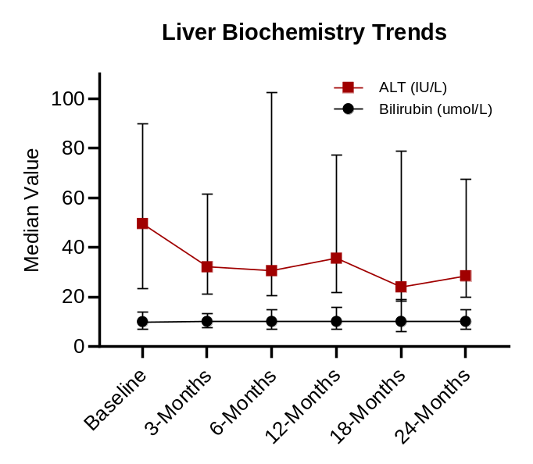
IBD and liver biochemical responses to anti-IL23 agents in PSC-IBD
- N=66 pts.; 62 on ustekinumab
- Median treatment time 9 mo. (IQR 5-24 mo.)
- IBD response observed in 15% at 6 mo.
- Changes in ALP values non-significant.
Al-Shakhshir et al. (AASLD 2024; manuscript in preparation)

Slide 14
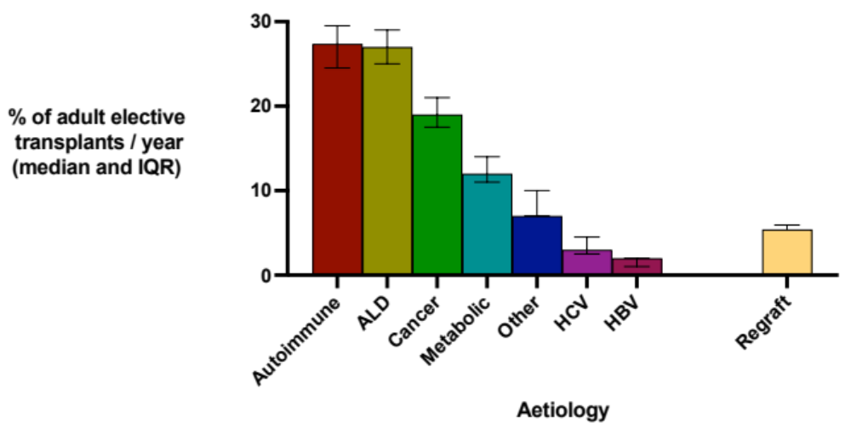
Autoimmune liver disease: a lead indication for adult liver transplantation in the UK
PSC 12 (IQR 10-14) %
PBC 8 (IQR 7-8) %
AIH 7 (IQR 7.5-8.5) %
UK NHS Blood and Transplant Registry 2017-2023

Slide 15
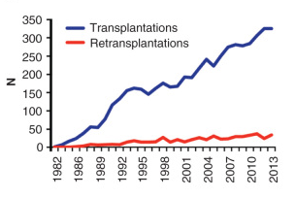
PSC is a leading indication for transplantation in Europe
Nordic liver transplant programme
- 15.3% are performed for PSC
French liver transplant programme
- PSC was predicted to be the lead indication by 2025
Fosby et al. Scand. J. Gastro 2015
Conolly et al. J. Hepatol./ EASL ILC 2020A

Slide 16
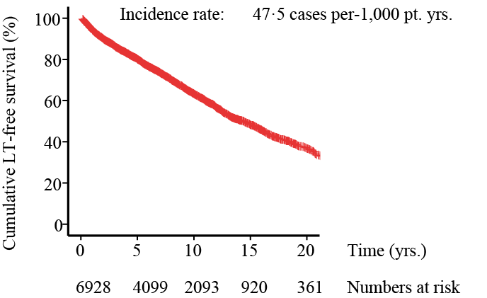
Natural history: Data from the International PSC Study Group
Trivedi,* Weismuller* et al. Gastroenterology 2017
International PSC Study Group Data; n=7,119 pts, 37 centres

Slide 17
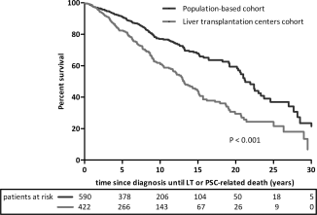
Referral bias highlighted through population-based cohorts
Coverage of 50% of the Dutch population ¹
Nationwide data from England:
Death and transplant rates lower for patients diagnosed at non–transplant vs liver transplant centres
17.6 vs. 33.1/1000 patient years
Incidence rate ratio: 0.5; P <0.001.
Boonstra, et al. Hepatology 2013
Trivedi et al. Gastroenterology 2020

Slide 18
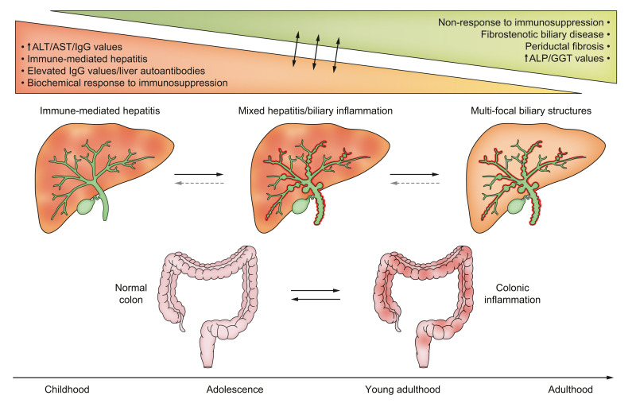
Evolution of autoimmune hepatitis to PSC in people of young presenting age
Ricciuto,…,Trivedi J. Hepatol. 2023

Slide 19
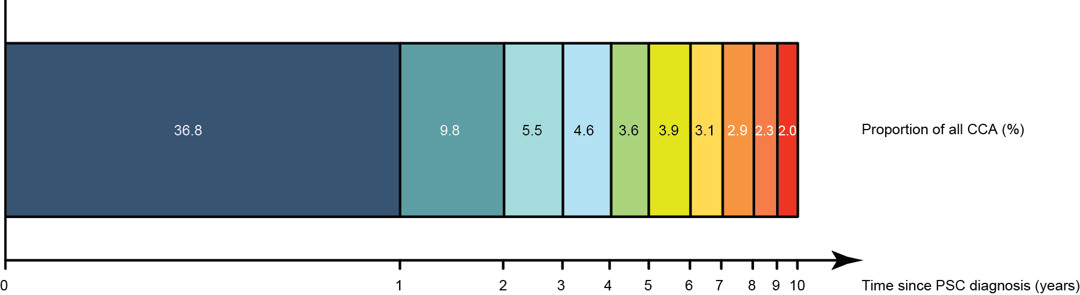
There is a risk of cholangiocarcinoma, but this falls over time
(International PSC Study Group data: 7,119 with PSC; 594 with CCA)
Trivedi* Weismuller* et al. Gastroenterology 2017

Slide 20
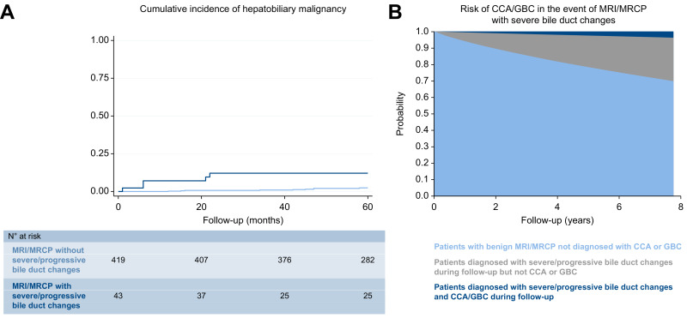
Does radiological surveillance add value?
Villard,…,Bergquist et al. J. Hepatol. 2022
Sweden

Slide 21
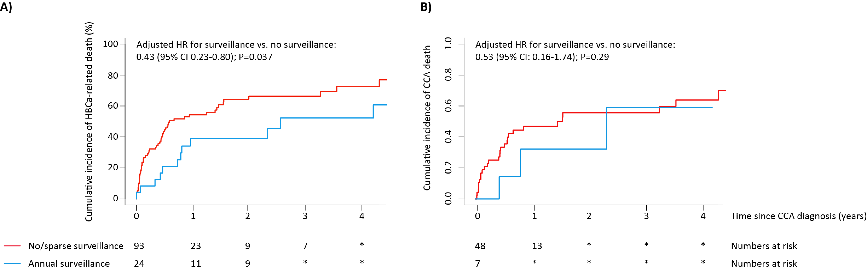
Annual imaging surveillance is associated with reduced risk of cancer-associated death
Trivedi et al. Gastroenterology. 2020

Slide 22
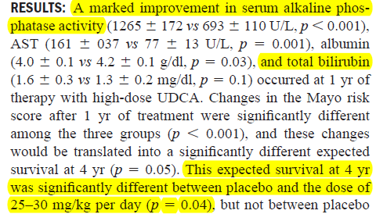
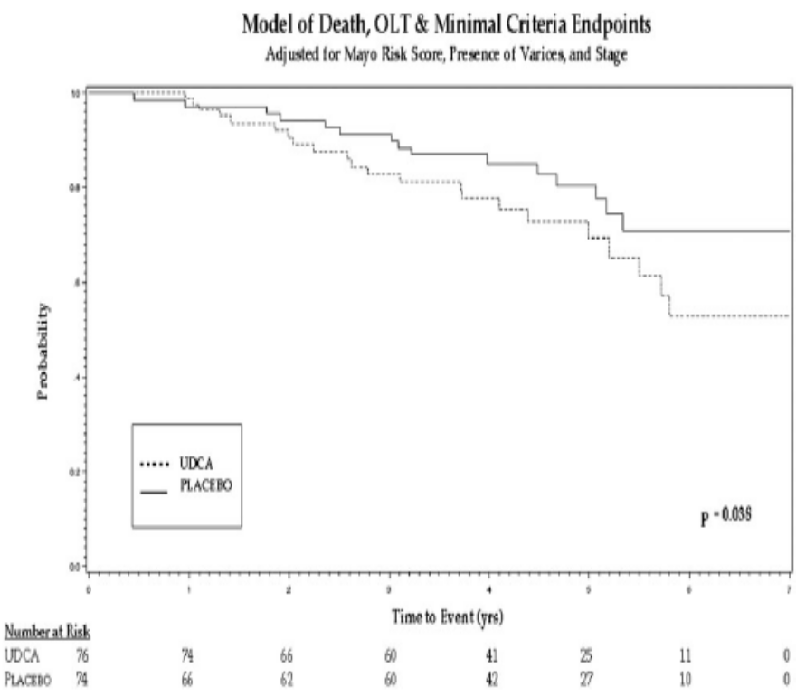
Lessons from UDCA Trials
Pilot study: 30 patients,
UDCA 25-30 mg/kg/d, 1 year
Randomised control trial
28-30 mg/kg/d
RR = 2.11 (1.04-4.28)
Harnois et al. Am J Gastroenterol 2001
Lindor et al. Hepatology 2009

Slide 23
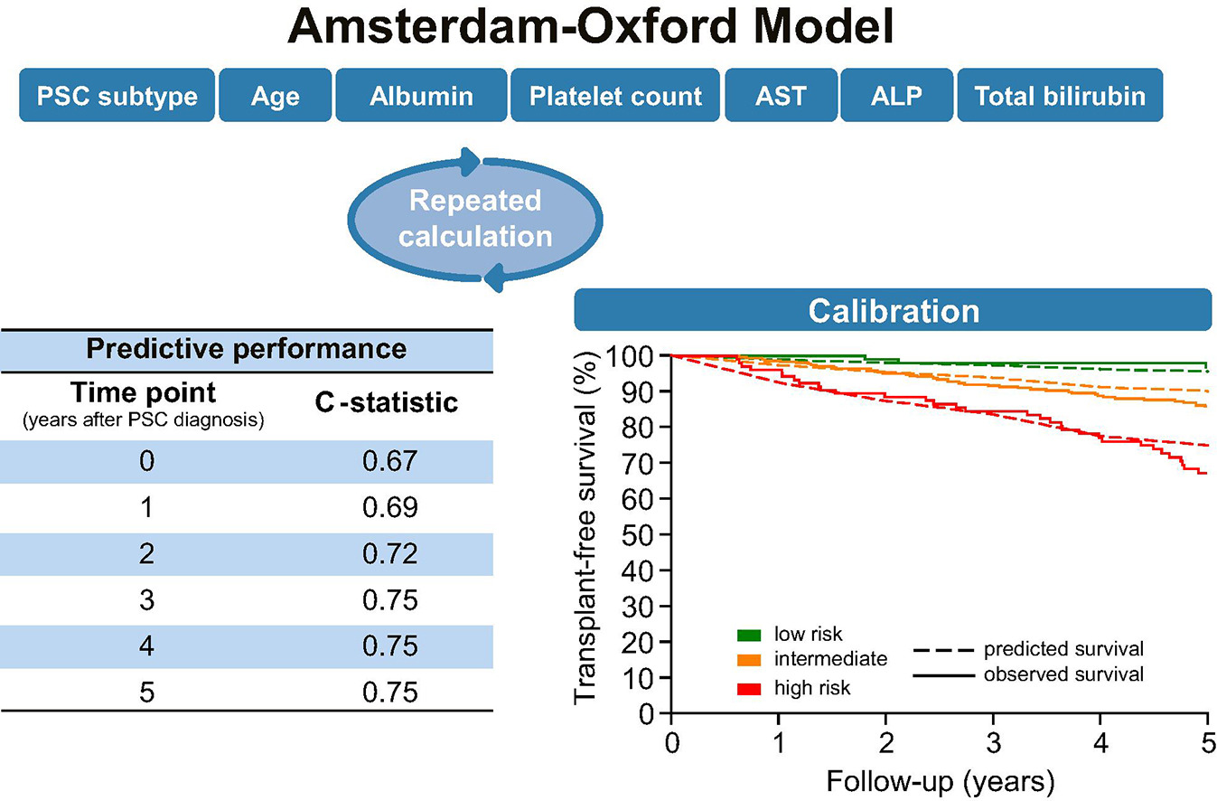
de Vries et al. Gut 2017
Goet et al. J. Hepatol. 2019

Slide 24
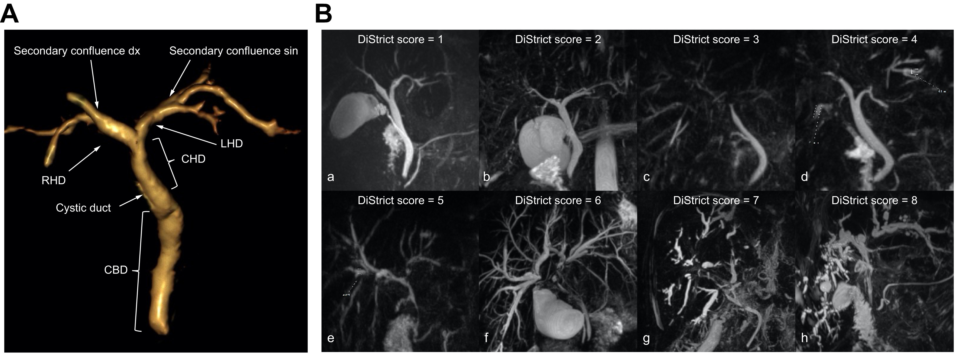
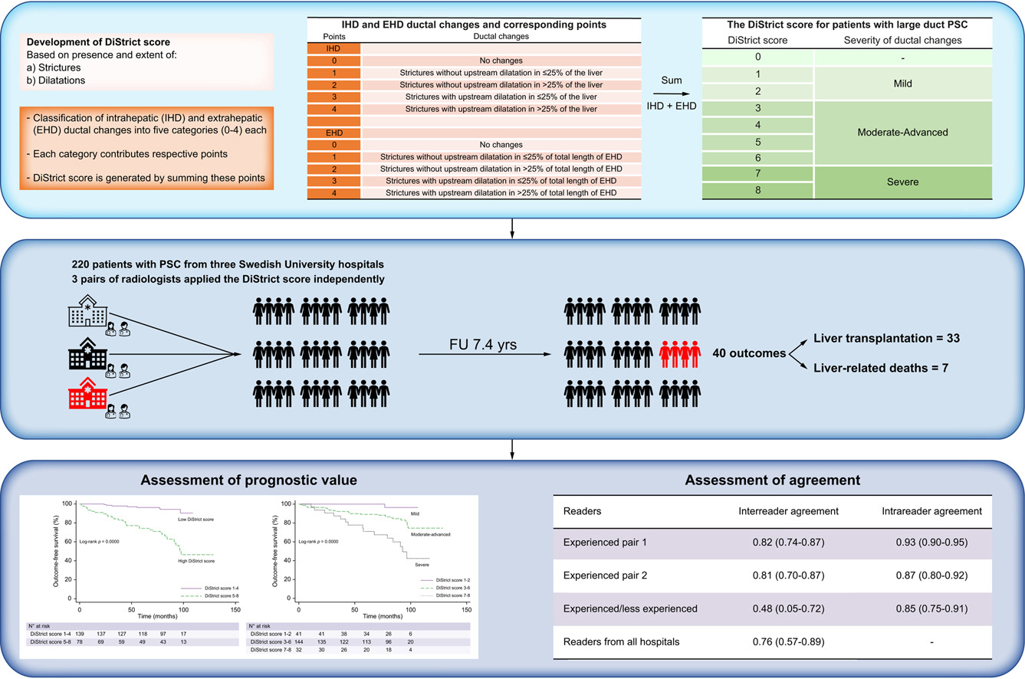
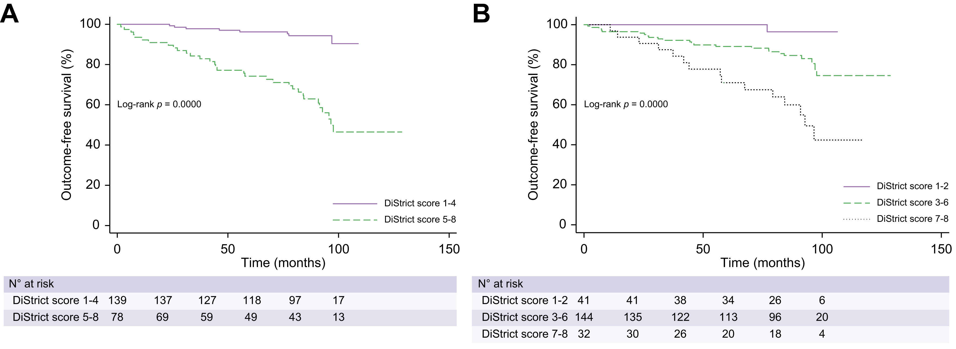
Extent of ductal disease progression associates with clinical outcomes
Grigoriadis et al. JHep Rep. 2022

Slide 25
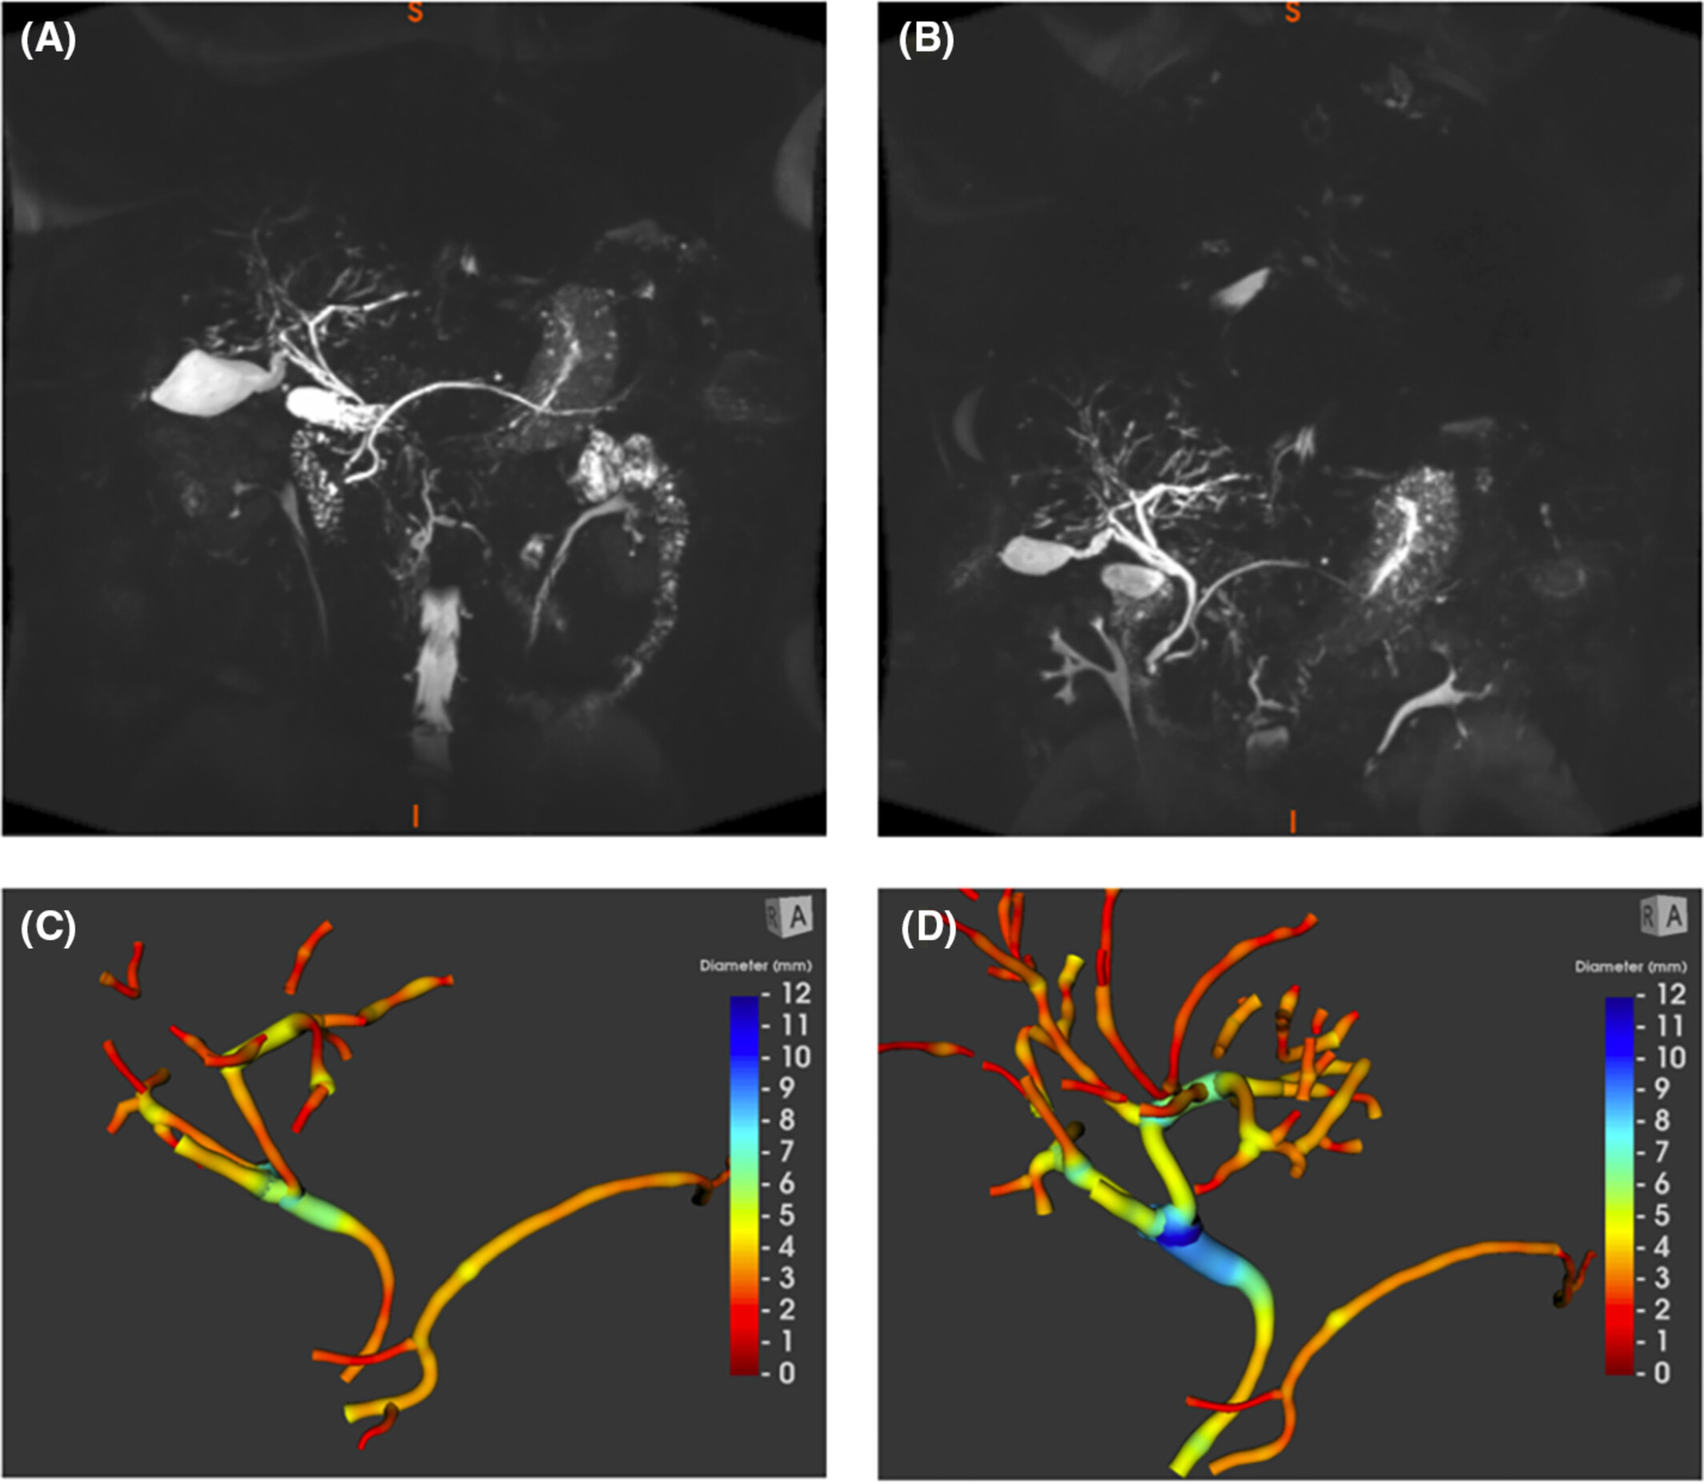
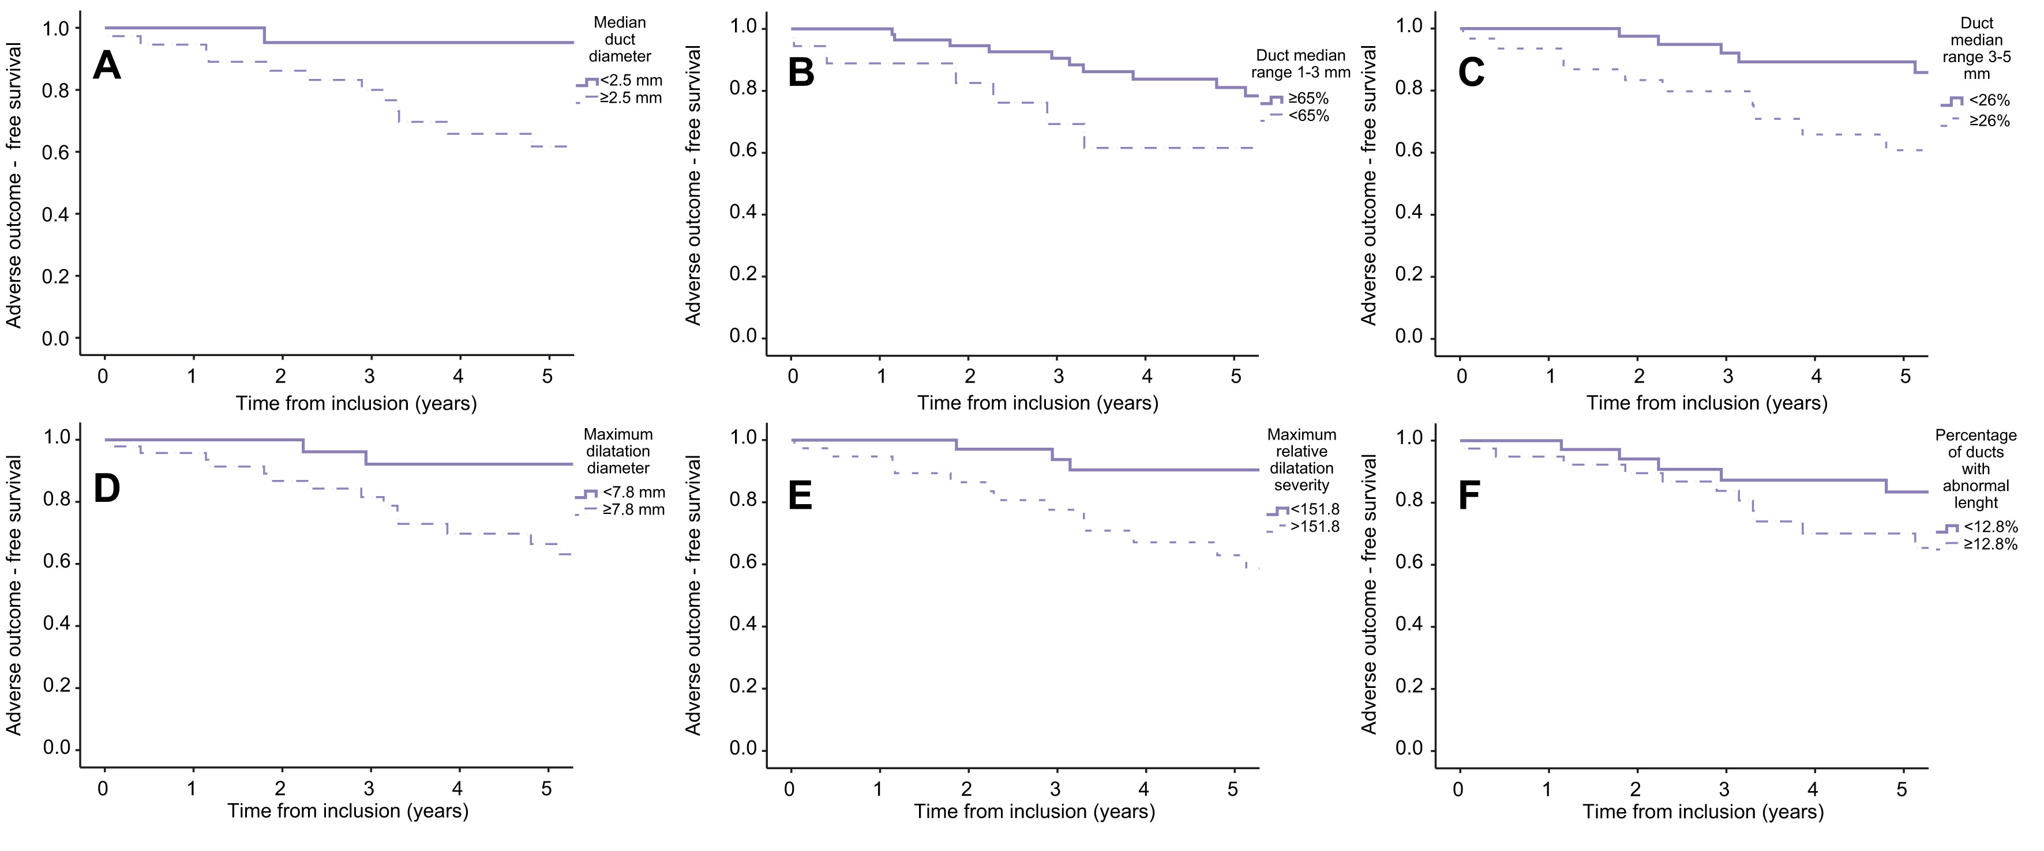
Association between quantitative biliary metrics and clinical outcomes in PSC
Trivedi et al. Aliment. Pharmacol. Ther. 2024
Cazzagon et al. JHep Rep. 2022

Slide 26
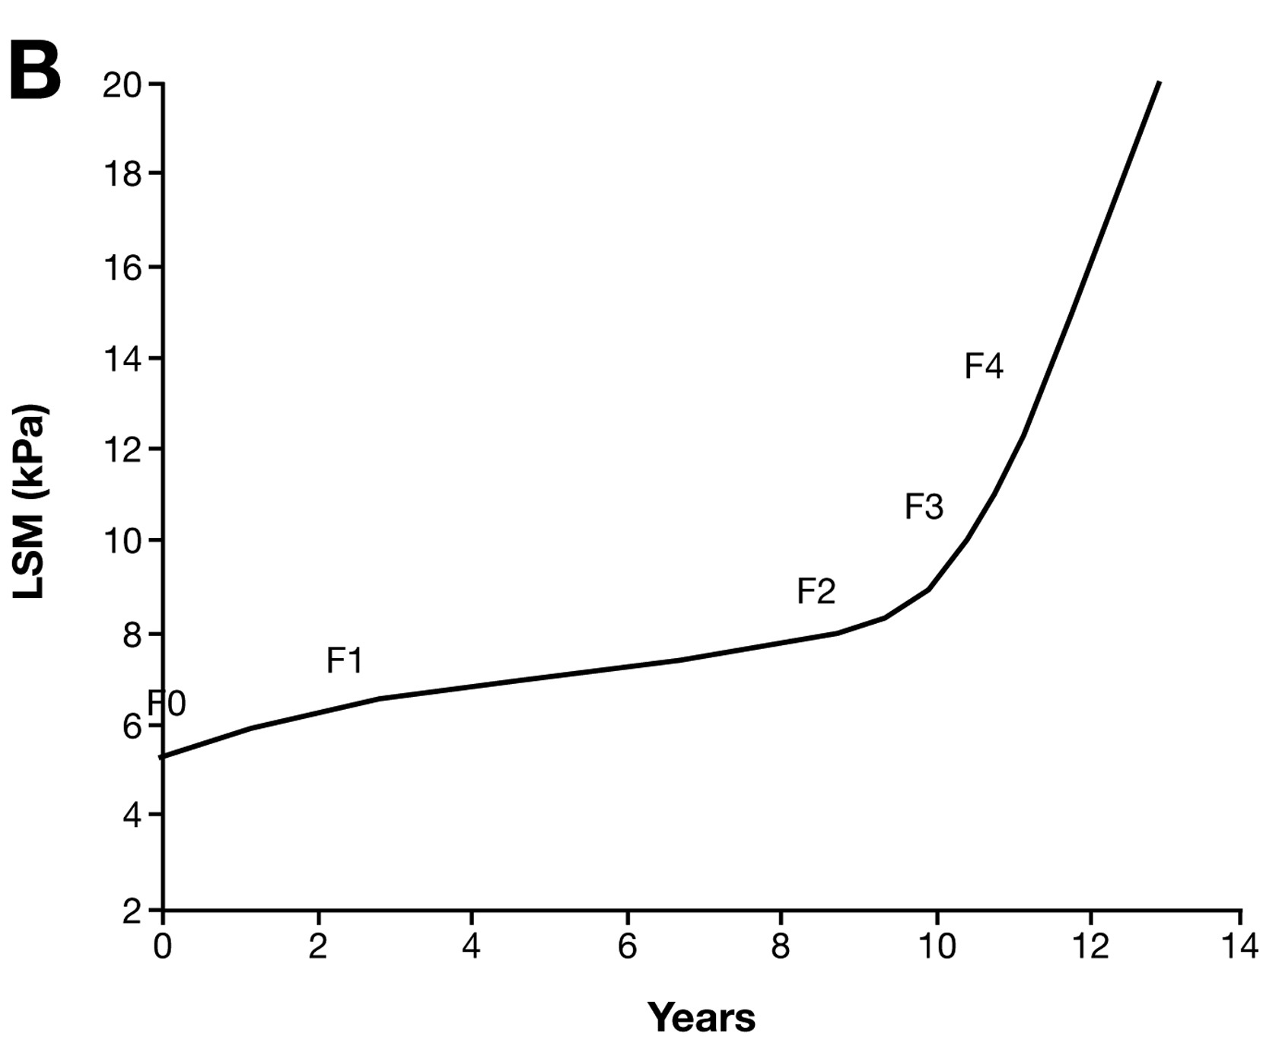
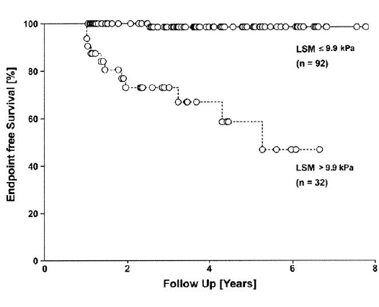
Prognostic utility of transient elastography in PSC
♠ Transplant and complication-free survival: 168 patients, mean F/Up: 4 years
Corpechot et al. Gastroenterology 2014

Slide 27
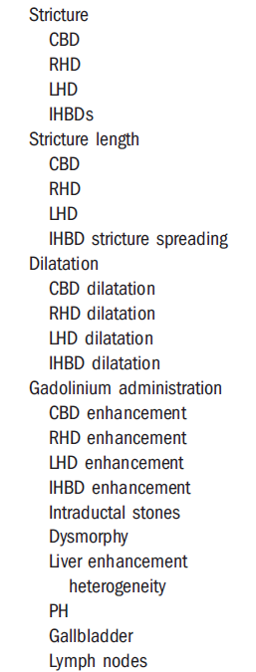
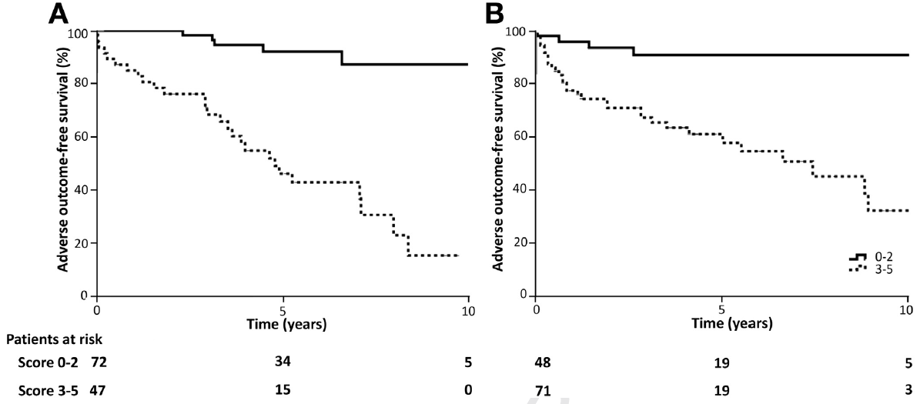
MRI-based scoring systems: MRCP
♦MRI progression risk score (without gadolinium):
1 x dilatation IHBD + 2 x dysmorphy +1 x Portal HT
♦ MRI progression risk score (with gadolinium):
1 x dysmorphy + 1 x parenchymal enhancement heterogeneity
Derivation: Paris
Validation: Bham, Padua, Montreal
Ruiz et al, Hepatology 2014
Lemoinne,…, Trivedi et al. Clin. Gastroenterol. Hepatol. 2019

Slide 28
Primary sclerosing cholangitis industry drug development pipeline
 |  |  | Volixibat potassium Mirum Pharmaceuticals IBAT inhibitor
 |  |  | Berberine ursodeoxycholate HighTide Therapeutics Unspecified
 |  | SCO-240 Scohia Pharma SSTR5 antagonist | CM-101 Chemomab/Abzena CCL24 antagonist
GRI-0124 GRI Bio NKT cell stimulant | HM-15211 Hanmi Pharmaceutical GLP-1/GIP/GCG agonist | Ritivixibat IPSEN Pharma ASBT inhibitor | HK-660S Curome Biosciences NAD+ modulator
H-01 Halo Biosciences Hyaluronan synthase inhibitor | Metabolic and infectious disease therapy CD3 Centre for Drug Design ASBT inhibitor | CS-0159 Cascade Pharmaceuticals FXR agonist | Orbcel-C Orbsen Therapeutics IV MSC therapy
Rock2 Inhibitor Angion Biomedica ROCK2 inhibitor | PSC therapy Engitix Therapeutics Unspecified | HPG-1860 Hepagene Therapeutics FXR agonist | PLN-74809 / Bexotegrast Pilant Therapeutics a1b6 integrin antagonist
ST-003 SteroTherapeutics GAL antagonist | PV-201 Parvus Therapeutics Unspecified | INVA-8001 Invea Therapeutics Immunosuppressant | Elafibranor Ipsen PPAR-a/PPAR-d agonist
BX-002 BiomX Microbiome modulator | Setanaxib Calliditas Therapeutics NADPH oxidase 1/4 inhibitor | STP-707 Sirnaomics TGF-β1/Cox-2 gene inhibition | Vidofludimus calcium Immunic 4SC DHODH inhibitor | Norursodeoxycholic acid Dr. Falk Pharma/Eisai Choleretic
Preclinical | Preclinical (continued) | Phase I | Phase II | Phase III
Trivedi et al. (unpublished)

Slide 29
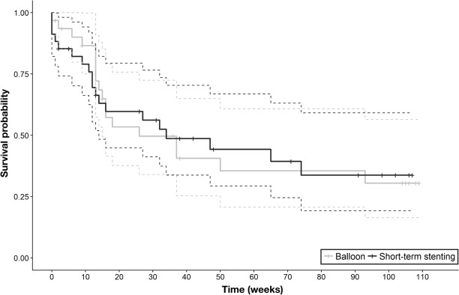
High-grade biliary strictures: evidence is in favour of dilation alone over biliary stenting
SAEs:
Stent: 45%
Dilation alone: 6%
Survival free of dominant strictures
P=1.0
Ponsioen et al. Gastroenterology 2018

Slide 30
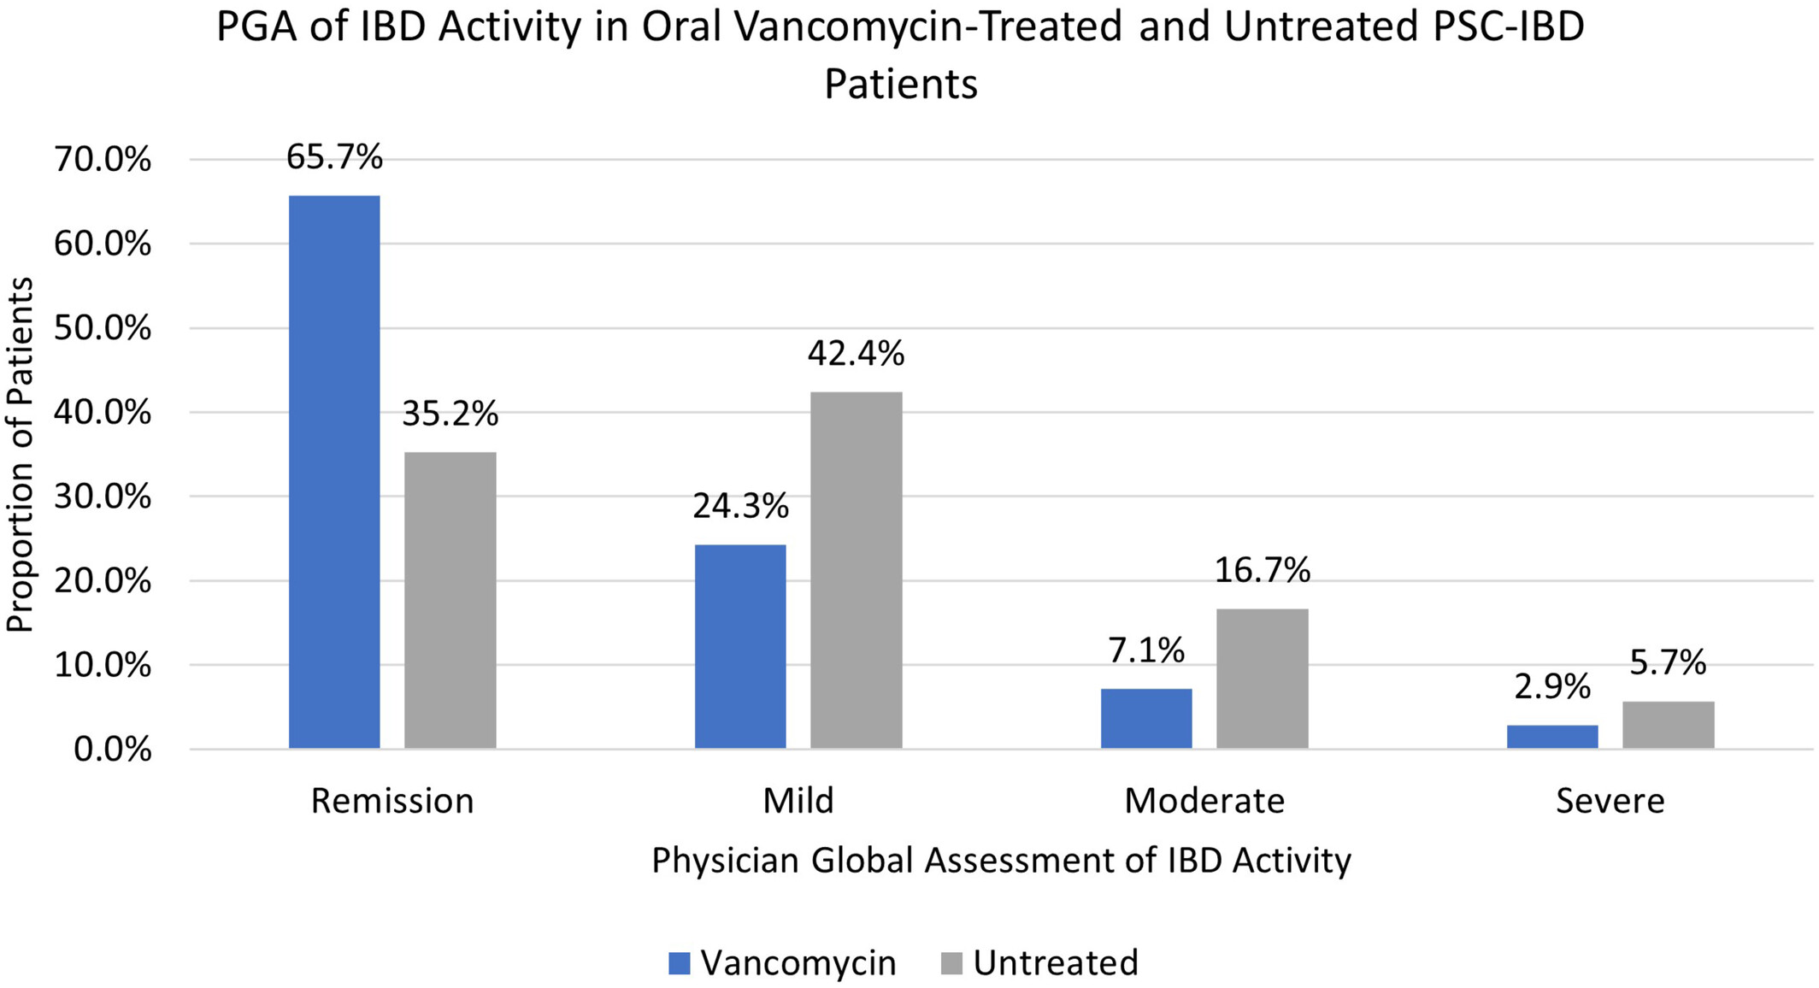
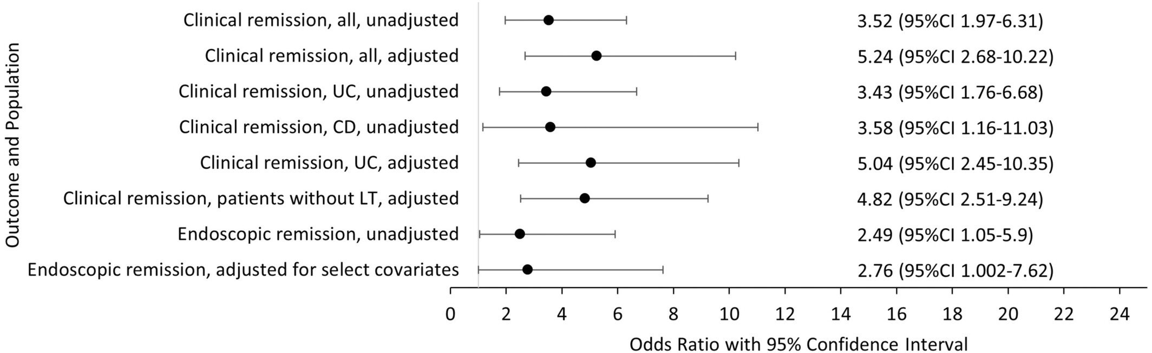
Oral vancomycin is associated with improved IBD outcomes in PSC
Ricciuto et al. APT. 2024
International Paediatric PSC Consortium

Slide 31
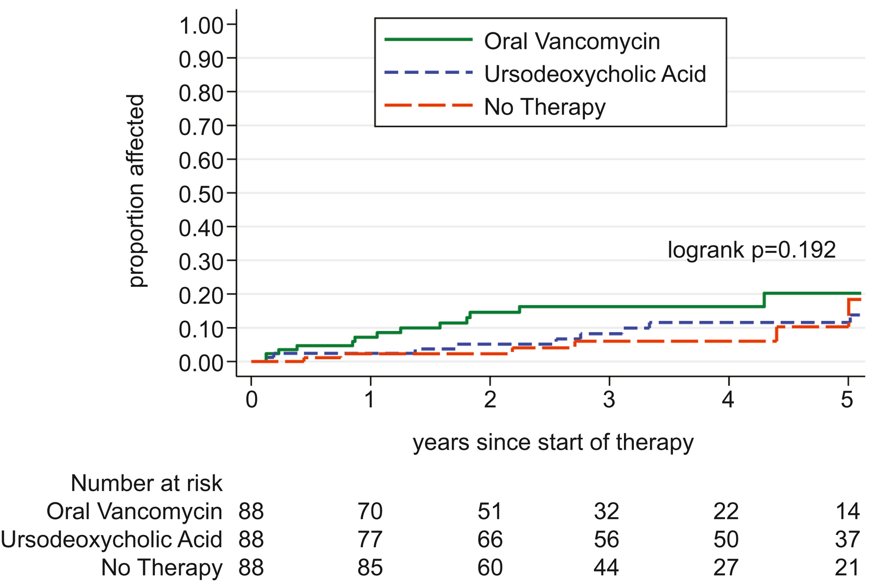
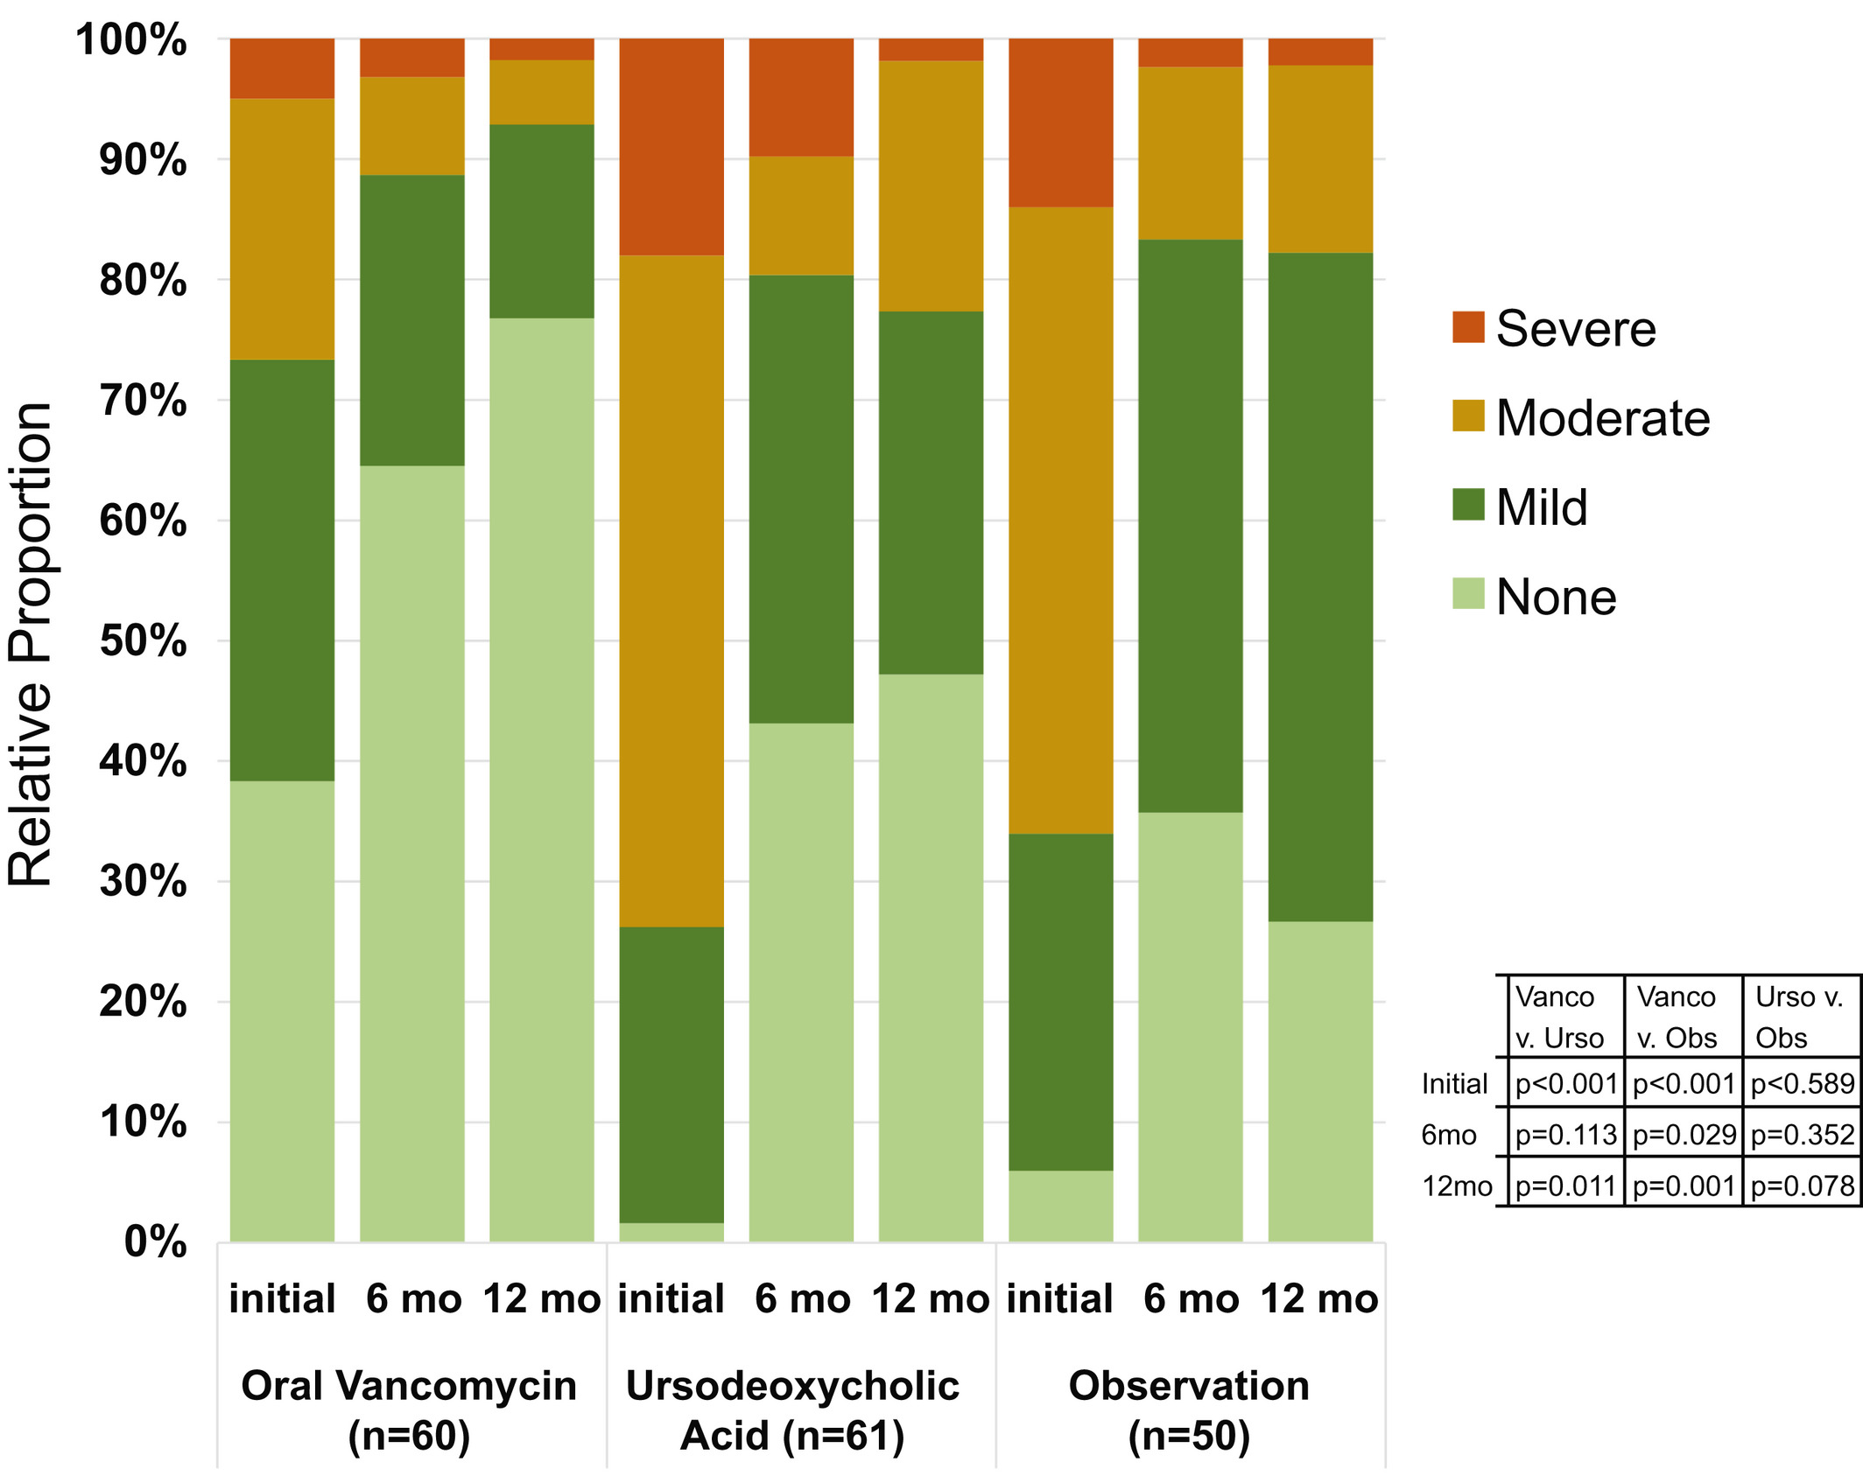
Impact of vancomycin on liver-related outcomes in PSC is less clear
Deneau et al. Hepatology. 2020

Slide 32
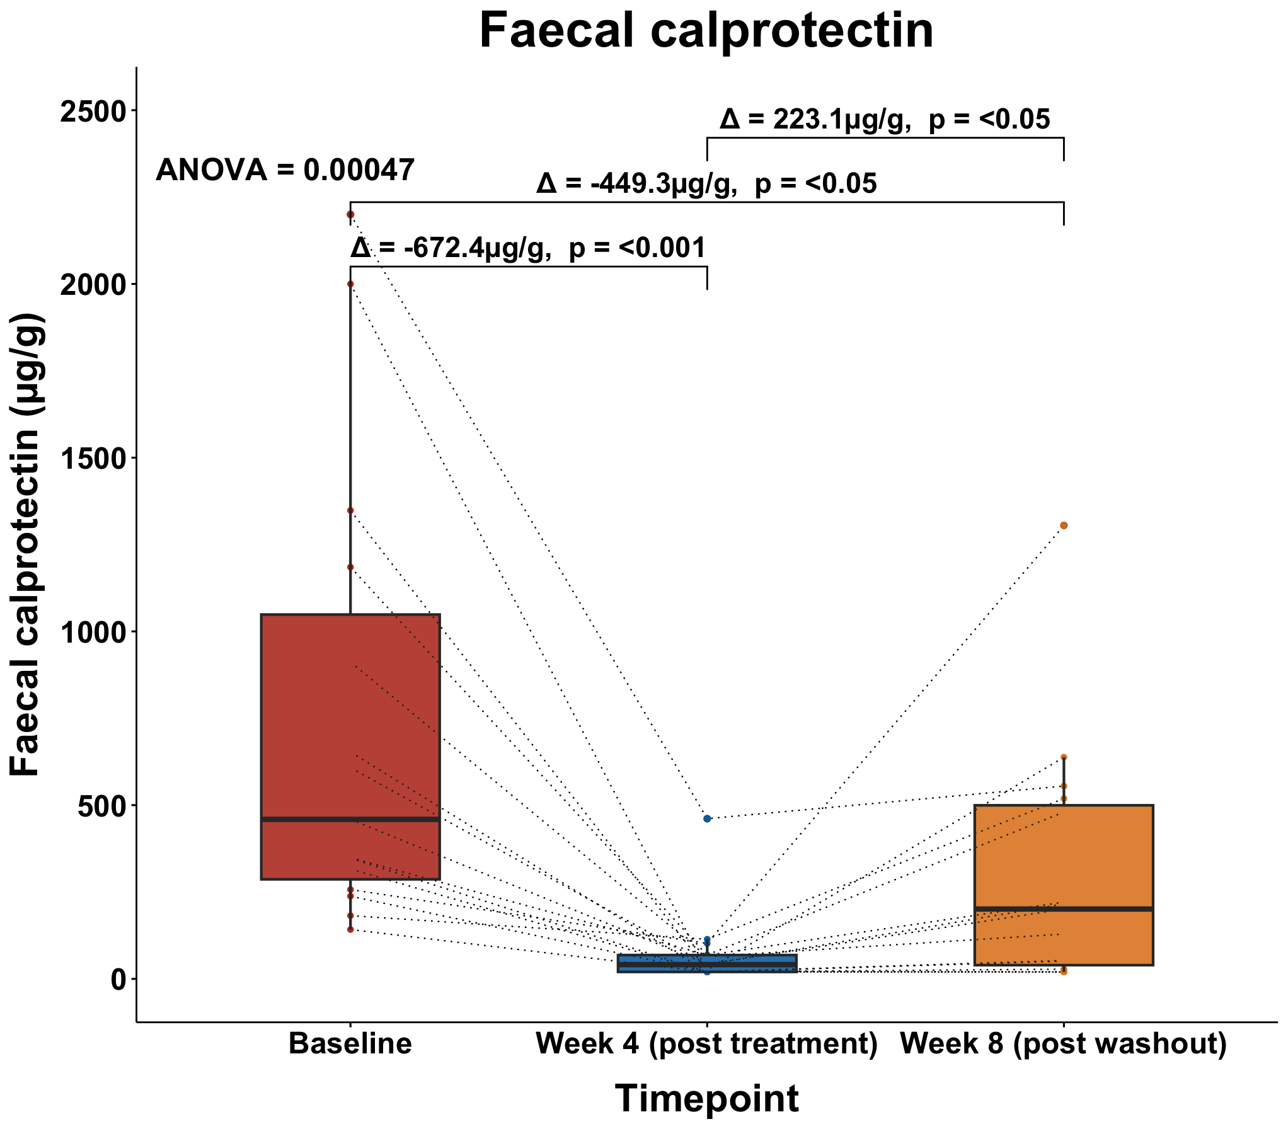
Oral vancomycin as a treatment for PSC-colitis (NCT05376228)
Quraishi et al. (under revision)

Slide 33
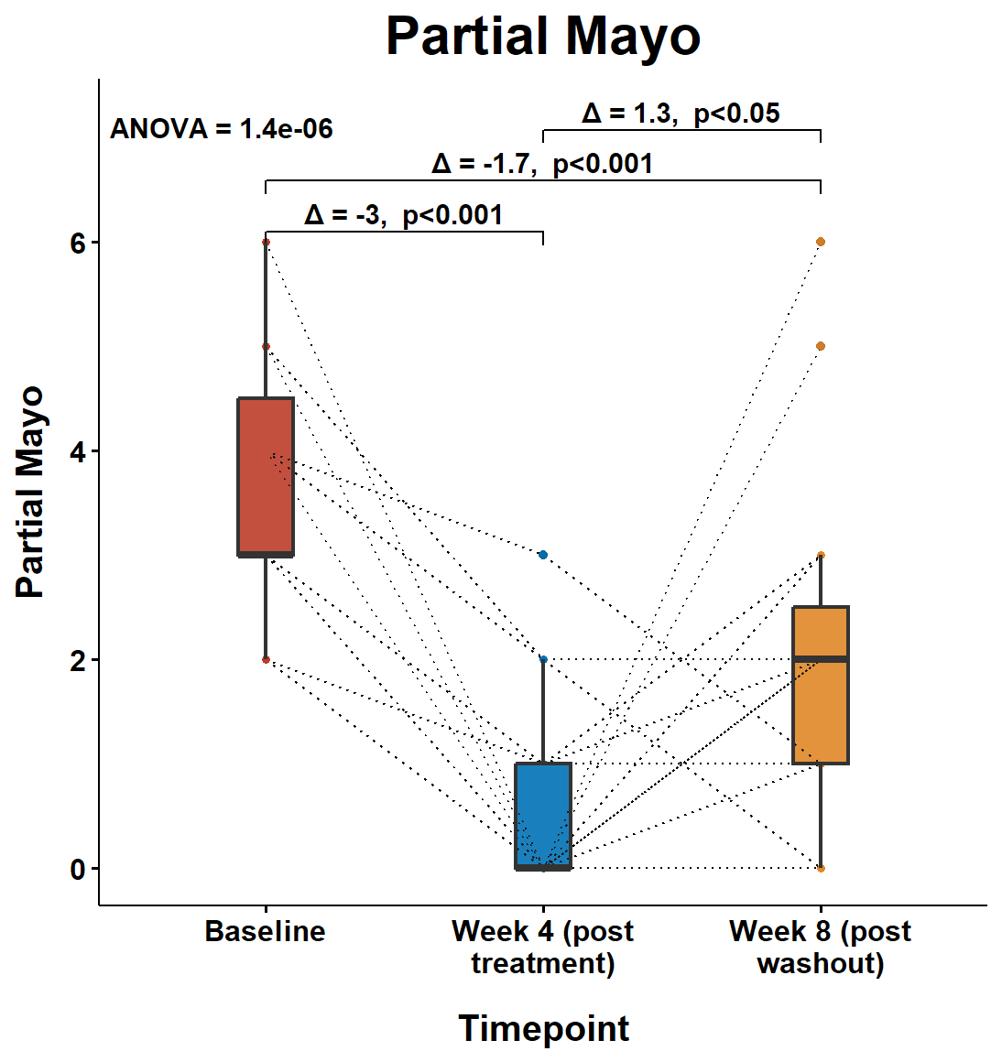
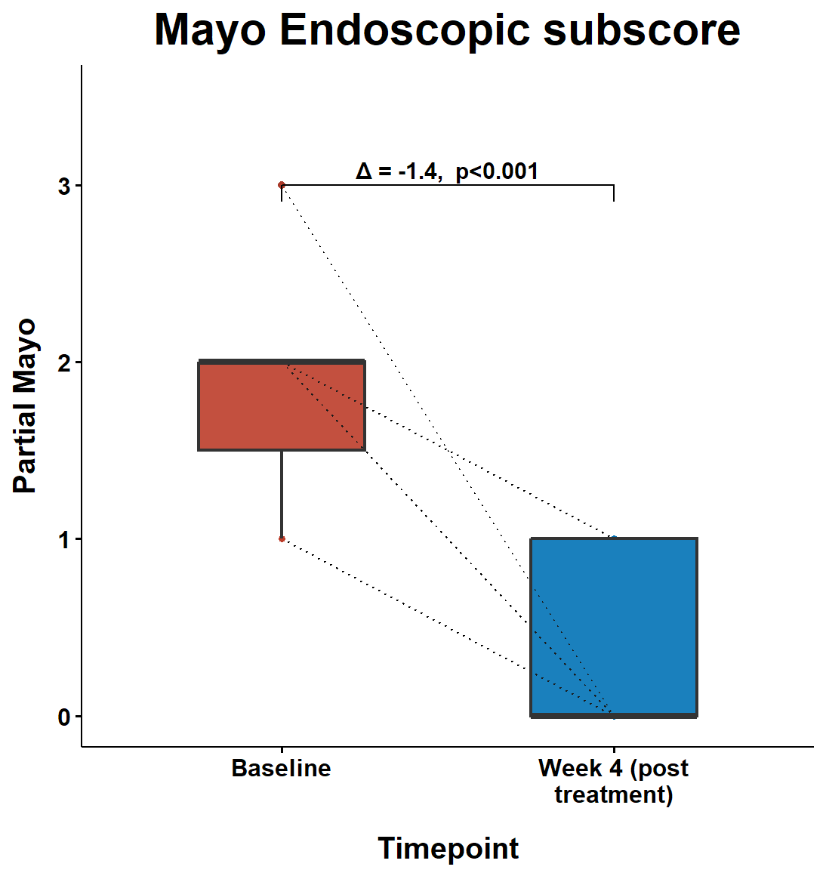
Clinical outcomes – Mayo scores
Quraishi et al. (under revision)

Slide 34
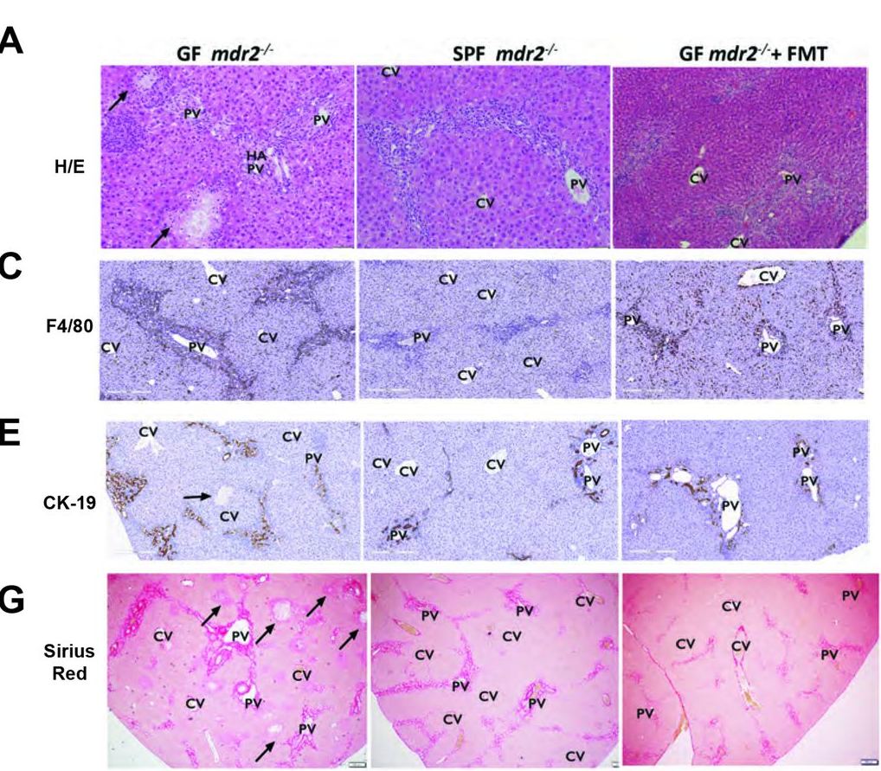
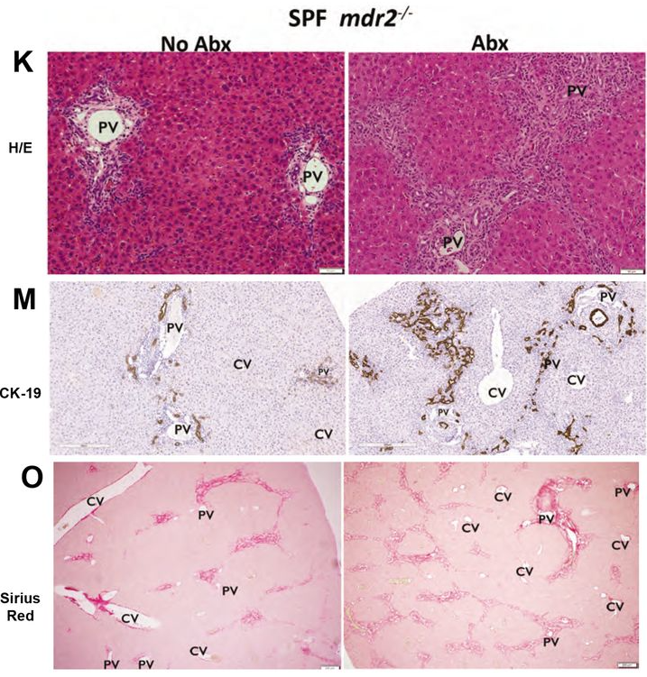
Vancomycin exacerbates, whereas faecal microbiota transplantation attenuates biliary injury in mice
Awoniyi et al. Gut 2022

Slide 35


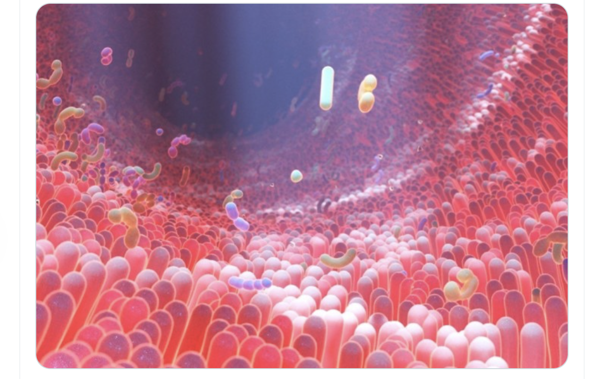
NCT06286709
LifeArc Grant Awarded 2021
Nationwide study: placebo-controlled RCT

Slide 36
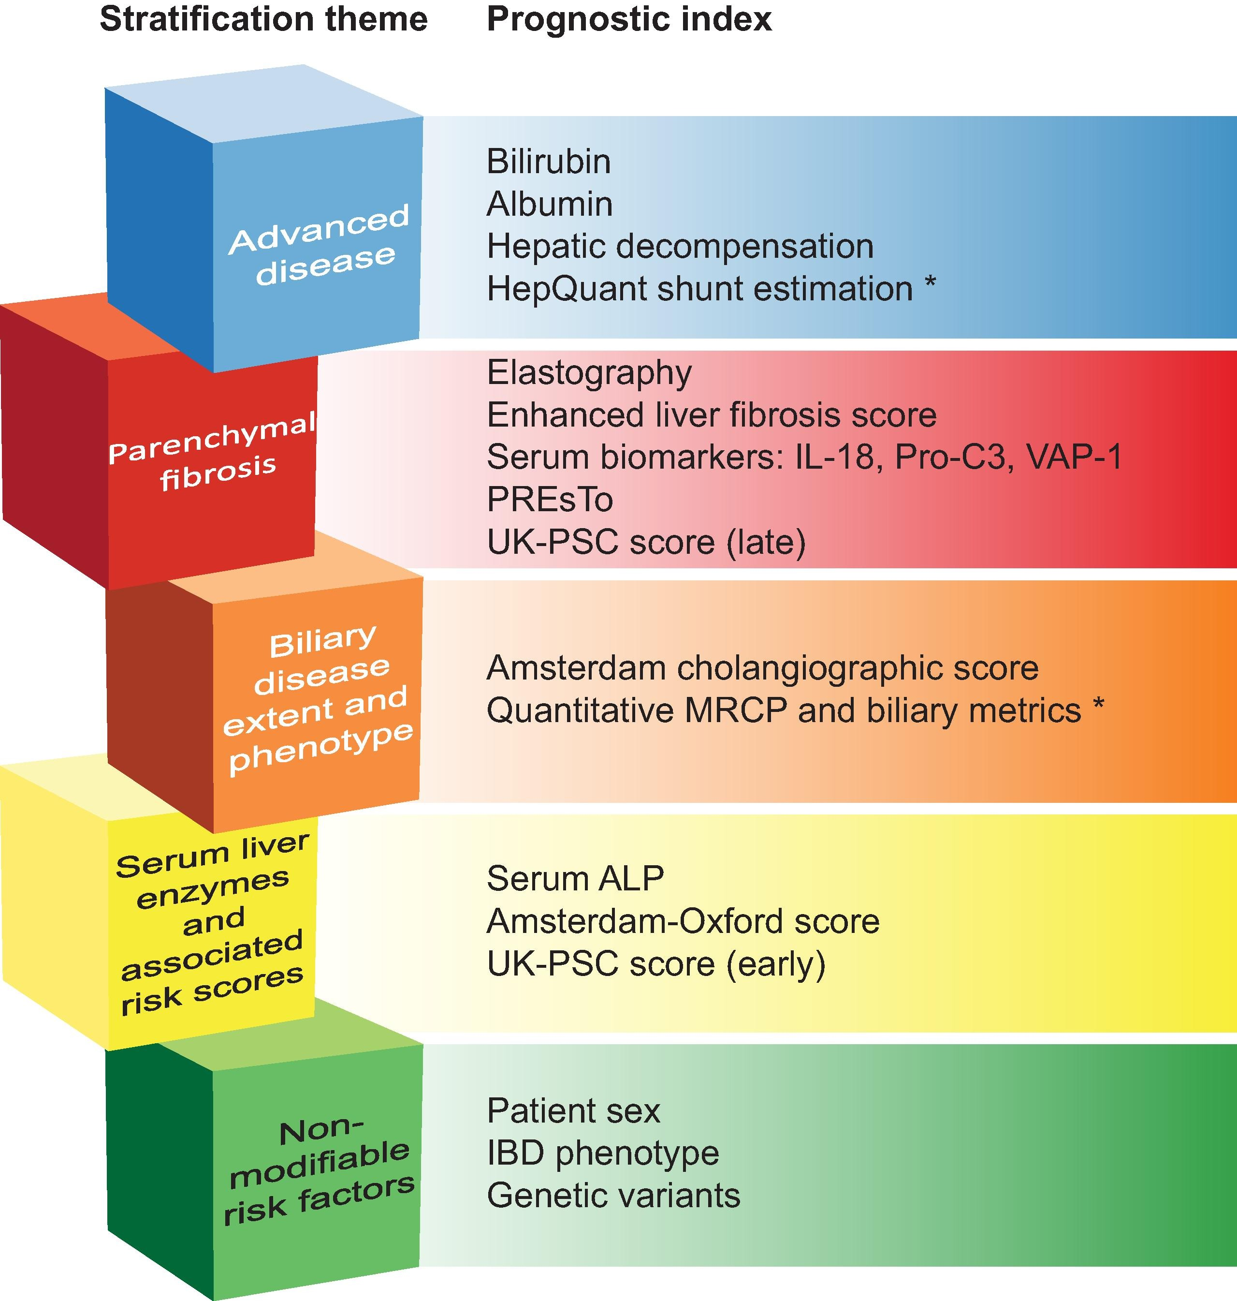
Estimating risk and what to do about it
Is a liver transplant assessment needed now?
- Persistent jaundice or hepatic decompensation
- Recurrent infections (cholangitis flares) despite antibiotics
Is a non-transplant intervention needed now?
- Compensated cirrhosis? (Trials coming)
- Dominant (clinically relevant) biliary stricturing
All with large duct PSC, controlled colitis, and non-cirrhotic disease
- Eligible for any current / future clinical trial?
- Eligible for (will they benefit from) an ‘off-license’ medicine?
Trivedi J. Hepatol. 2019

Slide 37
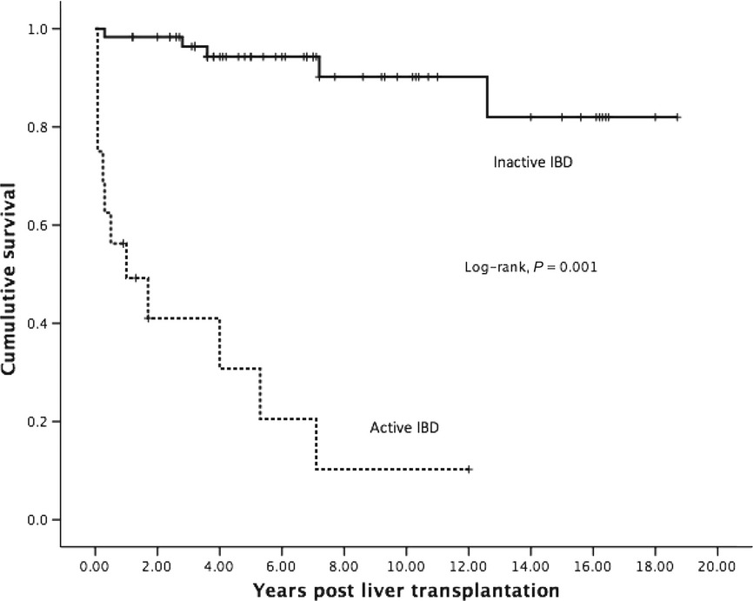
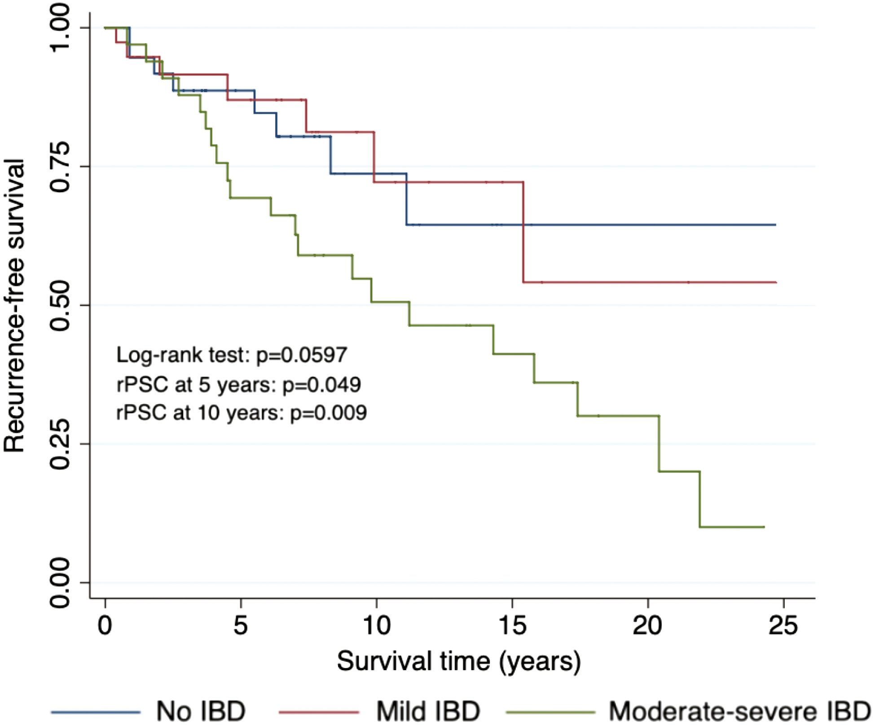
Active colitis before transplantation is a risk factor for graft loss and recurrent PSC
Graft survival post transplant in PSC
London, UK: n=110
Recurrent PSC
Australia (2-centre study): n=112
Risk of mod-severe vs. quiescent-mild IBD: 8.8, 2.8-27.6, P<0.001
Rec-PSC in severe, moderate and mild active IBD:
64% vs 18% vs 20%; p <0.001.
Joshi et al. Liver Int. 2013
Peverelle et al. Inflamm. Bowel. Dis. 2020
Notes:
1 missing patient

Slide 38
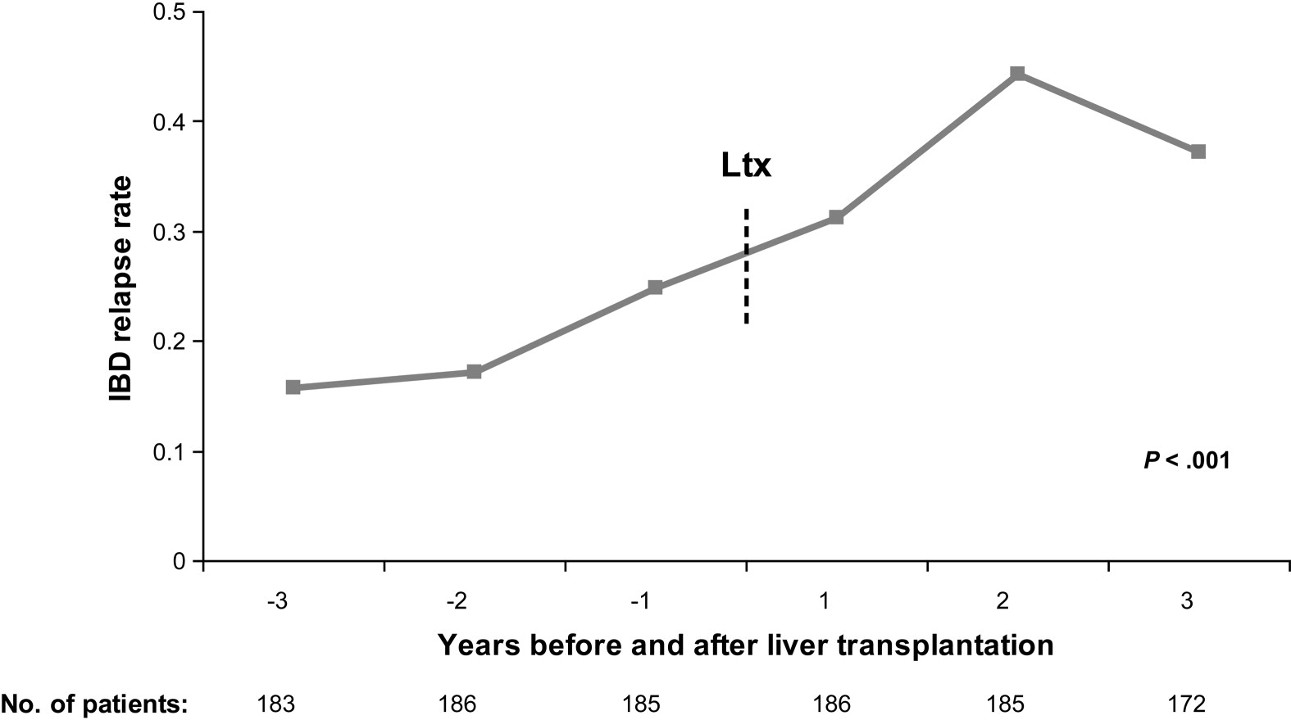

Deterioration in PSC-associated IBD occurs in 40% of liver transplant recipients
Age <20y at IBD diagnosis: HR 1.8 (1.1-2.9) P=0.011
CsA/Aza vs. Tacro/MMF: HR 0.4 (0.2-0.9) P=0.043
Jørgensen et al. Clin. Gastroenterol. Hepatol. 2013

Slide 39

Active IBD after liver transplantation as a risk factor for recurrent PSC
Risk of rPSC across six transplant centres; 531 pts.
Increase in IBD activity after LT:
HR 1.7, 95% CI 1.08–2.75; p = 0.021
Recurrent cholangitis before LT:
HR 3.6, 95% CI 2.5–5.2
Multiple ACR episodes:
HR: non-linear
Visseren et al. JHep Rep. 2023

Slide 40


The presence /activity of colitis and recurrent PSC post-transplant
Birmingham (UK) ¹
Validation:
UK (multiple centres)
  Presence of UC post-LT
  H.R.: 2.4
Germany (multicentre) ³
  Presence of UC post-LT
  H.R.: 2.07
  Active colitis post-LT
  H.R.: 2.31
Nordic transplant registry
  Colectomy pre-LT
  H.R.: 0.49
Hazard ratios (vs. pre-LT colectomy)
- Post-LT colectomy: 11.8
- No colectomy: 8.85
1. Alabraba E. et al. Liver Transplantation 2009
2. Ravikumar et al. J. Hepatol. 2015
3. Hildebrand et al. Liver Transplantation 2015
4. Lindstrøm et al. Scand. J. Gastro. 2018
Notes:
In the Alabraba study:
- PSC transplants from 1986 - 2006
- Overall, 146 patients with PSC had UC
- 61 had a colectomy
- Of which 13 had a pouch and 48 a colectomy

Slide 41

Who wants to have a pouch in PSC?
Hepatic artery thrombosis risk
- Elevated by >4x in the IPAA vs. ileostomy group
Rec-PSC risk
- Elevated by >3x in the IPAA vs. ileostomy group
* Cleveland clinic:
- N=160 patients
- Chronic pouchitis post- vs. pre-transplant:
32 (67%) vs 51 (45.5%), P=0.03
Trivedi et al. Aliment. Pharmacol. Ther. 2018
* Maspero et al. Ann. Surgery 2023

Slide 42

Timing and type of colectomy vs. transplantation in PSC
Colitis: refractory to medical interventions, high risk of dysplasia/cancer
PSC: incurable, invariably progressive liver disease, recurrence after transplant and risk of graft loss

Slide 43
The PSC Consultation in 2024
New and follow-up diagnosis
”This is what PSC is: <<draw a picture!>>”
“These are the familial / genetic risks”
“Nutrition and dietary advice; minimize ultra-processed foods.”
“Natural history / clinical course on a population level”
“Estimated natural history / clinical course on an individual level, based on blood tests, scoring systems, fibroscan scores and MRI” – Quantifiable risk, not qualitatively defined.
”The symptoms to look out for are, itching (new or worsening), pain, jaundice and fever.”
“Do you need a battle supply of antibiotics to keep at home?”
“Whilst there are no licensed medical treatments, there are clinical trials and off-label repurposed medicines.”
“The optimum way to manage your inflammatory bowel disease (IBD)”
“Trigger factors for transplantation are recurrent infection, persistent jaundice, liver failure

